Slide 1
Cluster Hub School
Rehmani Khatija Khuwaja Government Girls’ High School Tando Muhammad Khan
Semis Code: 425010294

Slide 2
Cell Hub School
Government Girls’ (Prov:) High School Tando Muhammad Khan
Semis Code: 425010295

Slide 3
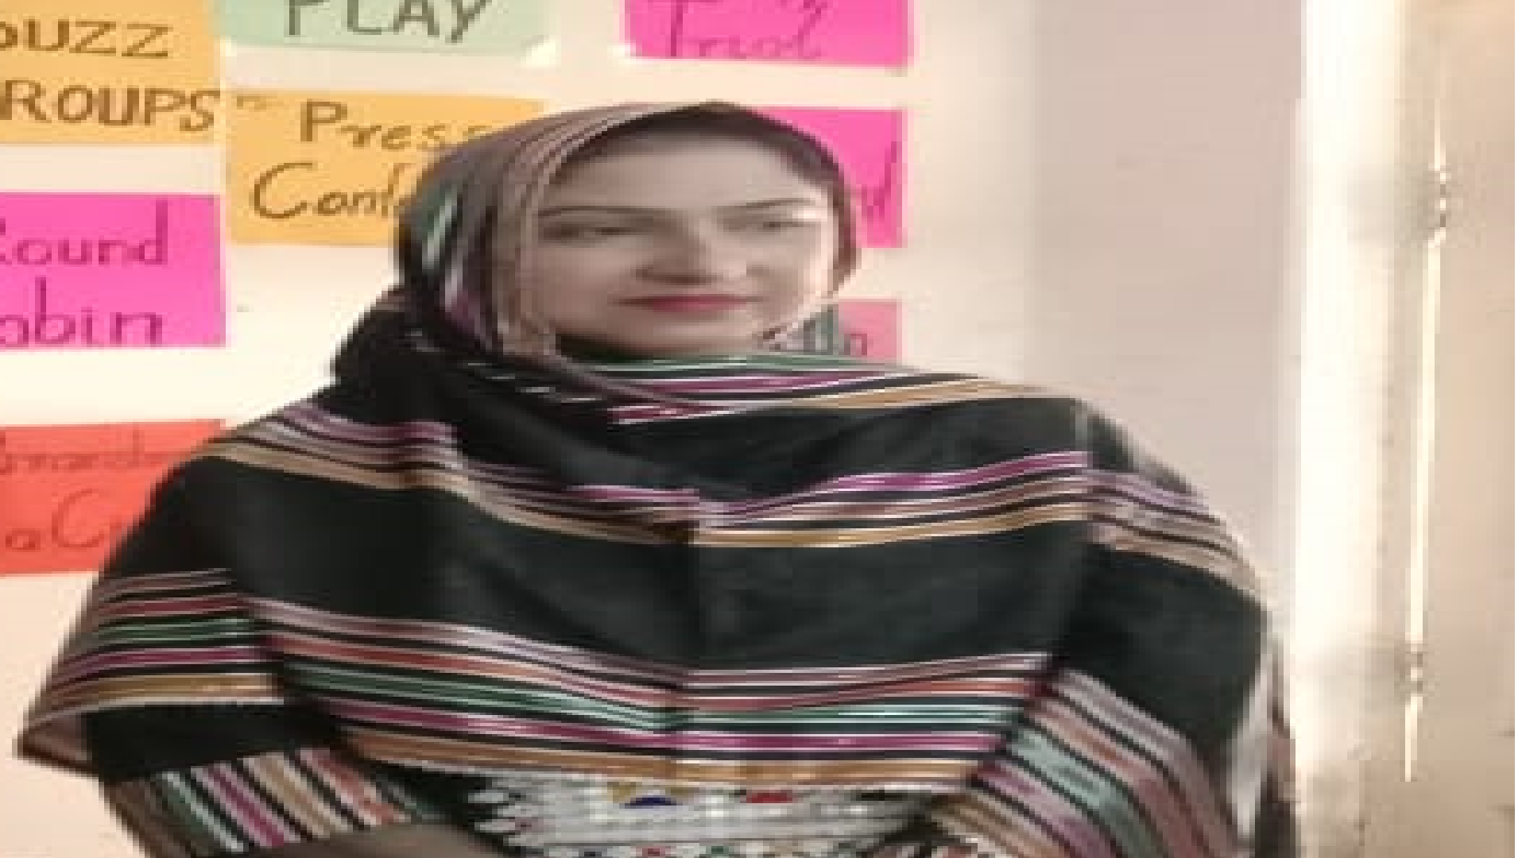
REHMANI KHATIJA KHUWAJA GOVERNMENT GIRLS HIGH SCHOOL
TANDO MUHAMMAD KHAN
Cluster Hub Head:
Cluster Hub School
Madam Gulafshan Bhatti Sahiba

Slide 4
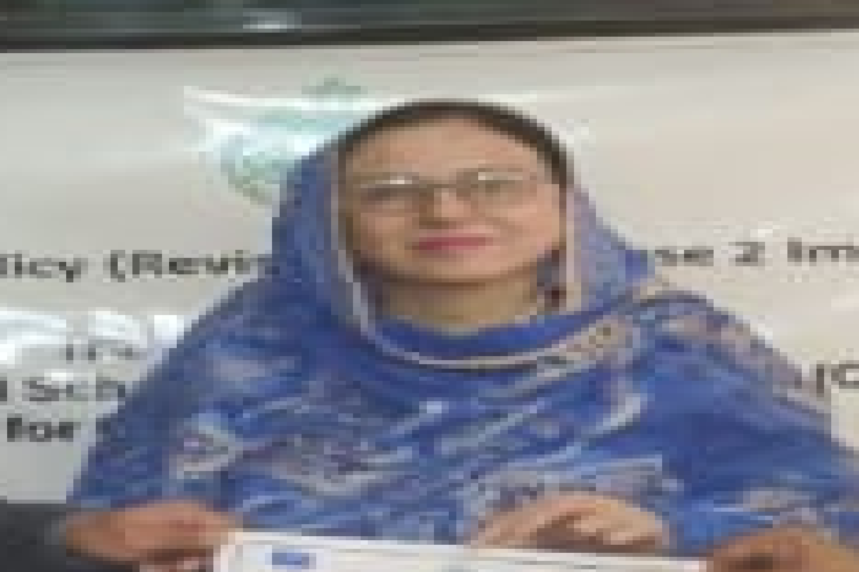
GOVERNMENT GIRLS (PROV) HIGH SCHOOL
TANDO MUHAMMAD KHAN
Cluster Cell Head:
Cluster Cell School
Madam Gulajan Bhatti Sahiba

Slide 5
GBPS Islamia Urdu
GGPS Barrage Colony
GBLS Jadeed (N)
GBPS Karmabad Colony
GBPS Muslim Gharibabad
GGCHS Dollah Jo Pir
GGPS Gharibabad (Girls)
Feeder Schools
GGLSS Rias Abdul Rahman Bhatti Mohalla
GBPS Barrage Colony
GG(P)H School
GGPS Barrage Colony
GBPS Gharib Abad Mohalla II
GBPS Shaheed Benazir Bhutto
GBPS B&R Colony
GGPS Bhatti Mohalla (Girls)
GBPS Main School
GBPS Alam Khan Talpur
GGPS Alam Khan Talpur
GBELS Millat (N) Urdu
GBPS Talpur Colony
GGPS Soomra Mohalla

Slide 6
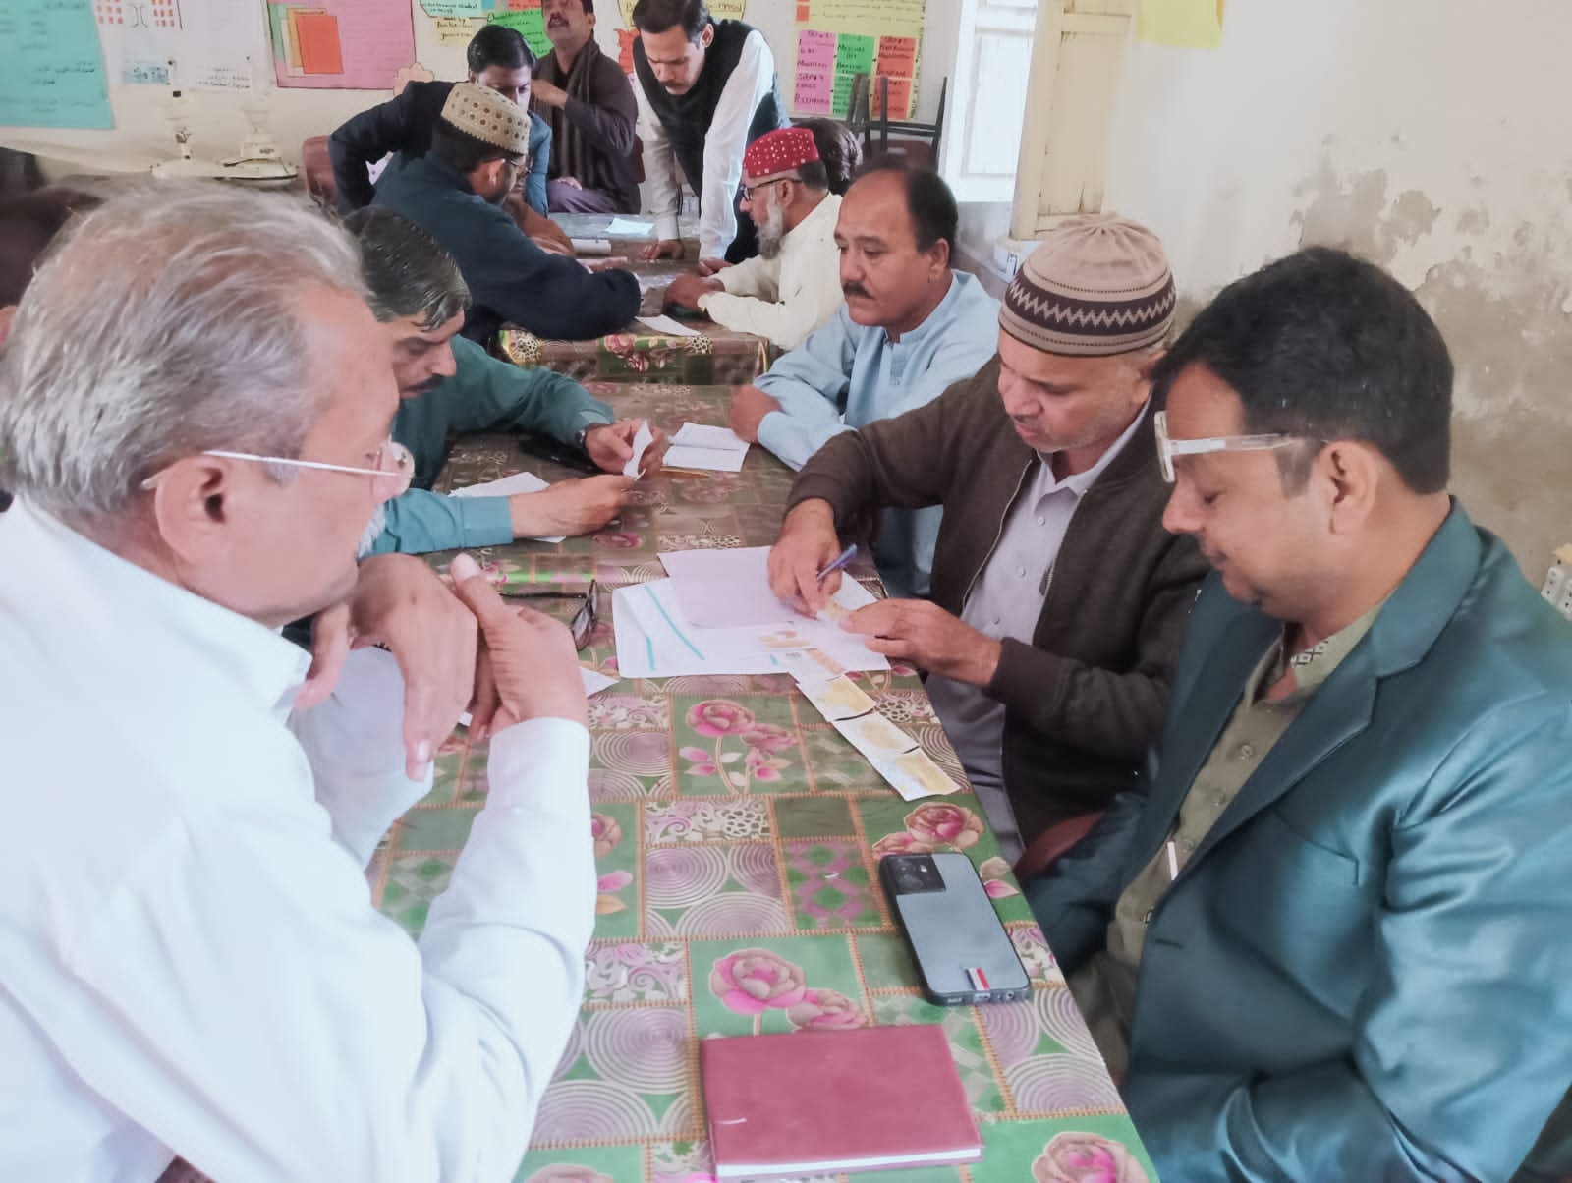
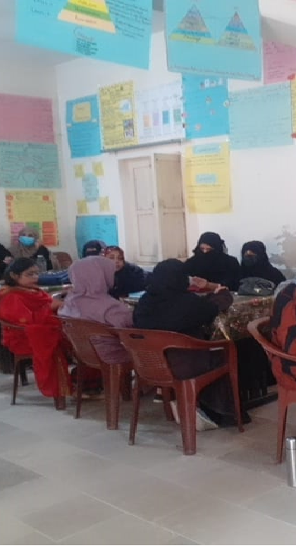
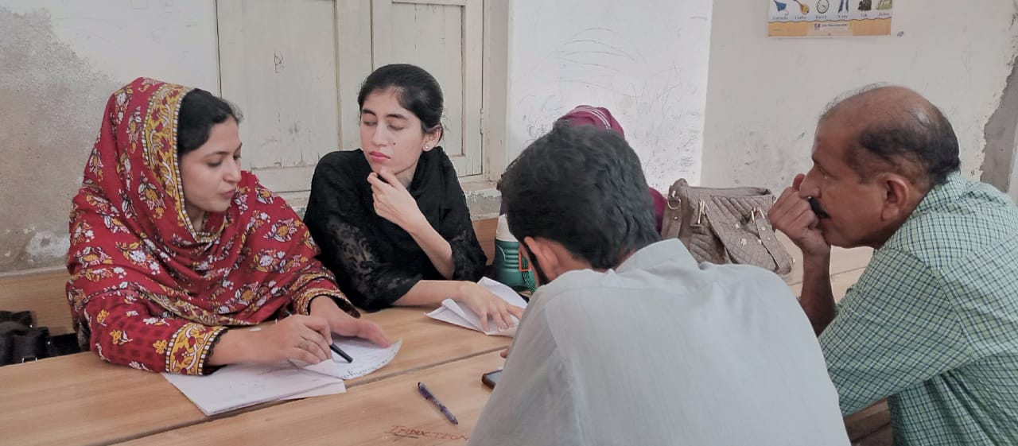
NUMBER OF TRAINED
TEACHERS
PHASE I
PEDAGOGICAL SKILLS
Males: 85
Females: 90
Total: 175
PHASE II
CONTENT BASED LEARNING CYCLES
Males: 80
Females: 125
Total: 205
MALES
85
FEMALES
90
TOTAL
175

Slide 7
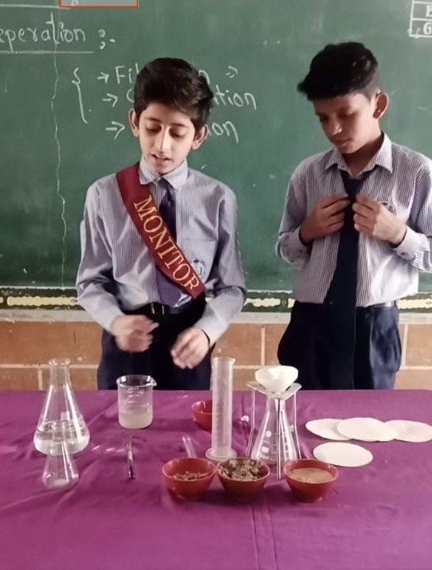
OUR ACHIEVEMENTS
23%
Confidence in teachers/ students
Creativity (low coast no coast material usage)
Mutual understanding between all teachers
Working as team
Healthy competition between teachers
More motivated
Change in teaching methods
Collaborative work
Teachers are connected/ centeralized/ interacted
Attractive teaching/ more enjoyable teaching
Became more attantive due to continious monitoring
Day by day growth/ grooming

Slide 8
LOW COAST NO COAST MATERIAL CREATION AND USAGE

Slide 9
CHALLENGES WE FACED
Time management
Low budget
Work burden/ over burden
Tough schedule
Motivating teachers of different mindset
Visiting schools
Tolerance
Overtime

Slide 10
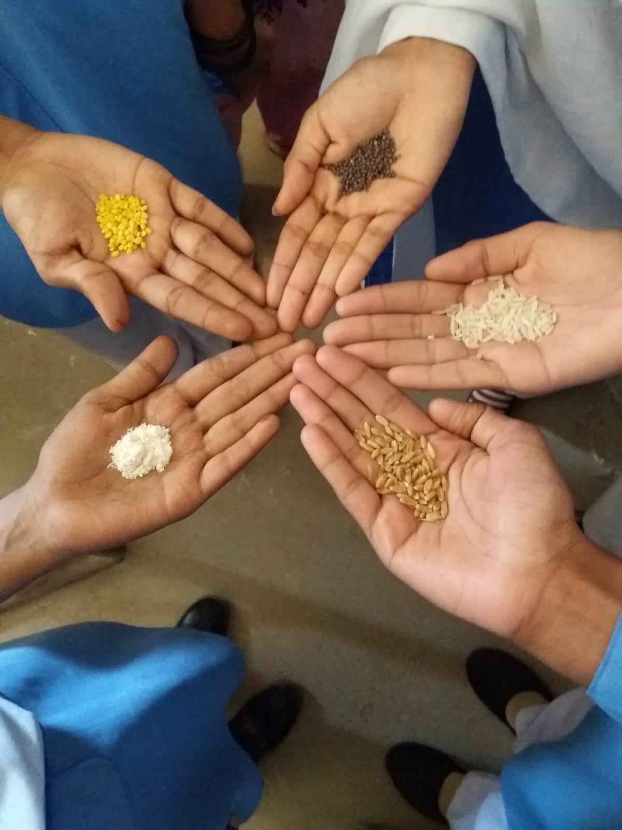
OUR STRENGTH
Teamwork/ collaborative work
Confidence/ presentation
Subject grip/ excel in content
Mutual understanding
Budget management
Judgement
Personal and professional growth
Leadership skills

Slide 11
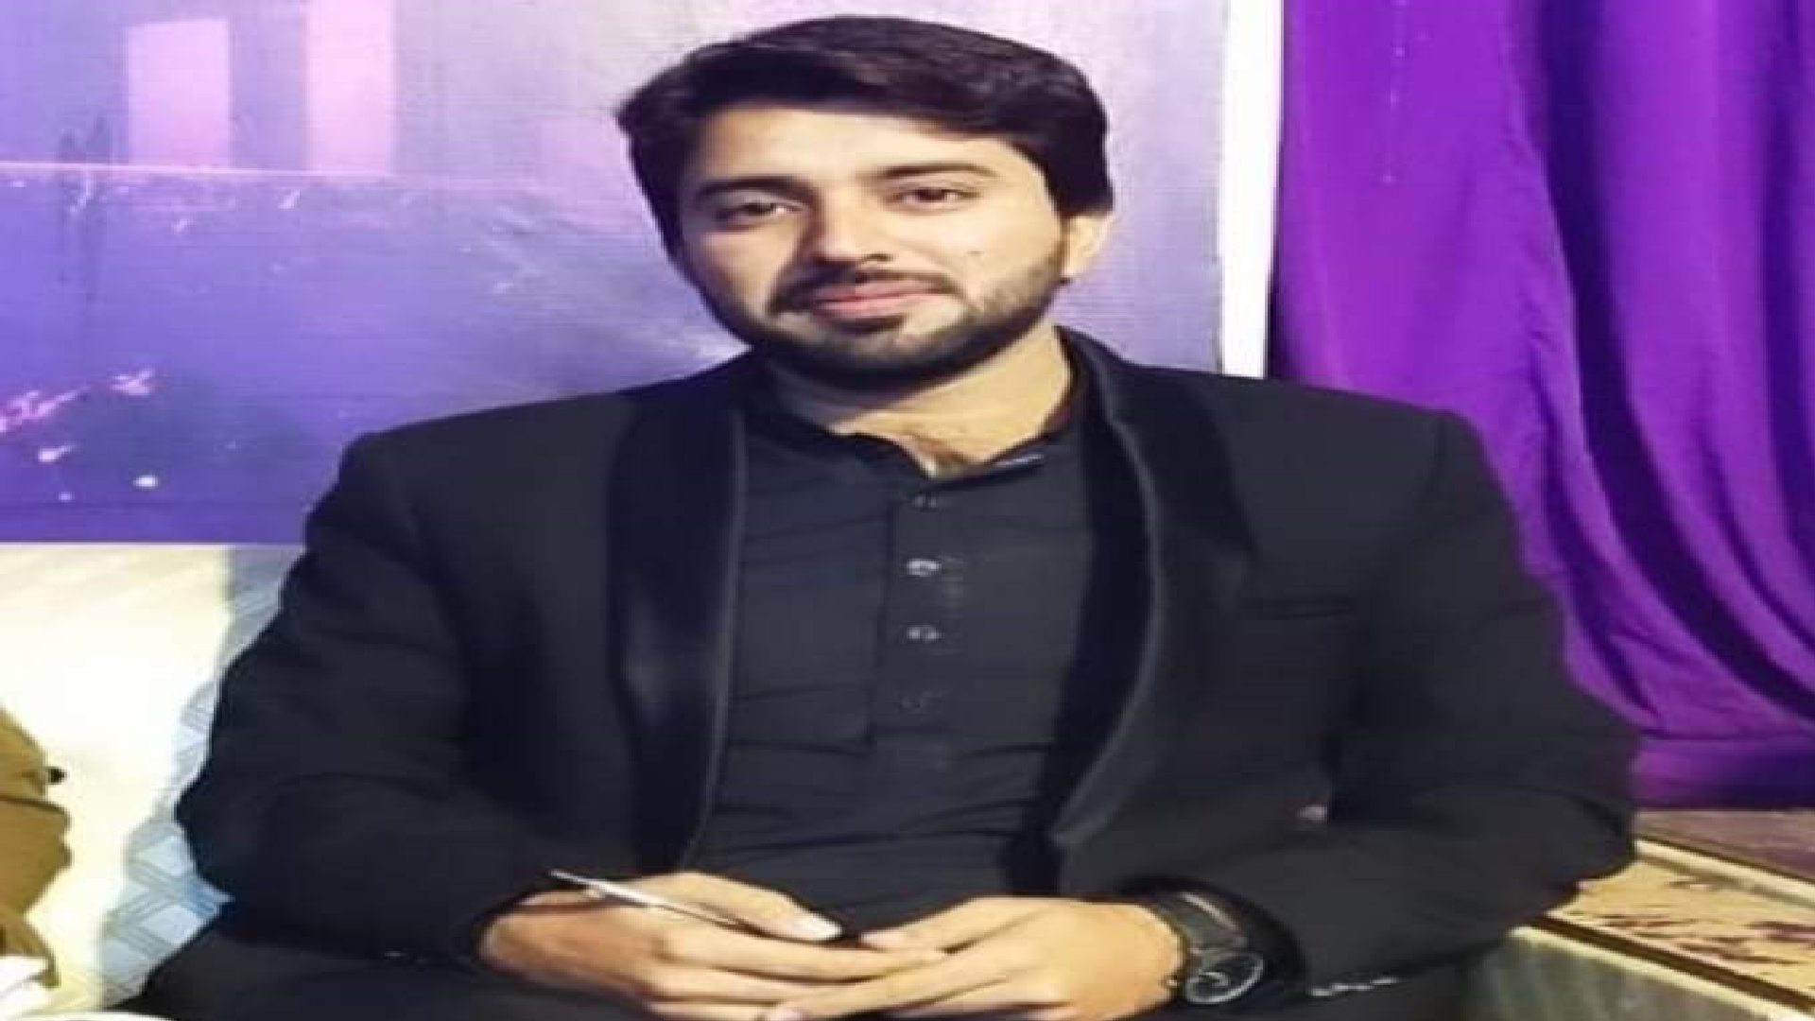
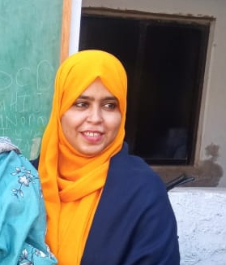
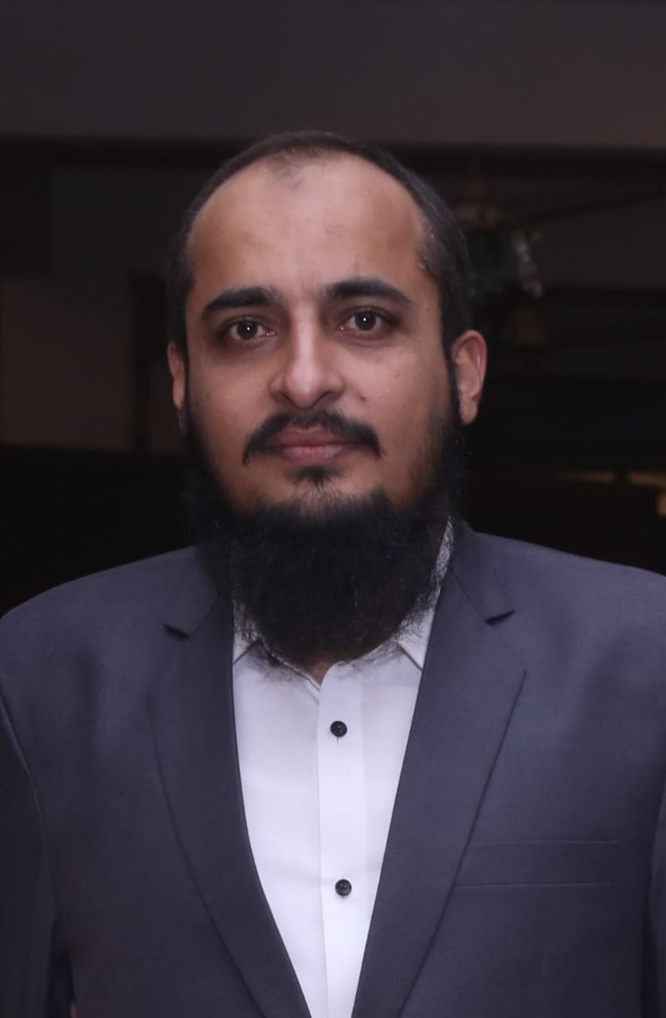
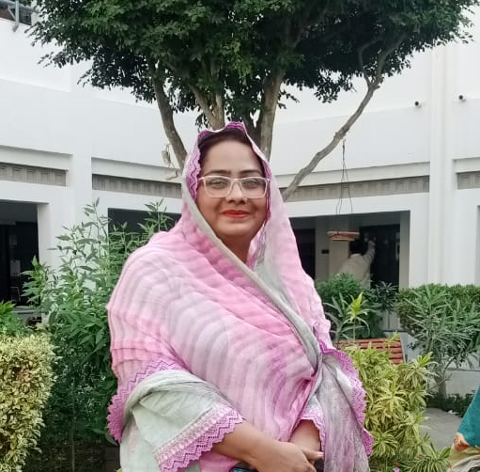
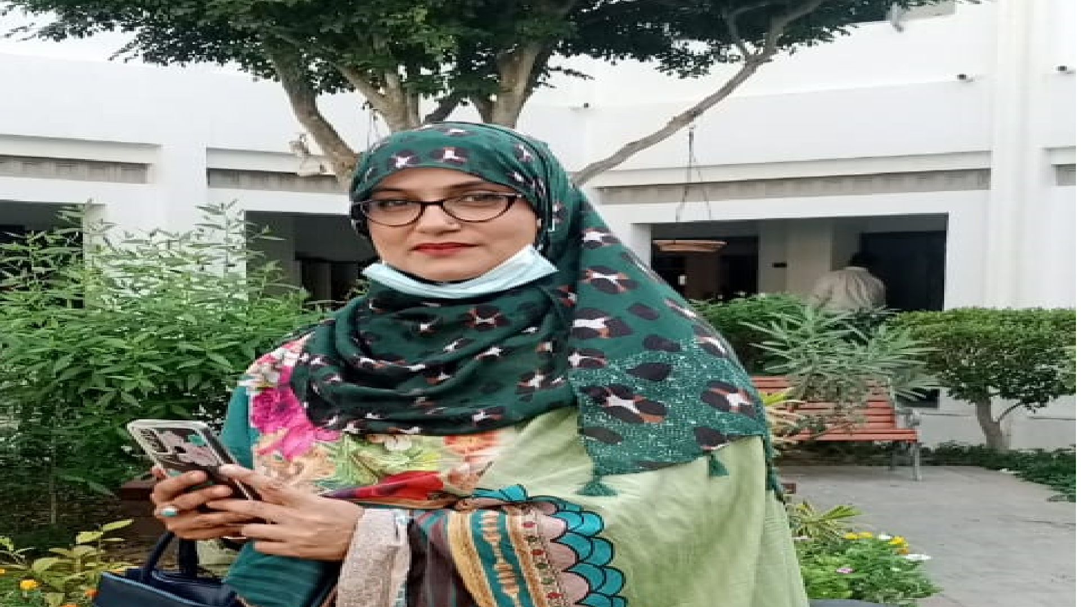
GUIDE TEACHERS/ MASTER TRAINERS OF OUR CLUSTER
IFTAKHAR AHMED
SHEERAZ SOLANGI
SUMIRA ALVI
SANAM BEHRANI
SHAZIA CHANDIO
Guide Teacher & Master Trainer of Subject Sindh

Slide 12
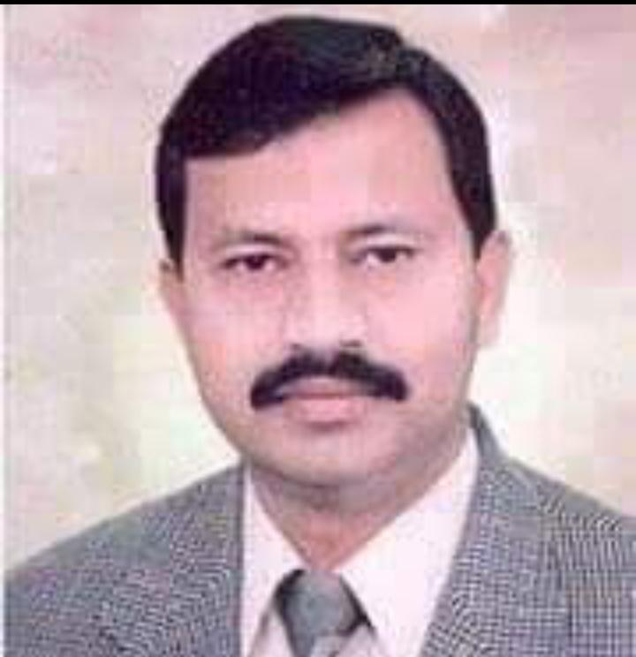
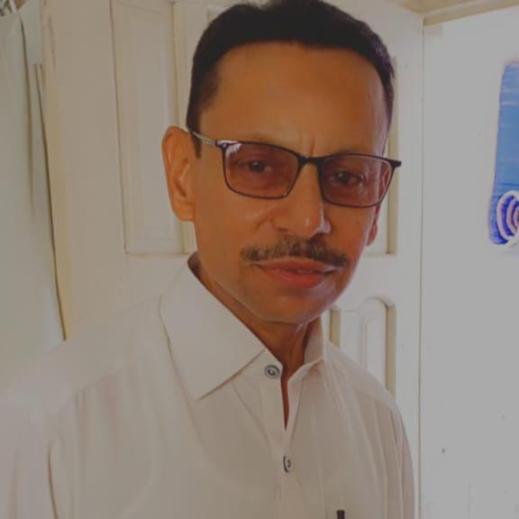
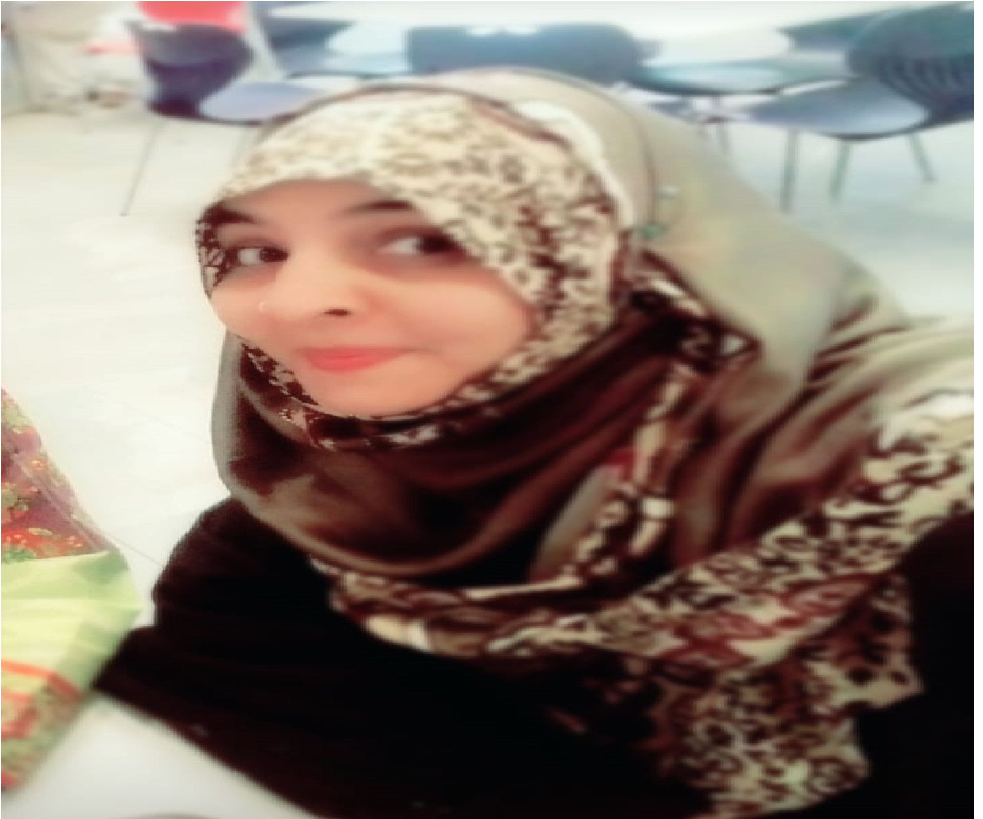
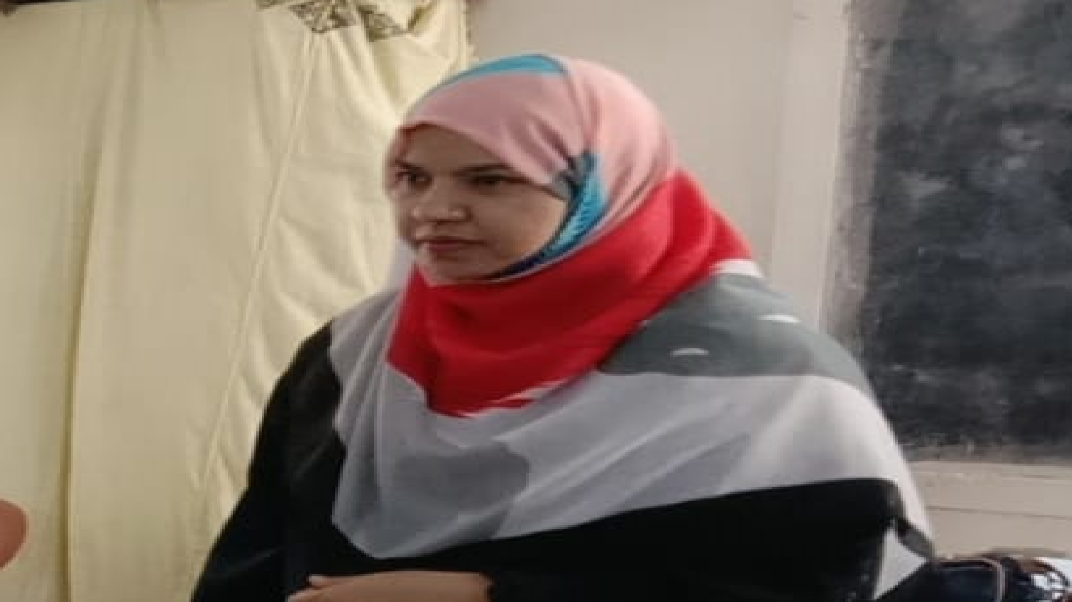
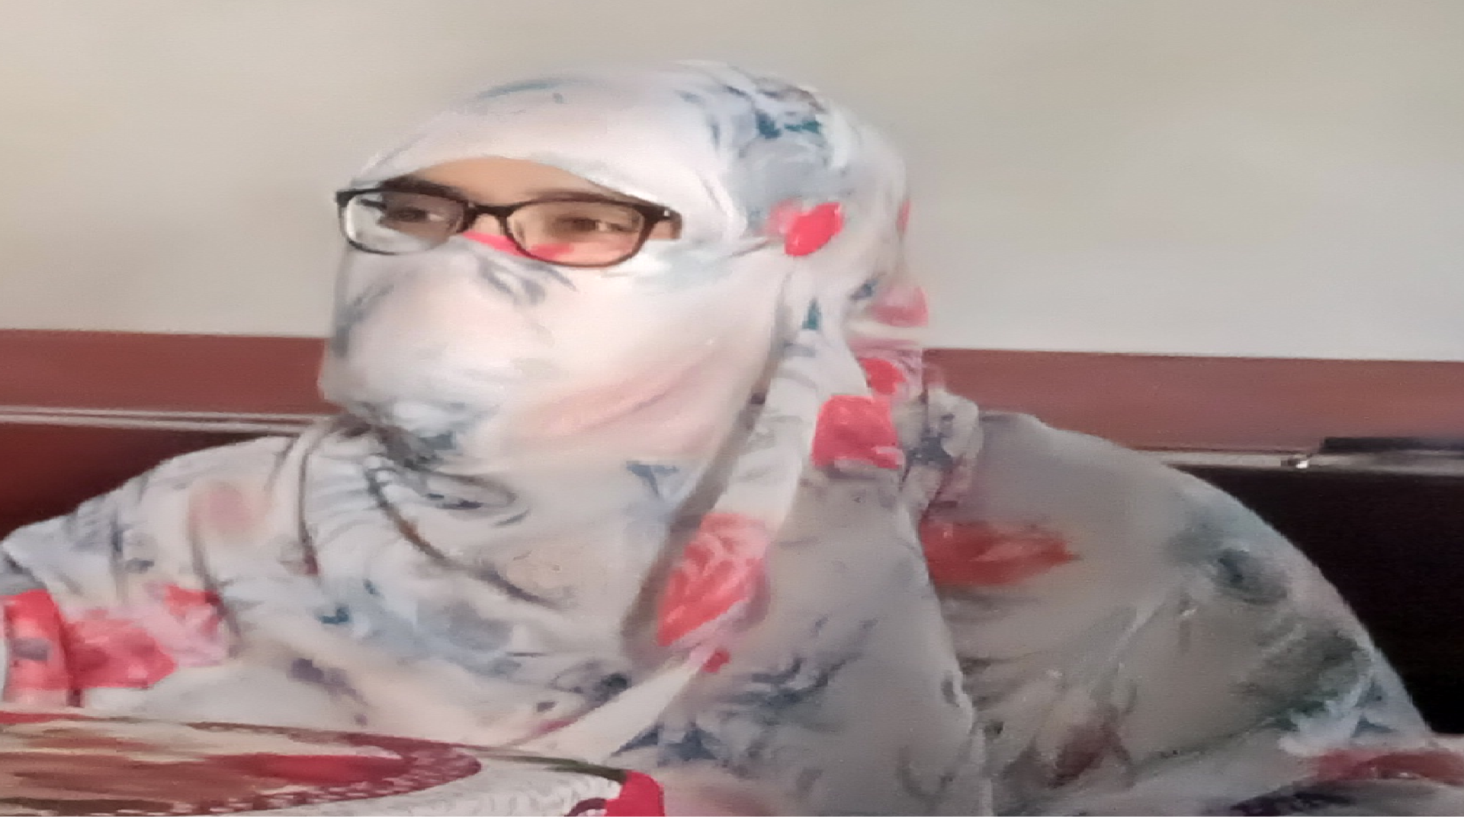
ABDUL FATEH
KULSOM IQBAL
MUHAMMAD UMER
MEHTAB TALPUR
ASIFA GHORI
HEADLINE 2
Subject Cordinator of Subject Sindhi

Slide 13
SINDHI

Slide 14
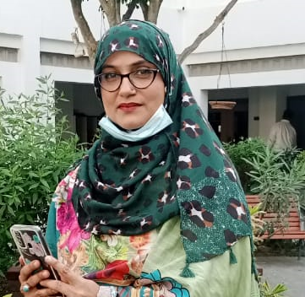
SUMIRA ALVI
SANAM BEHRANI
SHEERAZ SOLANGI
IFTAKHAR AHMED
SHAZIA CHANDIO
Guide Teacher & Master Trainer of Subject Science

Slide 15
MEHTAB TALPUR
MUHAMMAD UMER
ABDUL FATEH
ASIFA GHORI
KULSOOM IQBAL
Subject Cordinator of Subject Science

Slide 16
Science by doing

Slide 17
SHEERAZ SOLANGI
SHAZIA CHANDIO
SANAM BEHRANI
SUMIRA ALVI
IFTAKHAR AHMED
Guide Teacher & Master Trainer of Subject Mathematics

Slide 18
SUBJECT COORDINATORS OF OUR CLUSTER
ASIFA GHORI
ABDUL FATEH
MEHTAB TALPUR
KULSOOM IQBAL
MUHAMMAD UMER
Subject Cordinator of Subject Mathematics

Slide 19
MATHEMATICS

Slide 20
SANAM BEHRANI
IFTAKHAR AHMED
CHAZIA CHANDIO
SHEERAZ SOLANGI
SUMIRA ALVI
Guide Teacher & Master Trainer of Subject English

Slide 21
KULSOM IQBAL
MEHTAB TALPUR
ASIFA GHORI
MUHAMMAD UMER
ABDUL FATEH
Subject Cordinator of Subject English

Slide 22
ENGLISH

Slide 23
SHAZIA CHANDIO
SUMIRA ALVI
IFTAKHAR AHMED
SANAM BAHRANI
SHEERAZ SOLANGI
Guide Teacher & Master Trainer of Subject Urdu

Slide 24
MUHAMMAD UMER
ASIFA GHORI
KULSOM IQBAL
ABDUL FATEH
MEHTAB TALPUR
Subject Cordinator of Subject Urdu

Slide 25
URDU

Slide 26
THANK YOU!

