Slide 1
KORANGI CLUSTER G.G.S.S No 4 Korangi 3.1/2
Implementation CPD
(Continuing Professional Development) Model by Bloom's Taxonomy

Slide 2
Objectives:
To implement the CPD (Continuing Professional Development) model by Bloom's Taxonomy using the Pedagogical Steps .
we can follow these steps in all Feeders schools of Korangi Cluster.
1. Understand Bloom's Taxonomy
2. Identify our professional development goals
3. Map our goals to Bloom's Taxonomy
4. Utilize the Pedagogical cycle
5. We Select appropriate digital tools
6. Plan our CPD activities:
7. Engage in the learning experiences:
8. Evaluate and reflect:
9. Iterate and repeat:

Slide 3
Conclusion:
Remember that implementing the CPD model using Bloom's Taxonomy and the pedagogical cycle is a cyclical process. Continuous professional development involves continuously refining our skills and knowledge based on reflective practice.

Slide 4
Achievements of CPD implementation in KORANGI Cluster
The Continuous Professional Development (CPD) implementation in the Korangi cluster has led to enhanced teacher skills, improved student outcomes, and a more dynamic learning environment. Teachers have benefited from ongoing training, fostering a culture of lifelong learning. Student engagement and achievement have increased as a result of innovative teaching methods introduced through CPD. Additionally, the collaborative nature of CPD has strengthened professional relationships among educators, promoting a supportive and effective teaching community.

Slide 5
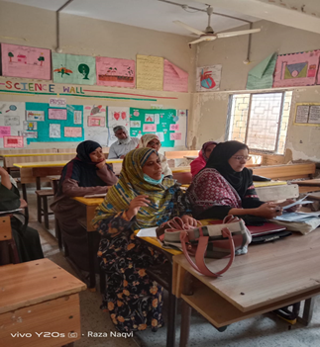
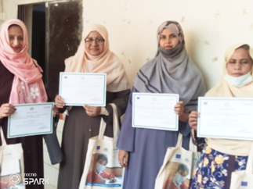
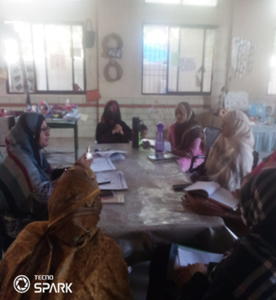
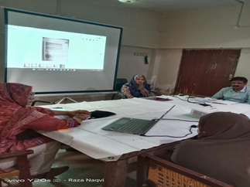

Slide 6
The Success Story of CPD Implementation in KORANGI Cluster
The success story of CPD implementation in the Korangi cluster is evident in various aspects. Firstly, it has resulted in a notable improvement in teaching methodologies, with educators incorporating innovative and effective strategies into their practices. This has directly translated into higher student achievement and engagement.

Slide 7
CONTINOUS Success Story
Furthermore, the collaborative nature of CPD has fostered a supportive community of educators who share best practices and continuously learn from each other. The positive impact of CPD is not only reflected in academic outcomes but also in the overall development of students, contributing to their holistic growth.
The successful implementation can be attributed to the commitment of educators, the support from educational leadership, and a tailored approach that addresses the specific needs of the Korangi cluster. The ongoing monitoring and evaluation of CPD initiatives have ensured its effectiveness, making it a model for other educational clusters to follow.

Slide 8
Videos of Success Story:

Slide 9
Highlight Impact of Pedagogy-Based Learning Cycles on Teacher Professional Development and Students Learning in KORANGI Cluster.
Implementing pedagogy-based learning cycles in the Korangi cluster has shown a pronounced positive impact on teacher professional development. Through ongoing reflection and collaboration, teachers in this context have honed their instructional skills, adapting to the unique needs of students. As a result, students in the Korangi cluster experience improved learning outcomes, benefiting from a more engaging and personalized educational approach that aligns with effective pedagogical strategies.

Slide 10
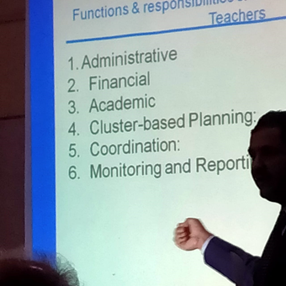
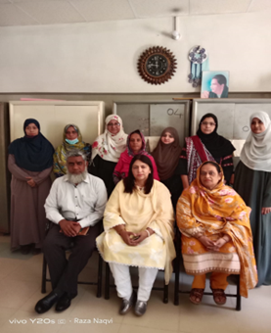
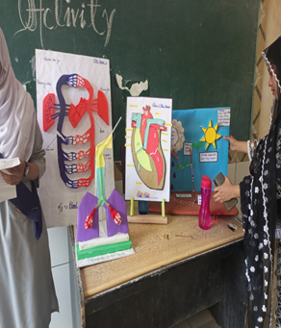
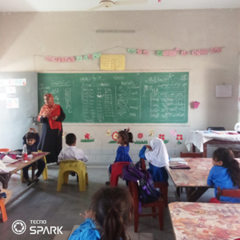
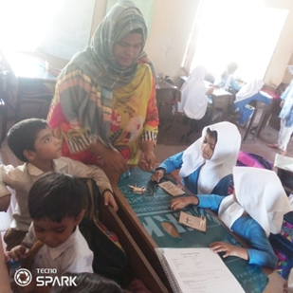
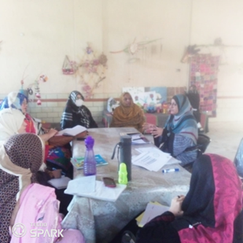
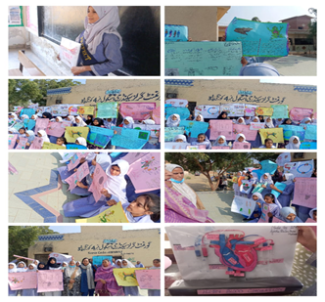
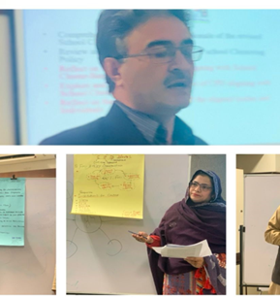
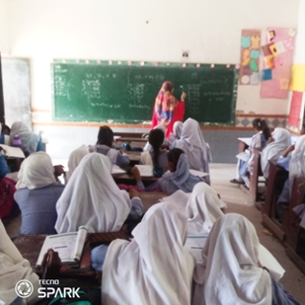
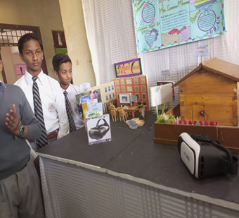
Highlight’s Of Korangi Cluster:

