Slide 2
CLUSTER NAME: GBHSS YOUNISABAD DISTRICT KEAMARI

Slide 3
SCHOOLS INCLUDED IN CLUSTER GBHSS YOUNISABAD CLUSTER HUB 1 :GBHSS YOUNISABAD FEEDER SCHOOL 1.GBPS HUSSAINI 2.GBHS SHAMSPIR 3.GBPS SHAMSPIR 4.GBPS KAKA VILLAGE 2: GBHS PIR MUHAMMAD BHIT 3: GBHSS K-B-G-N,BABA ISLAND FEEDER SCHOOL 1.GGPS MANORA CANTT 2.KMC BOYS PRIMARY SCHOOL 3.GBHS SALEHABAD 4.GBPS MANORA 5.GBPS ISMAIL ALI ISLAMIA

Slide 4
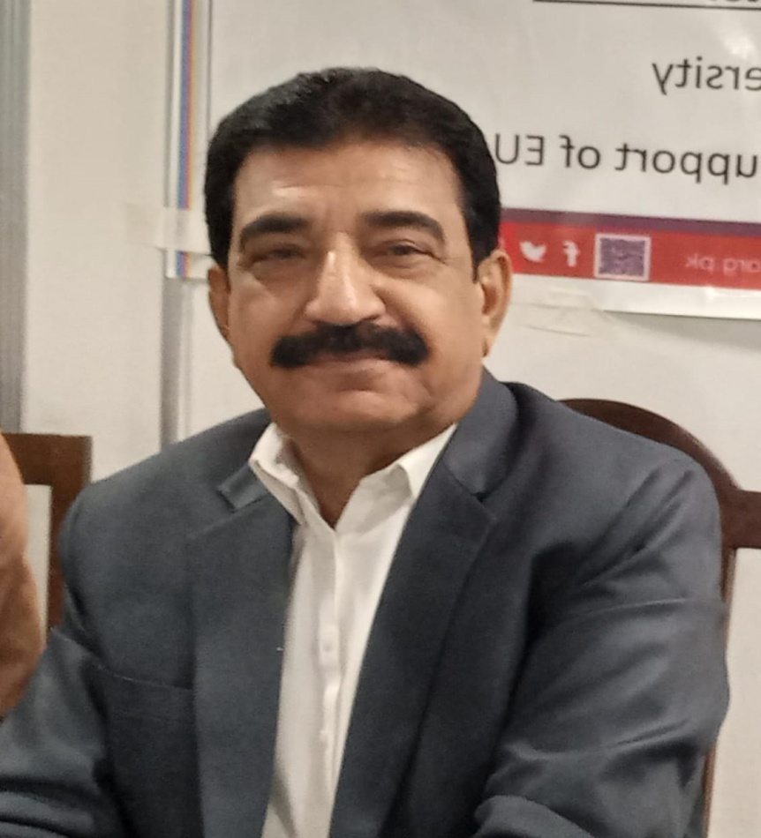
CLUSTER HEAD: Sir SHER MUHAMMAD JATOI

Slide 5
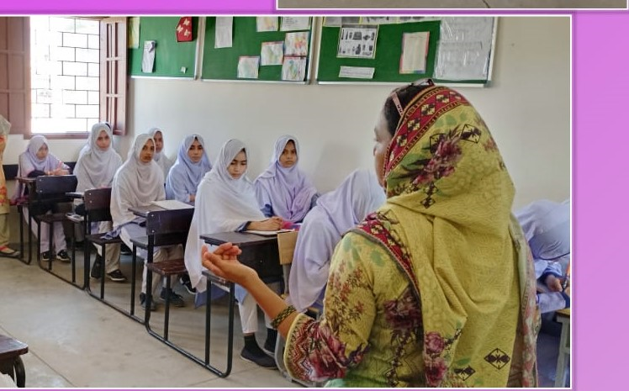
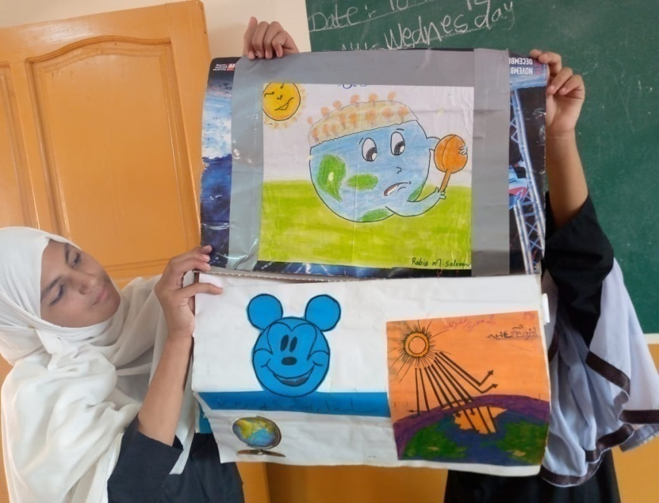
Goals 1.Enhancing Student Learning Improving Teacher Practice 2.Emphasis On Teachers Development And Learning Culture

Slide 6
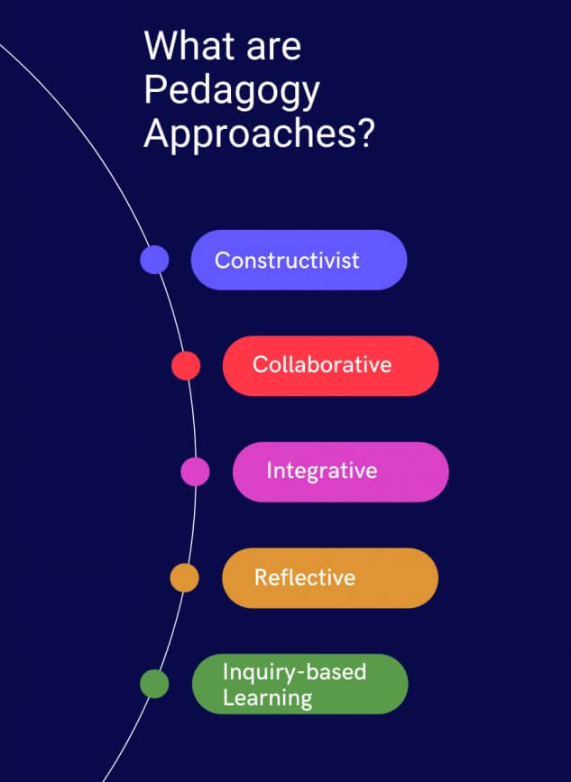
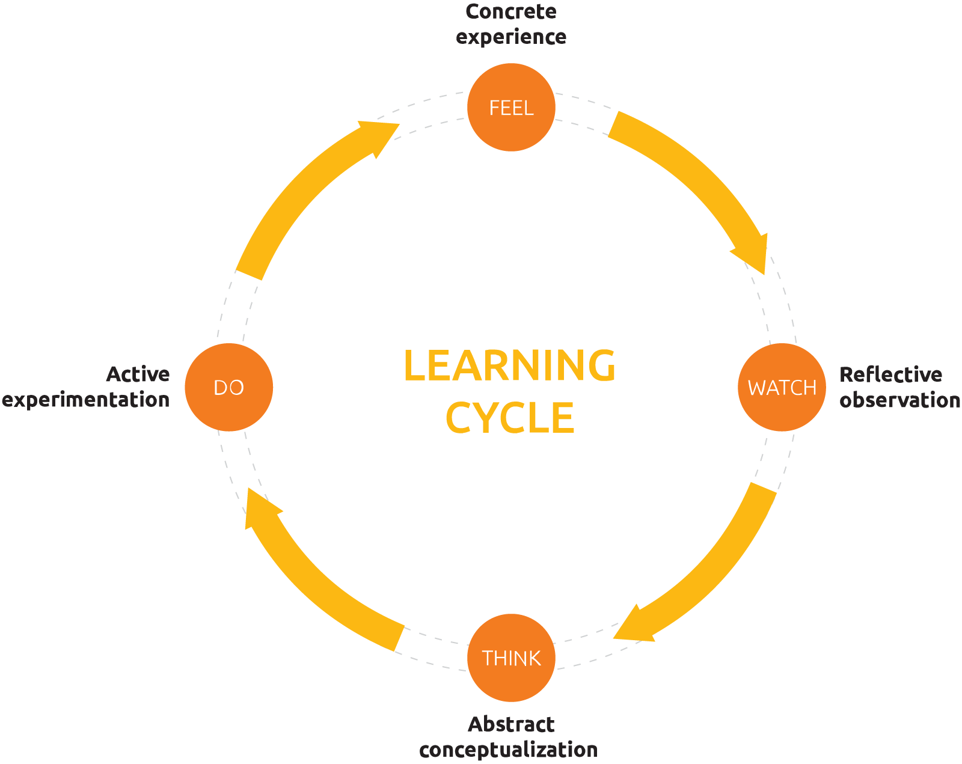
Impact of Pedagogy, CPD Cycle And Bloom’s Taxonomy

Slide 7
KEY CHARACTERISTICS FACE TO FACE INTERACTION WITH MENTEES ROLE OF GUIDE TEACHERS AND SUBJECT COORDINATORS MONTHLY TRAINING SESSIONS OF CLUSTERS/ HUB SCHOOL

Slide 8
ACADEMIC DEVELOPMENT 1-ACADEMIC PLANNER 2-LESSON PLANNING TECHNIQUE 3-PORTFOLIO OF TEACHERS 4-PARENTS TEACHER MEETING 5-EXAMINATION SCHEDULE

Slide 9
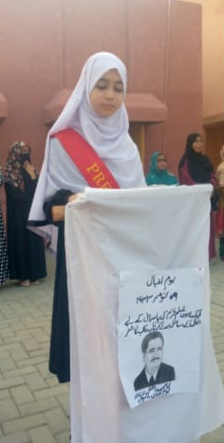
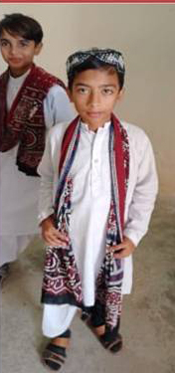
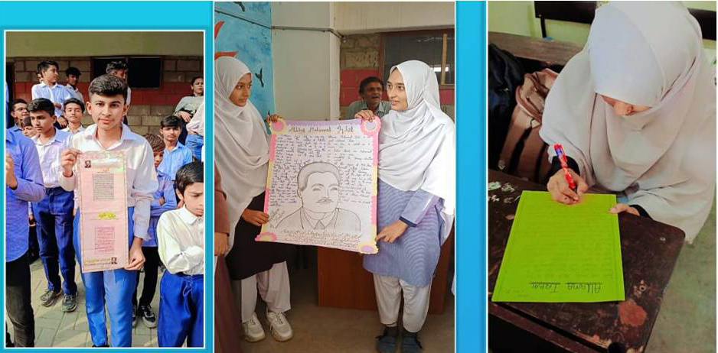
Event Activities
IQBAL DAY
SINDH CULTURE DAY

Slide 10
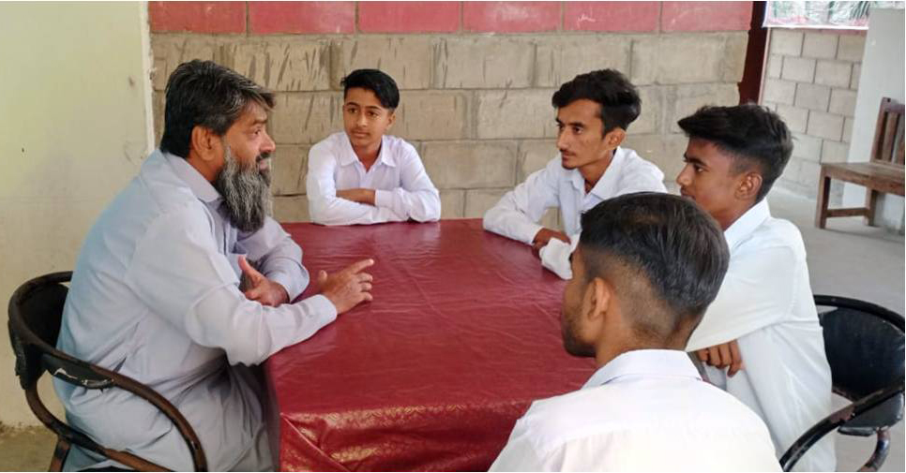
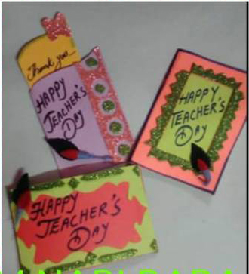
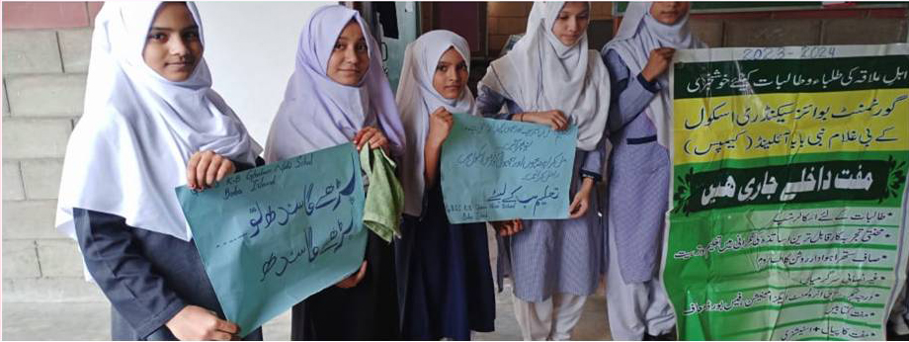
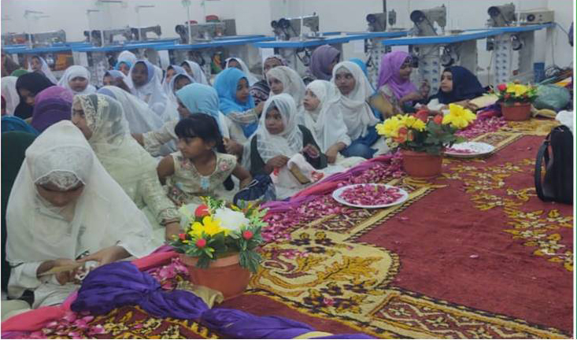
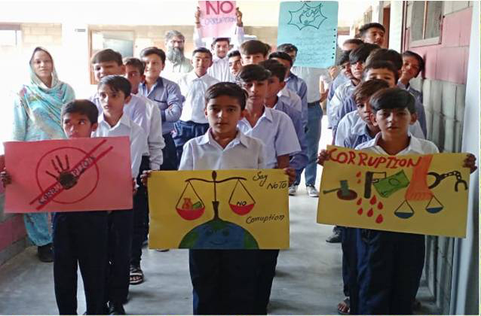
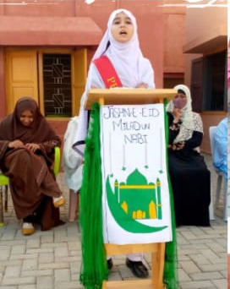
Consoling
Eid-Millad Un Nabi

Slide 11
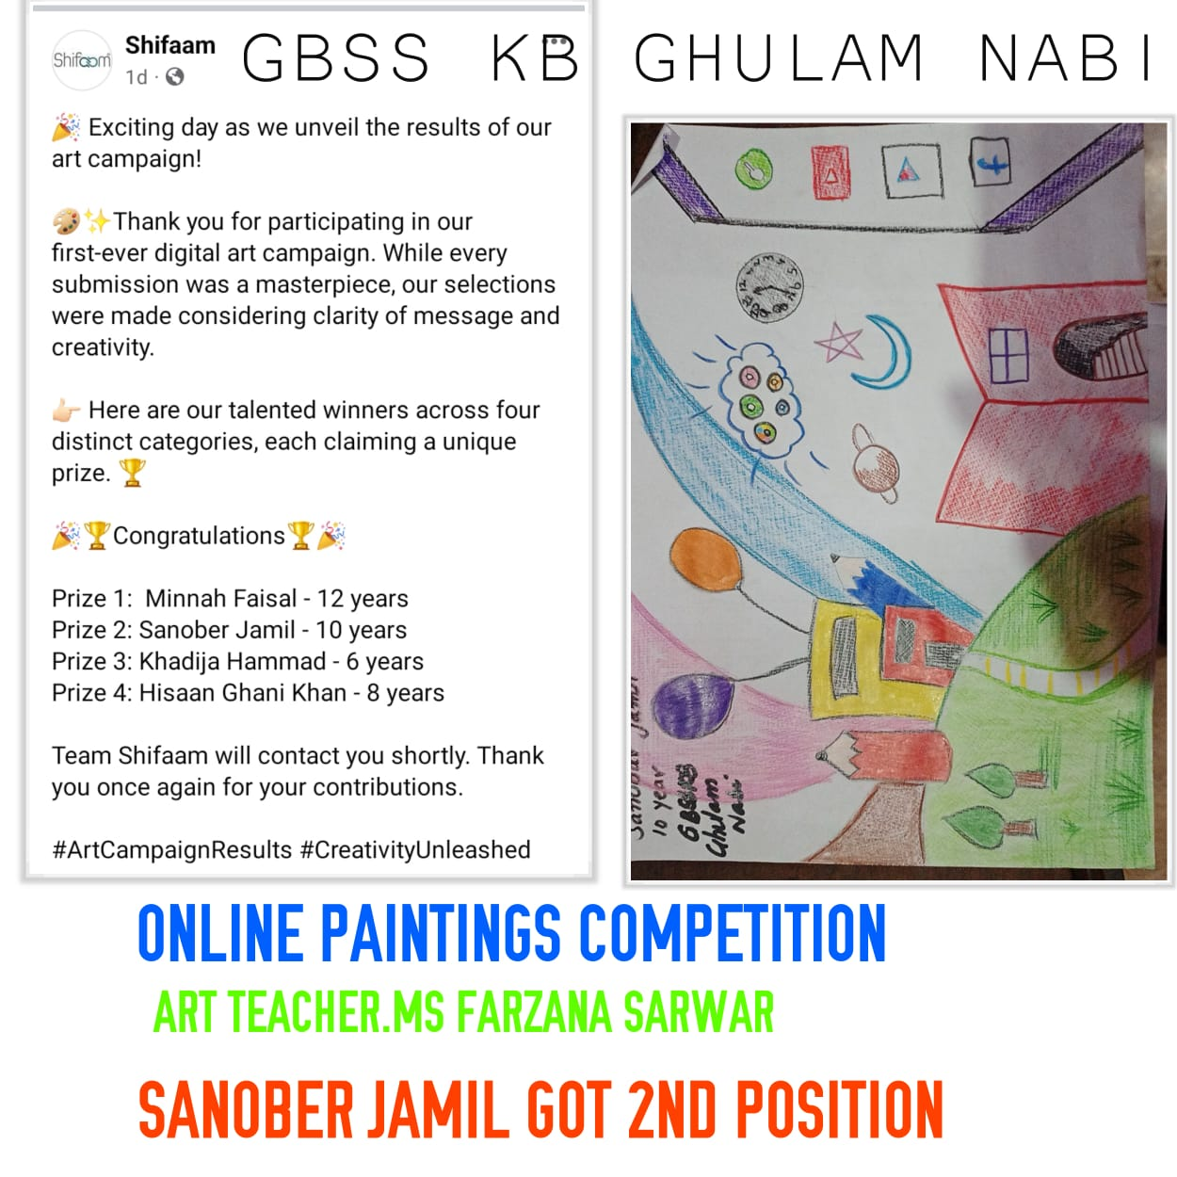

Slide 12
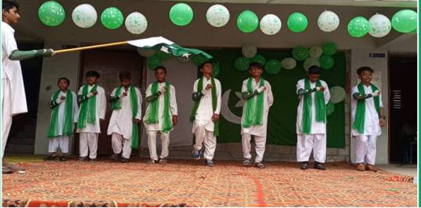
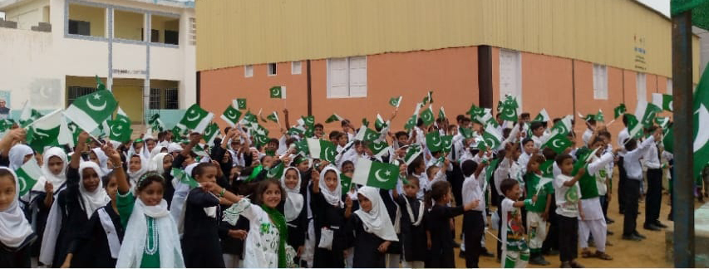
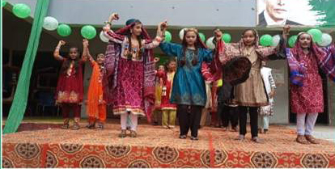
Independence Day
23rd March
Defence Day
Millad Ud Nabi
Iqbal Day
Teacher Day
Culture Day
Children Day
Quiz Competition
Speech Competition
Online Art Competition
World Peace Day
16th December Day
Quaid Day

Slide 13
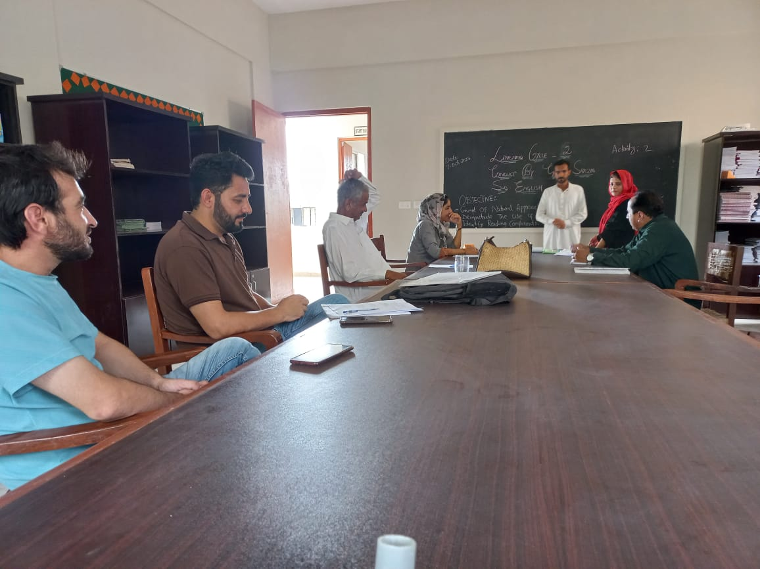
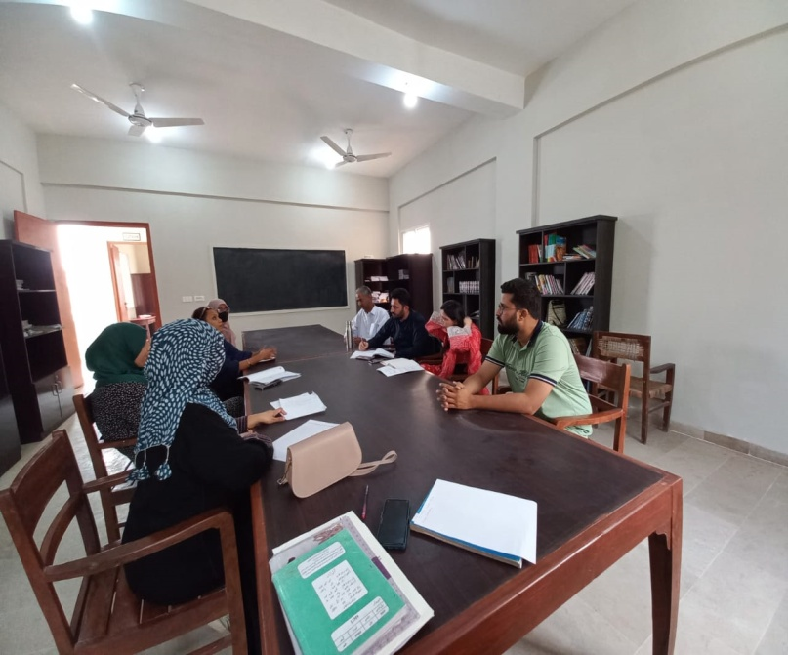
School Cluster Committee Meetings
* Plan Our CPD Activities.
* Planned Activities.
* Implementation.
* Share Resources And Staff
* To Improve Education.
* Identify Our Professional Development Goals.
* Utilize The Pedagogical Cycle.
* Session
* Workshops. & Seminars.

Slide 15
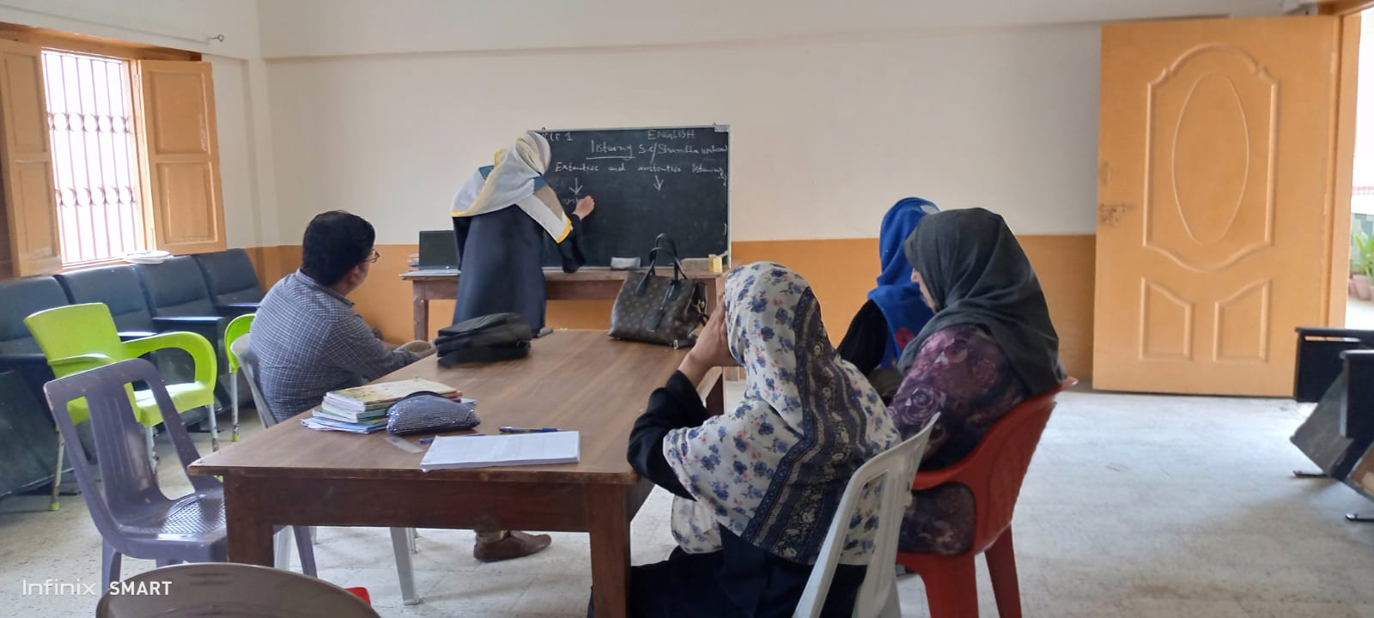
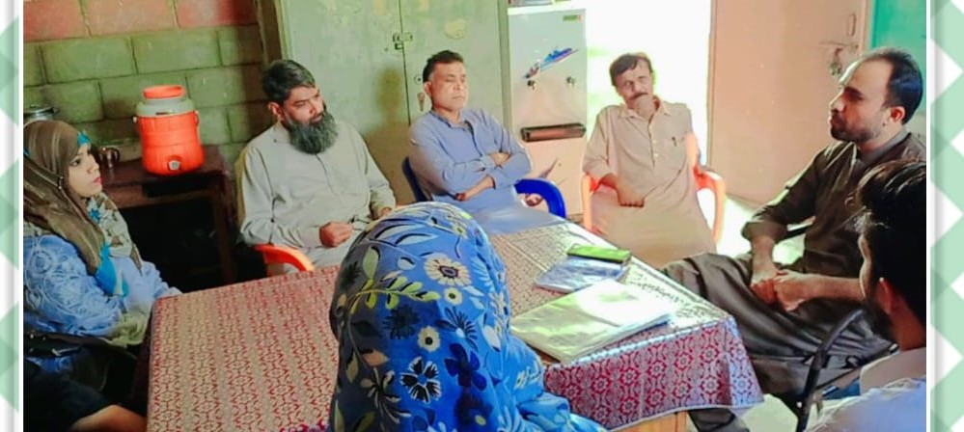
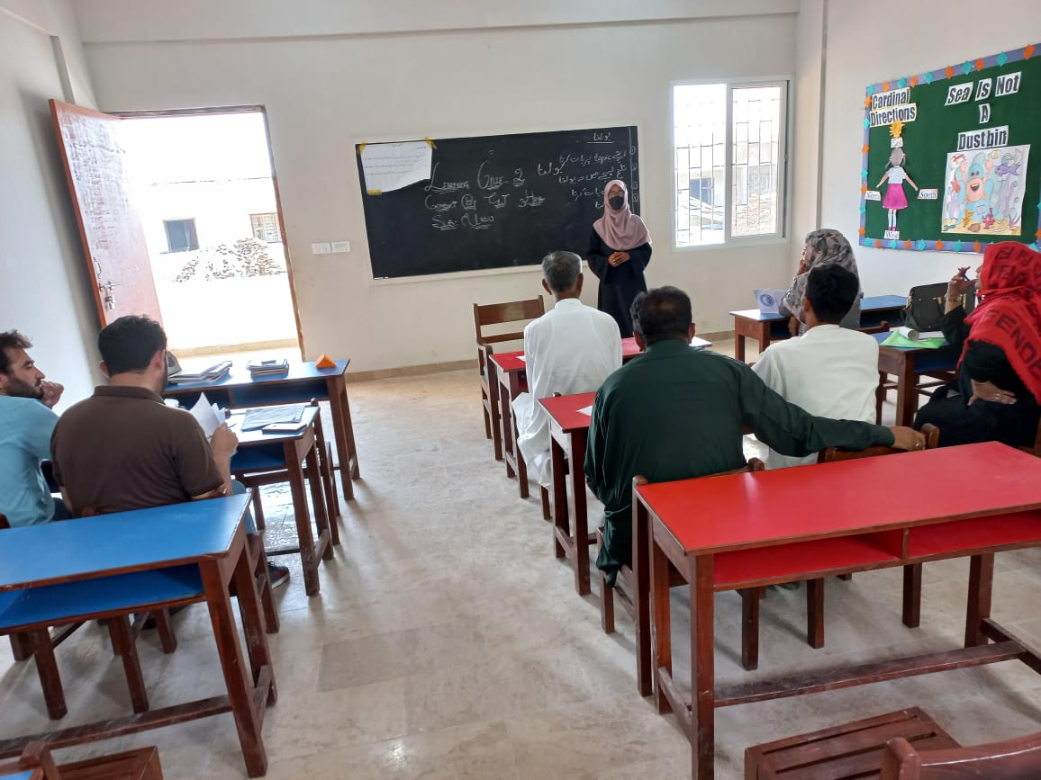
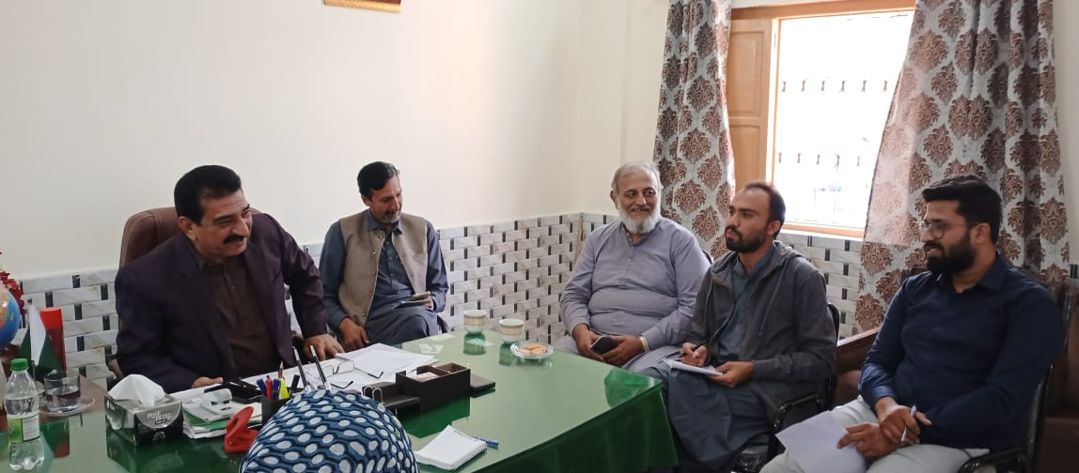

Slide 16
The Success Story Of Keamari Cluster

Slide 17
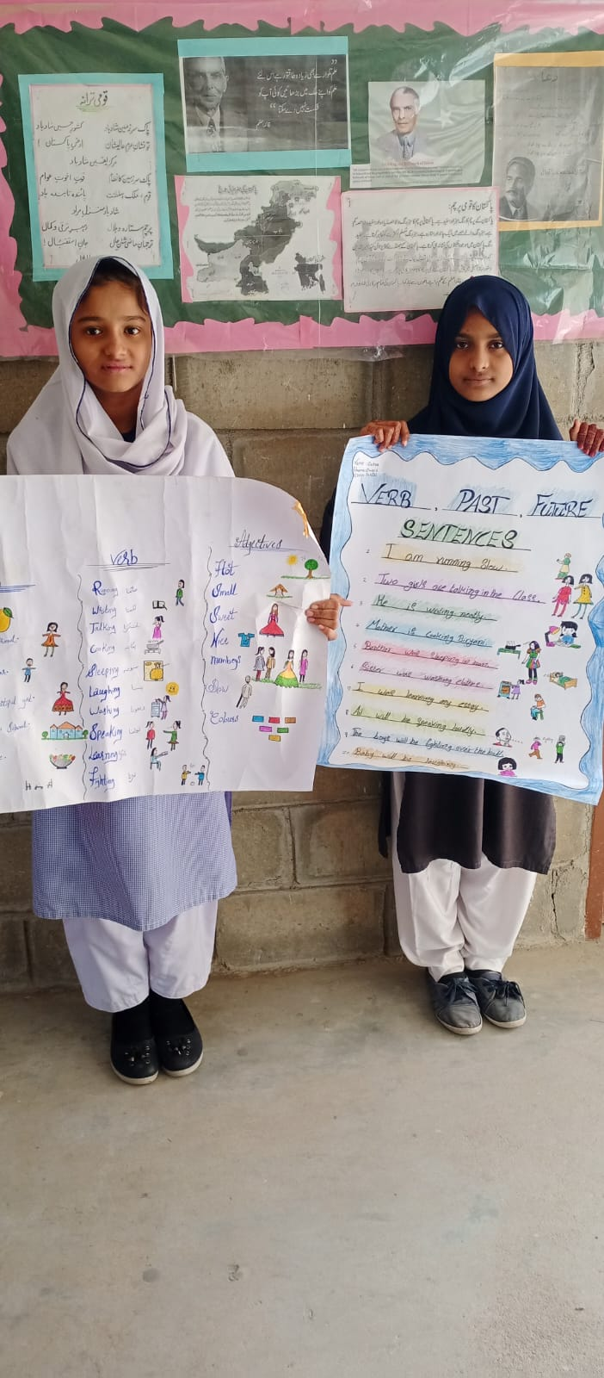
Activity Base Learning (Classroom Environment)
Visual Transformation of Learning Through Charts, Pictures, And Different Modole.
Students Participation.
Teacher Focus On Lecture Method.
Supportive And Students-Friendly atmosphere.
Improvement in student outcomes.
Showcase of students achievements and project.

Slide 18
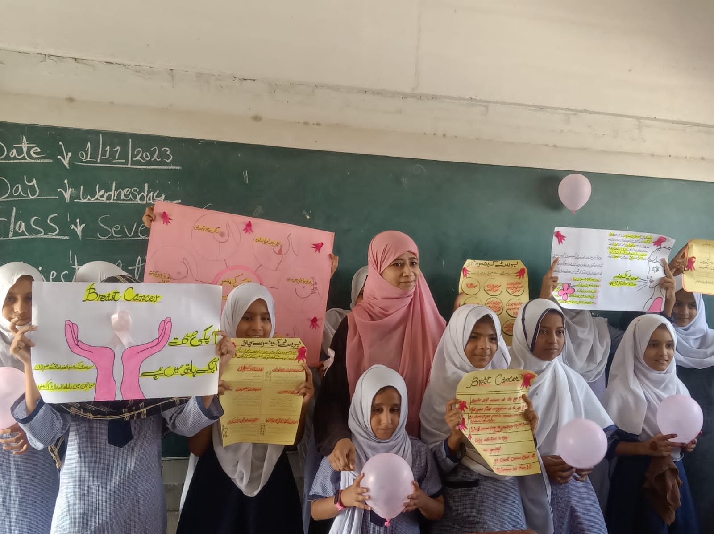
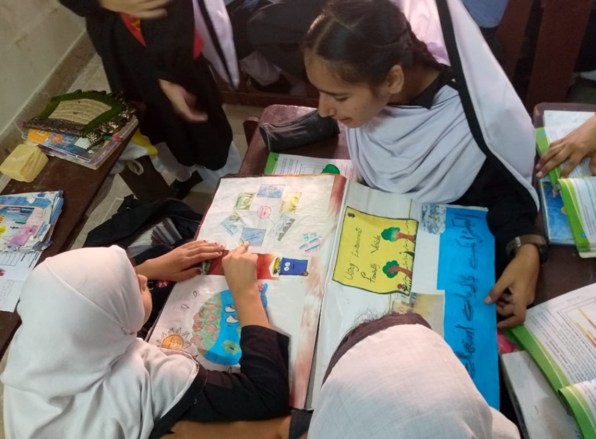
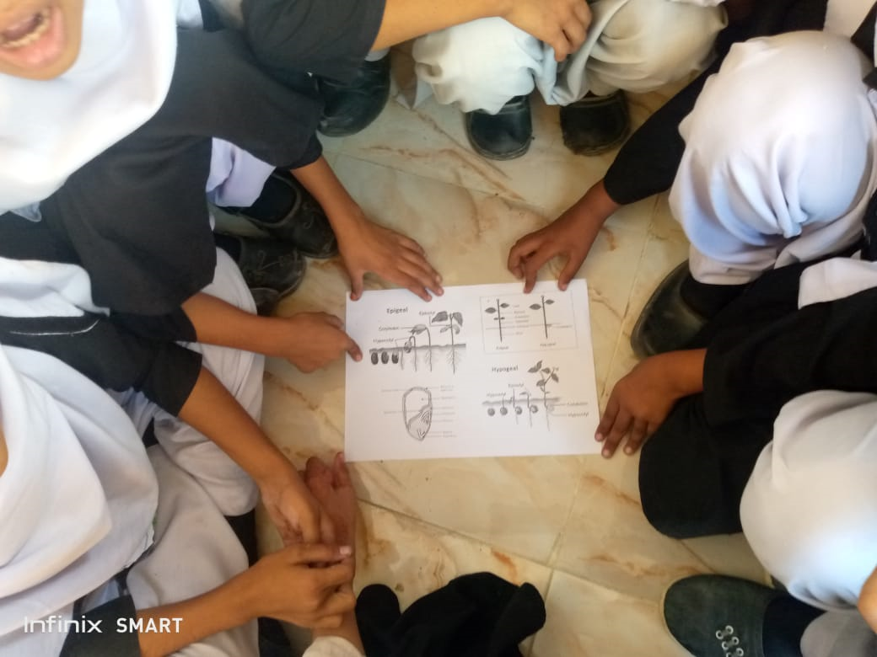
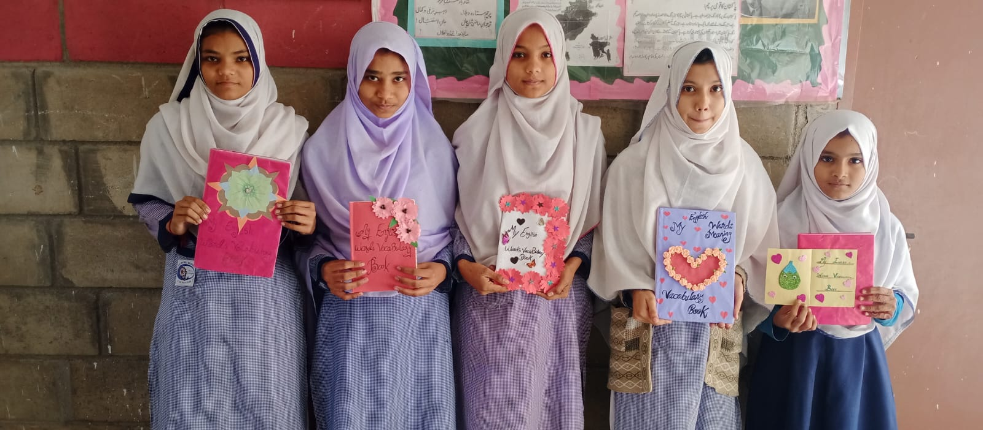

Slide 19
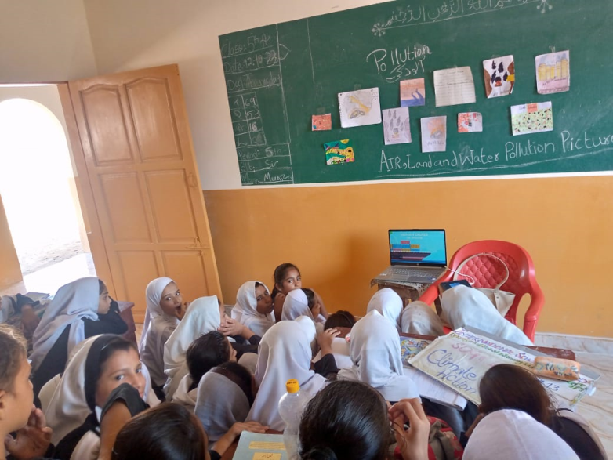
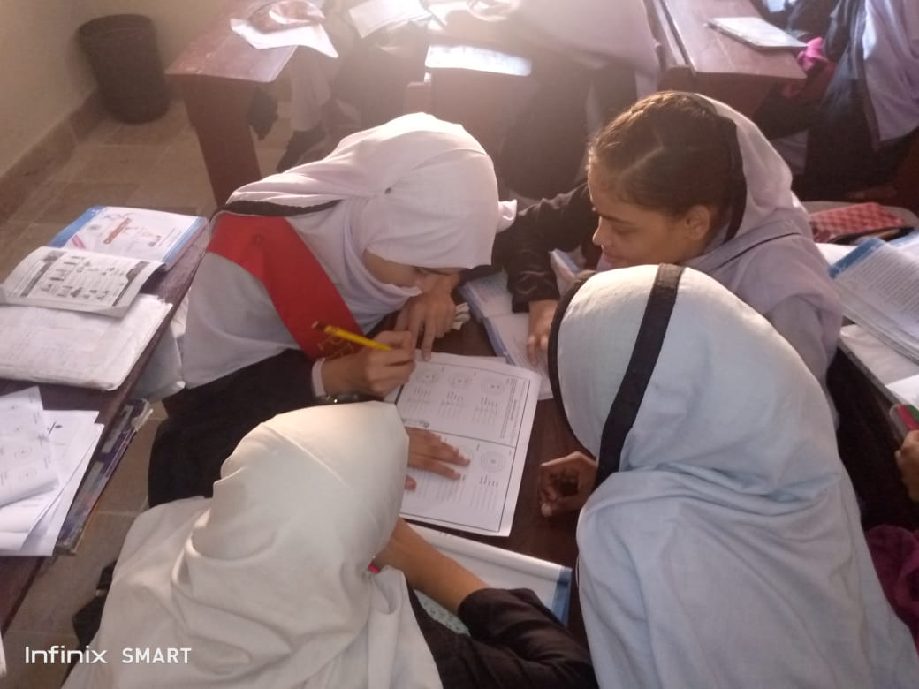
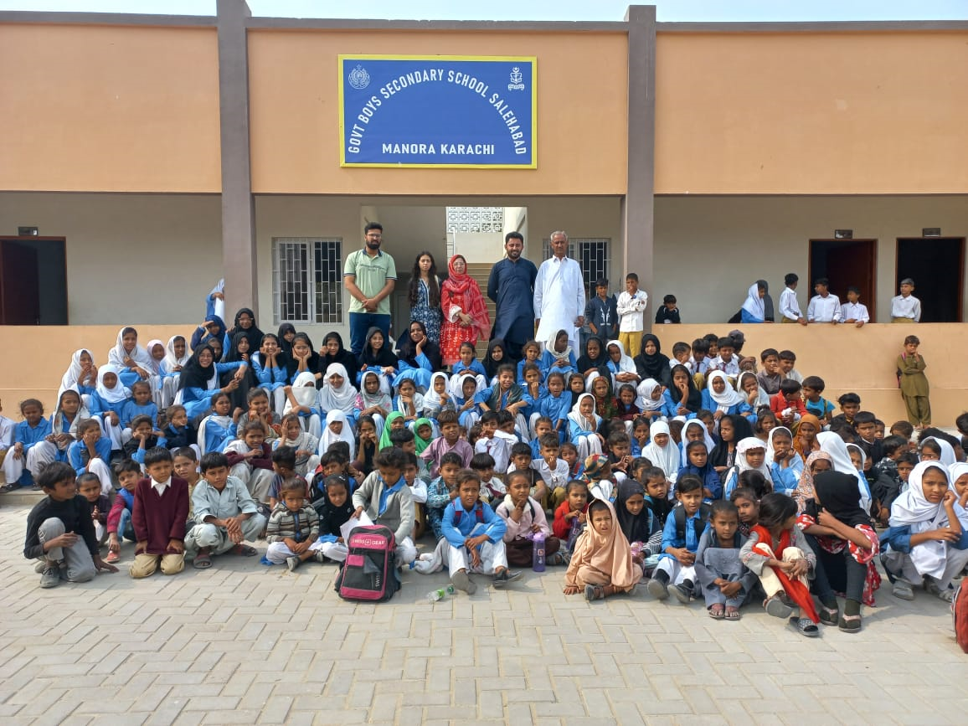
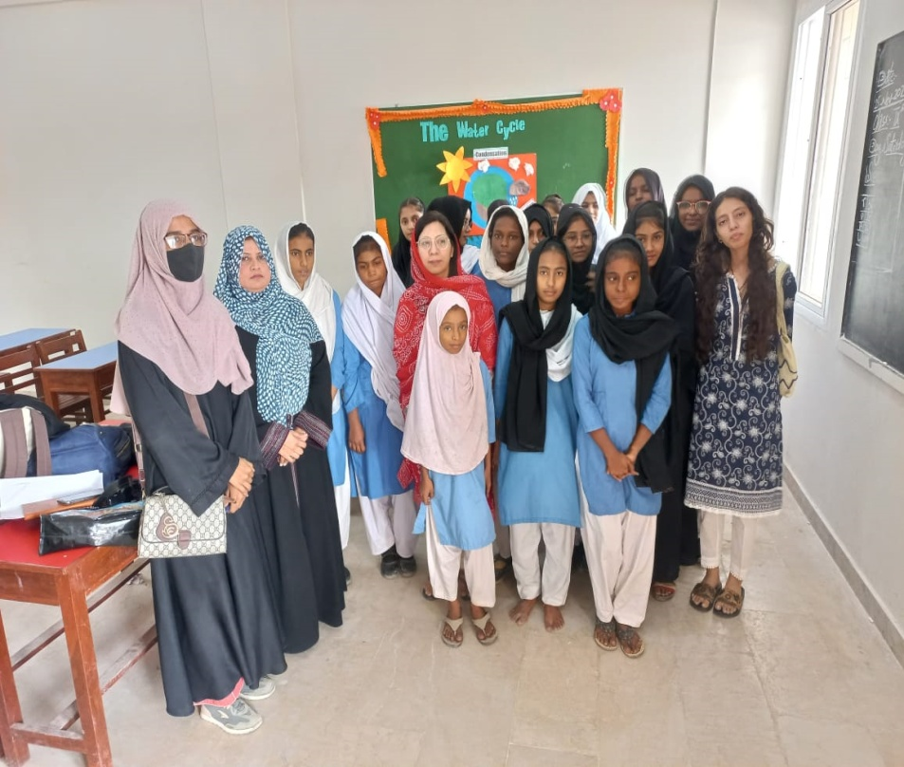

Slide 20
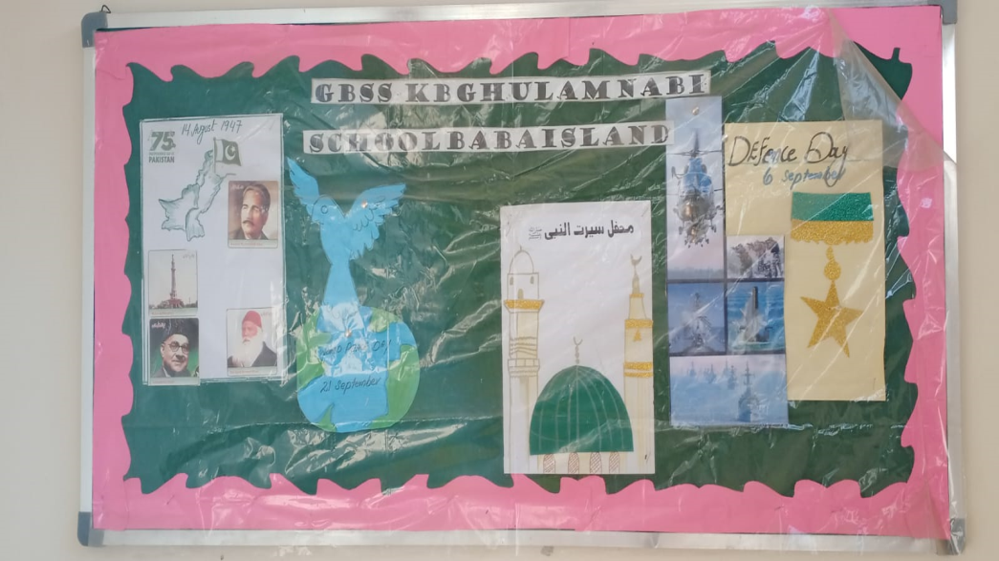
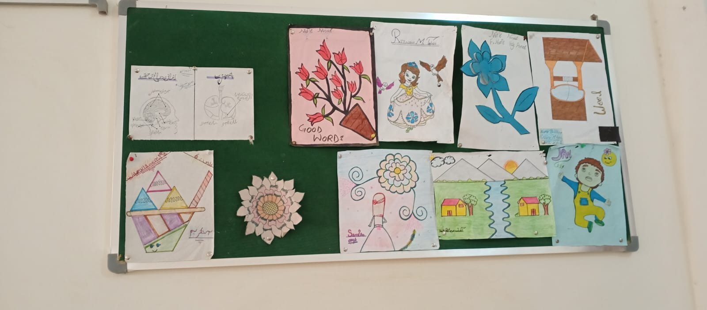
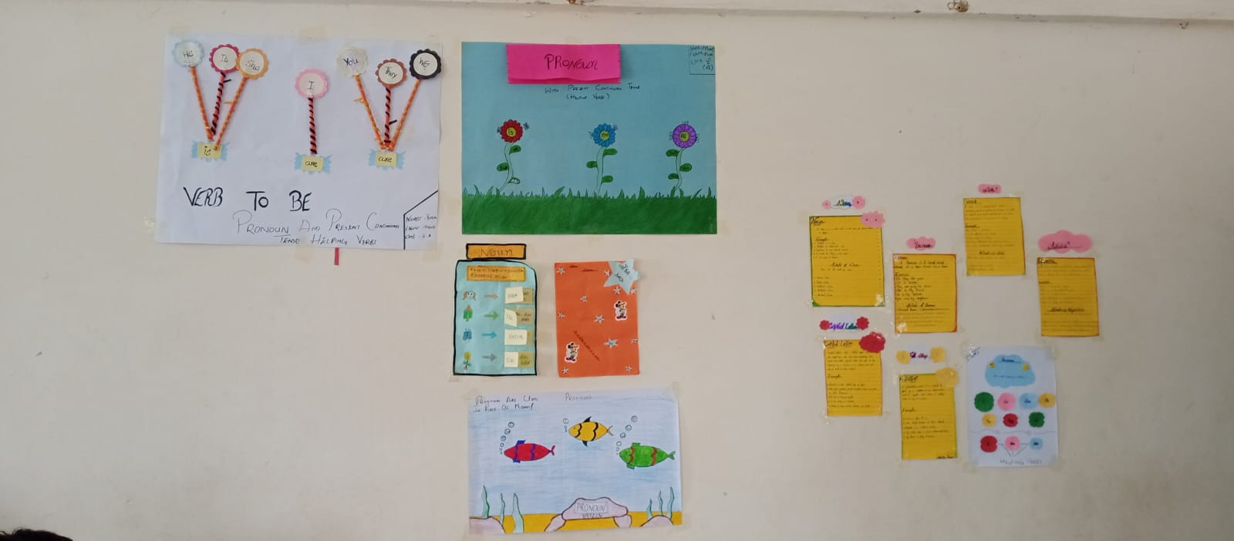
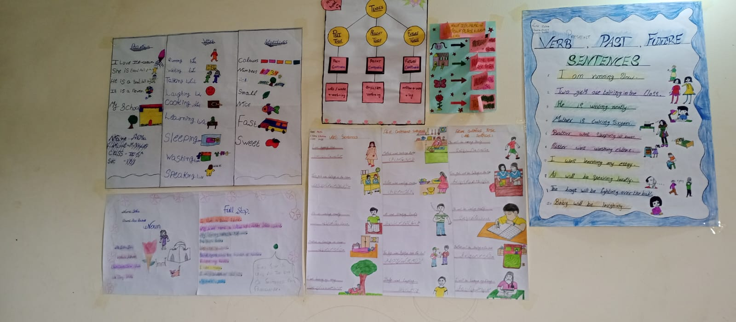
Students Corner Activities

Slide 21
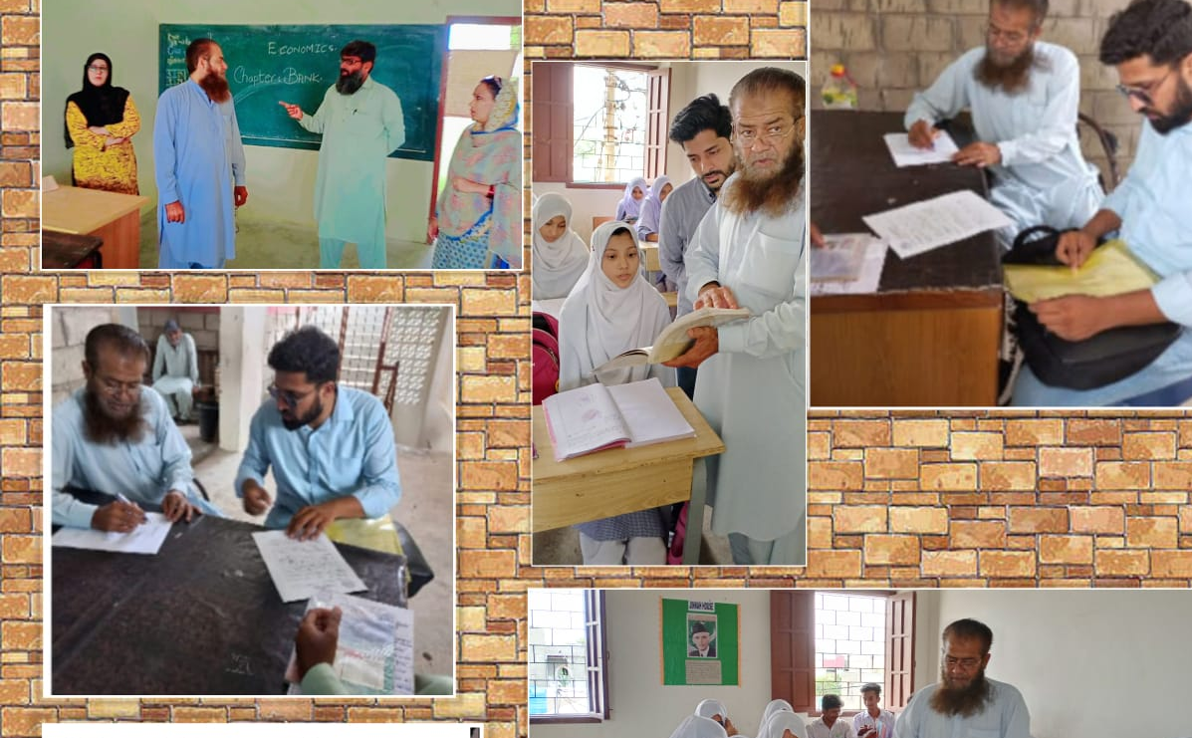
CHECK AND BALANCE

Slide 22
TEAM WORK MAKES A SUCCESS STORY

