Slide 1
IMPACT OF PEDAGOGY BASED AND CONTENT BASED LEARNING CYCLES
CLUSTER HUB SCHOOL GBSS DAMBA VILLAGE, DISTRICT MALIR, KARACHI

Slide 2
INTRODUCTION
As per School Cluster Policy 2021 Notification Number NO.SO (G-III)SE&L/3-1604/2021, GBHS Damba Village was selected as Cluster Hub School in District Malir Karachi.
There are total 28 School in the premises of GBHS Damba Cluster. Out of which , 5 are called Cell Hub Schools and Remaining 23 are called Feeder Schools.
GBSS Damba acts as a Cluster Hub School and all pedagogical cycle activities were monitored and implemented from this school.
To implement pedagogy cycles, 05 Guide Teachers and 18 Subject Coordinators are currently working in field.

Slide 4
GUIDE TEACHER AND SUBJECT COORDINATORS
S.NO | CLUSTER CELL HUB SCHOOL | GUIDE TEACHERS | SUBJECT COORDINATORS
1 | GBHS DAMBA GOTH | 01 | 05
2 | GBLSS HAKEEM GABOL | 01 | 04
3 | GBLSS DAMLOTI NO 06 | 01 | 05
4 | GBPS ALI MUHAMMAD BALOCH | 01 | 04
5 | GBPS HASHIM JOKHIO | 01 | 03

Slide 5
GT’S AND SC’S NOTIFICATION

Slide 6
Pedagogical Approaches
Before:
After:

Slide 7
CPD ACHIEVEMENTS
INCREASED MAN POWER (PROFESSIONALLY TRAINED)
05 TRAINED GUIDE TEACHERS
21 TRAINED SUBJECT COORDINATORS
45 TRAINED MENTEE TEACHERS
IN TOTAL, 71 PROFESSIONALLY TRAINED TEACHERS ARE NOW WORKING IN FIELD TO IMPROVE QUALITY OF EDUCATION.

Slide 8
CPD ACHIEVEMENTS
02. QUALITY OF TEACHING IMPROVED
Vast improvement has been in quality of teaching. Teachers are now using various methods , as per learned in pedagogy cycles, to interact with students. Some of methods being used are as follows
Roleplay , Elaboration, Modelling
Brain Storming, Asking Questions
Graphical Presentations and gamification
Proper Lesson Planning, Personalized Learning

Slide 9
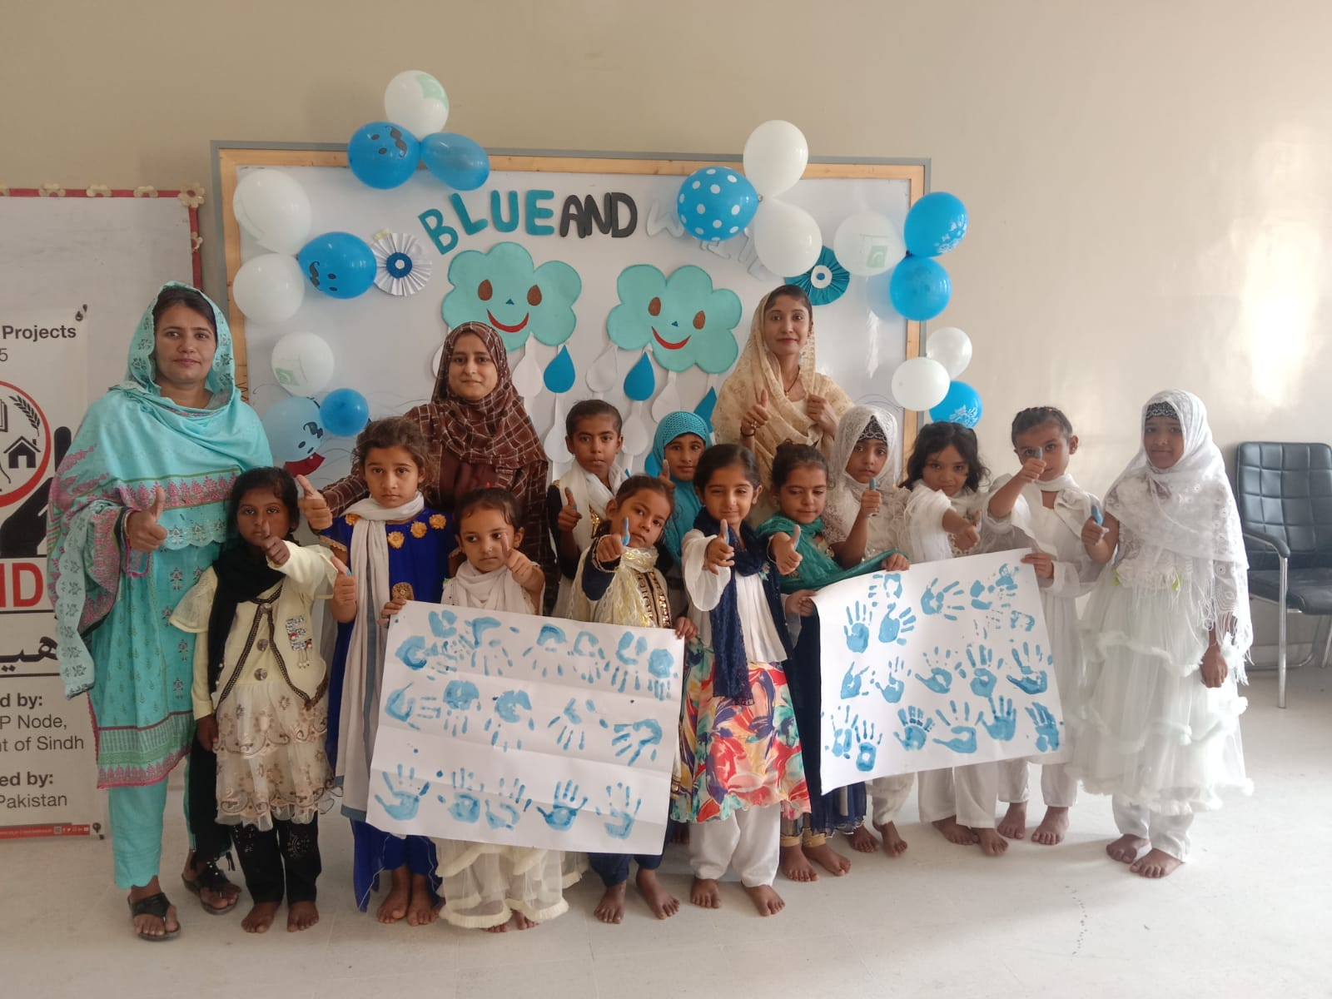
CPD ACHIEVEMENTS

Slide 10
CPD ACHIEVEMENTS
03: TEACHER CENTERED TO STUDENT CENTERED LEARNING
STUDENTS ARE ENCOURAGED TO GIVE PRESENTATIONS, ASK QUESTIONS.
AT THE END OF THE LESSON , STUDENTS ARE ALSO MOTIVATED TO IMPLEMENT LEARNED THINGS IN REAL LIFE SCENARIOS.

Slide 11
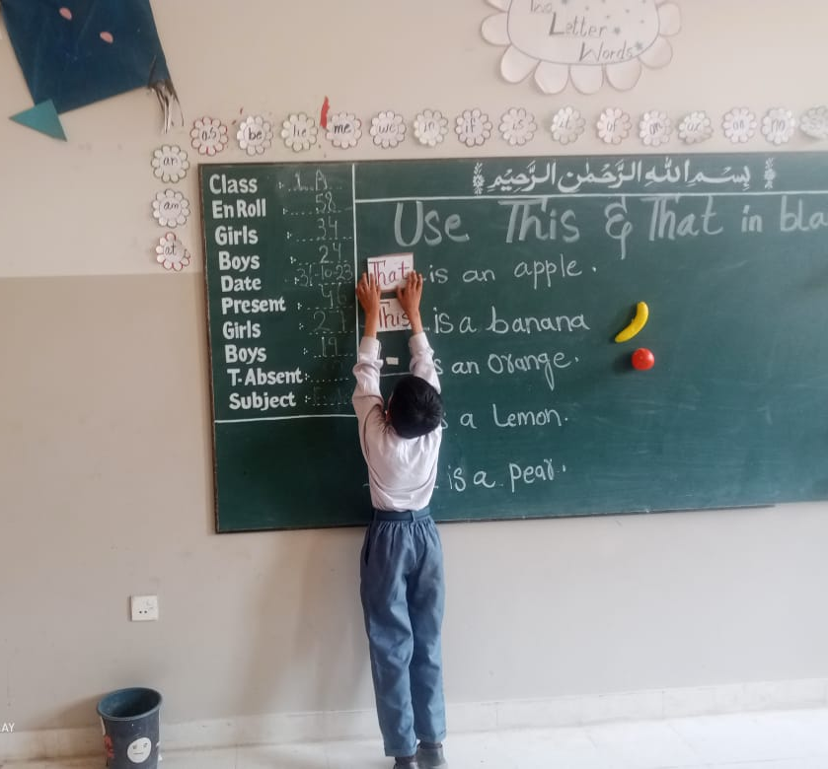
CPD ACHIEVEMENTS

Slide 12
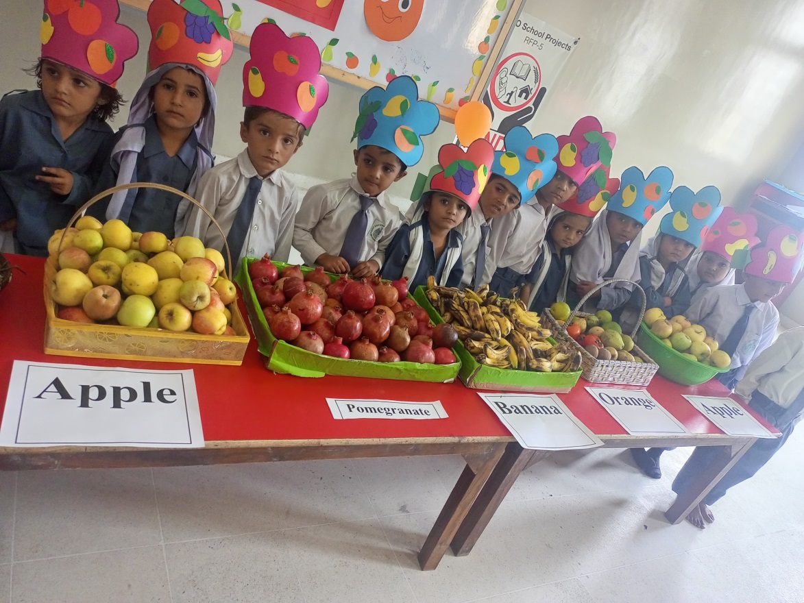
CPD ACHIEVEMENTS

Slide 13
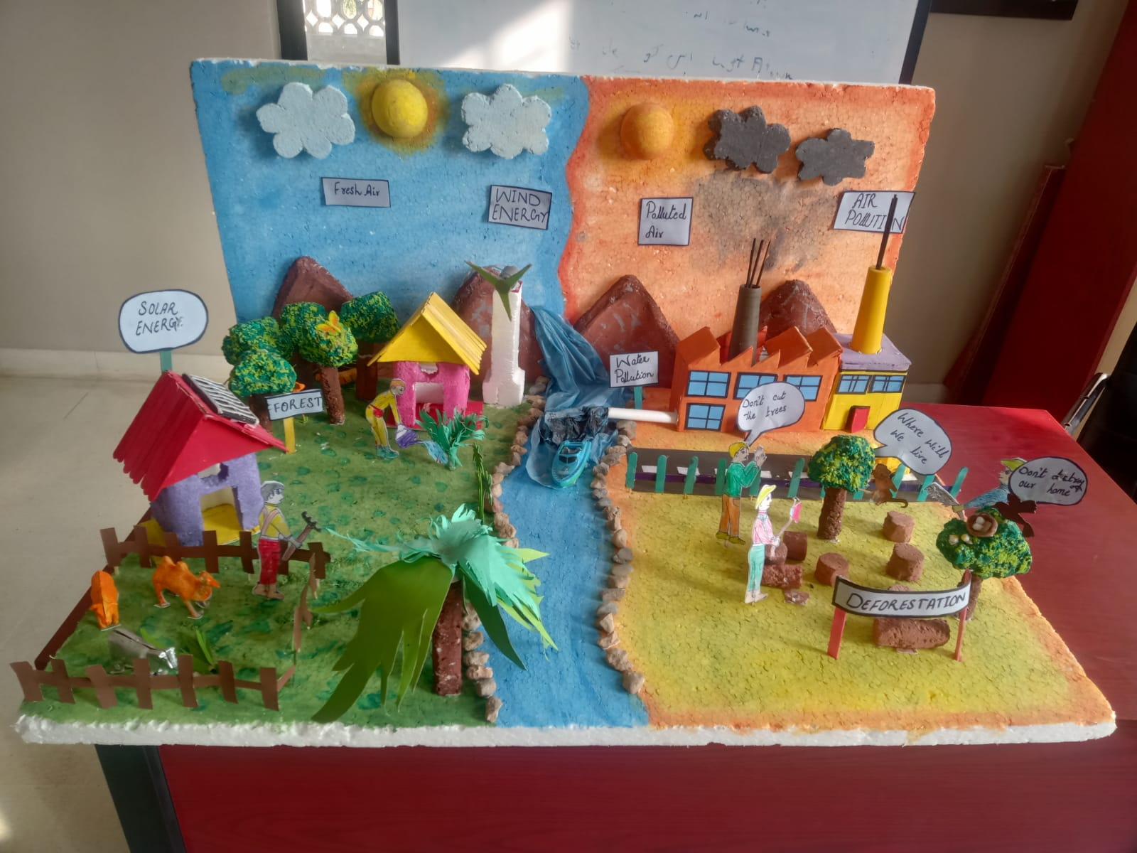
CPD ACHIEVEMENTS

Slide 14
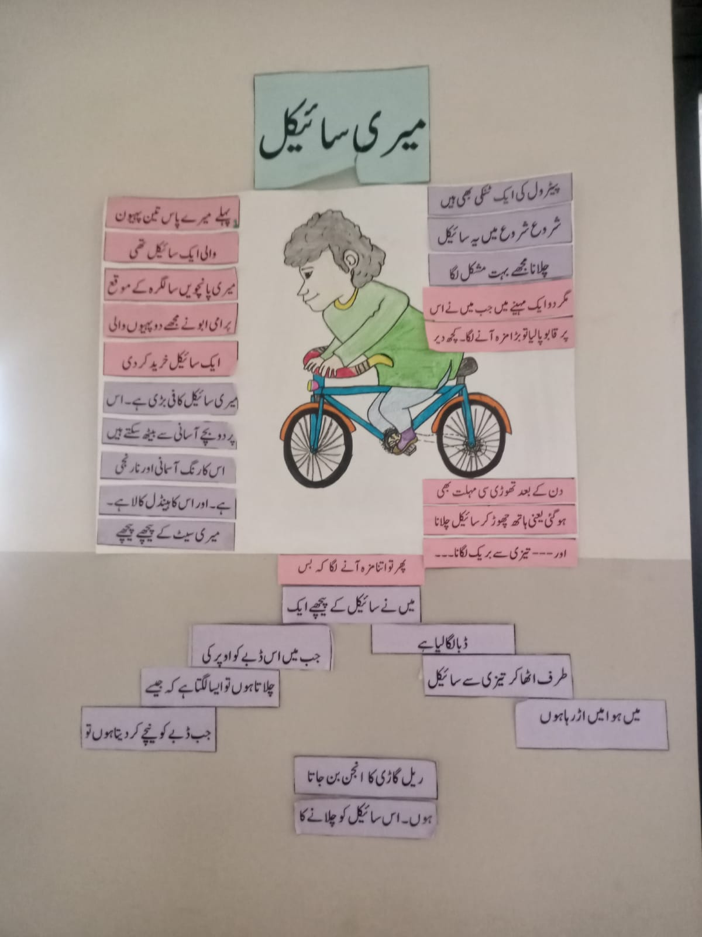
CPD ACHIEVEMENTS

Slide 15
IMPACTS OF PEDAGOGY BASED LEARNING CYCLE (CONTINUED)
4. IMPROVEMENT IN ENROLLMENT and DROP-OUT Decreased
Drastic improvement has been in enrollment as well. Due to improved teaching quality, many of the parents are now enrolling their students in Government Schools.
For example, In 2022 enrollment of GBHS DAMBA VILLAGE was 679. And now currently in 2023 , 881 students are enrolled at GBHS Damba Village. Which shows that 30% increase is seen in enrollment.
Moreover, in Overall Hub Cluster, total enrollment as of 2023 is 2455 students, where as in 2022 it was 1807 students. There is also increase of 17% in Hub Cluster.

Slide 16
IMPACTS OF PEDAGOGY BASED LEARNING CYCLE (CONTINUED)
5. PEER TO PEER LEARNING
The implementation of Pedagogy cycles have encouraged the Teachers to work together towards completing a task and learn together. This has increased their perceptions by understanding and taking views from the other colleagues.

Slide 17
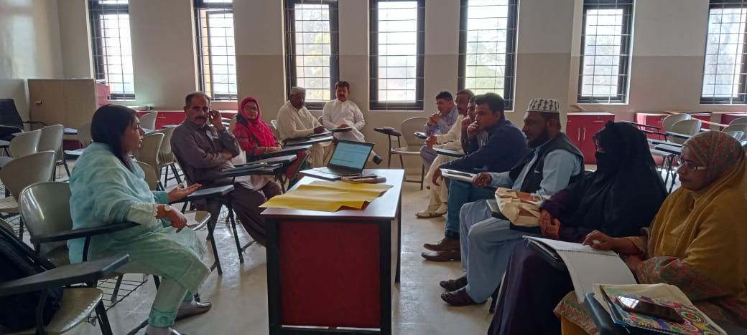
IMPACTS OF PEDAGOGY BASED LEARNING CYCLE (CONTINUED)
5. PEER TO PEER LEARNING

Slide 19
IMPACTS OF PEDAGOGY BASED LEARNING CYCLE (CONTINUED)
6. IMPROVED RESULTS
Due to improved quality teaching and teacher student relationship, results achieved in current Matric Exams by GBHS DAMBA village students are astonishing
This year 2023, 14 students achieved A+ Grade, 49 students achieved A grade, 18 Students obtained B grade and only 2 students got C grade.
Hence, the results above are speaking itself about the impact of pedagogy based learning cycles.

Slide 20
IMPACTS OF PEDAGOGY BASED LEARNING CYCLE (CONTINUED)
7. IMPROVED LESSON PLANNING
Teachers are now well prepared and they do lesson planning before coming to the class.
Syllabus is now completed in synchronized way and improving the quality of education in Government schools.
Followup is also taken by DEO/TEO and Cluster Hub School HM regarding lesson planning and syllabus being covered by teachers.
Hence, overall, education quality has improved.

Slide 21
Challenges of CPD Implementation
Resistance to change
Distance
Lack of Training Opportunities
Sustaining Teacher Engagement
Attendance Monitoring
Difficulties
Dropout Prevention Strategies
Lack of Basic Facilities
Timetable Implementation
Issues
Balancing Individualized Learning
Upgradation of schools
Fulfillment of financial needs.

Slide 22
CLUSTER IMPROVEMENT PLAN
Strong Communication and Coordination
Vision Statement (Excellence in Learning and Teaching, creating hope , inspiring potential and changing lives)
Appreciation Certificates for GTs and SCs
Academic Support
Improve Community Connection

Slide 23
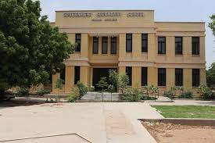
THANK YOU
THE END

