Slide 1
Achievements of Continue Professional Development (CPD) Implementation under STA-DEEP
Presenter: Honey Raza H.M B-18 Muslim GGSS No 1
TEO Liaquatabad Town Female District Central

Slide 2
Outline
Discussion with Cluster Head and School Heads, focusing on the professional development of teachers and the academic year at the town level.
Implementation of D.D.O training for financial matters
Professional development of teachers/ HM
Academic development
Acheivements of Muslim G.G.S.S No 1/ Town Level

Slide 3
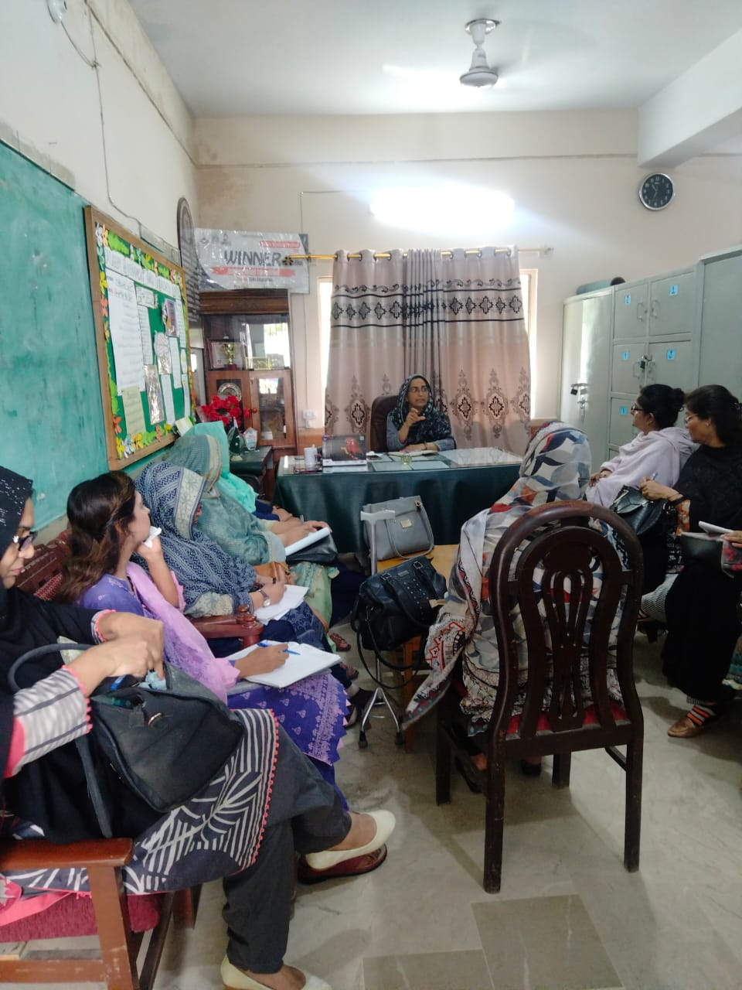
Discussion with Cluster Head and School Heads, focusing on the Professional Development of Teachers and the Academic Year

Slide 4
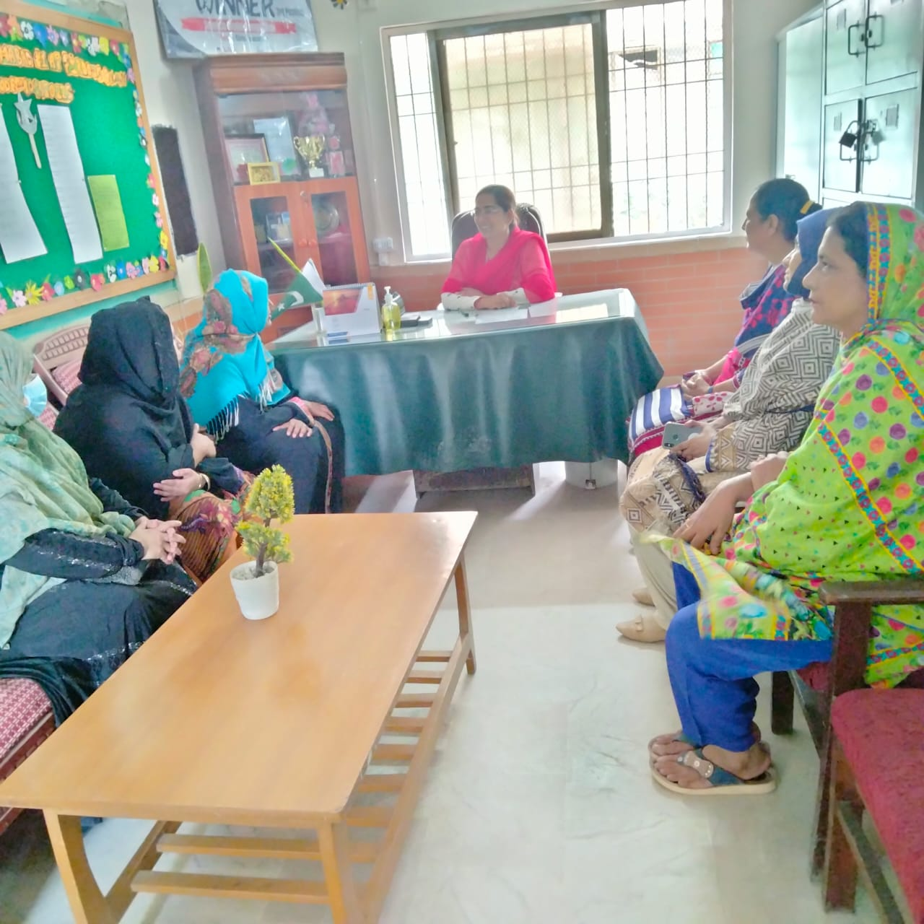
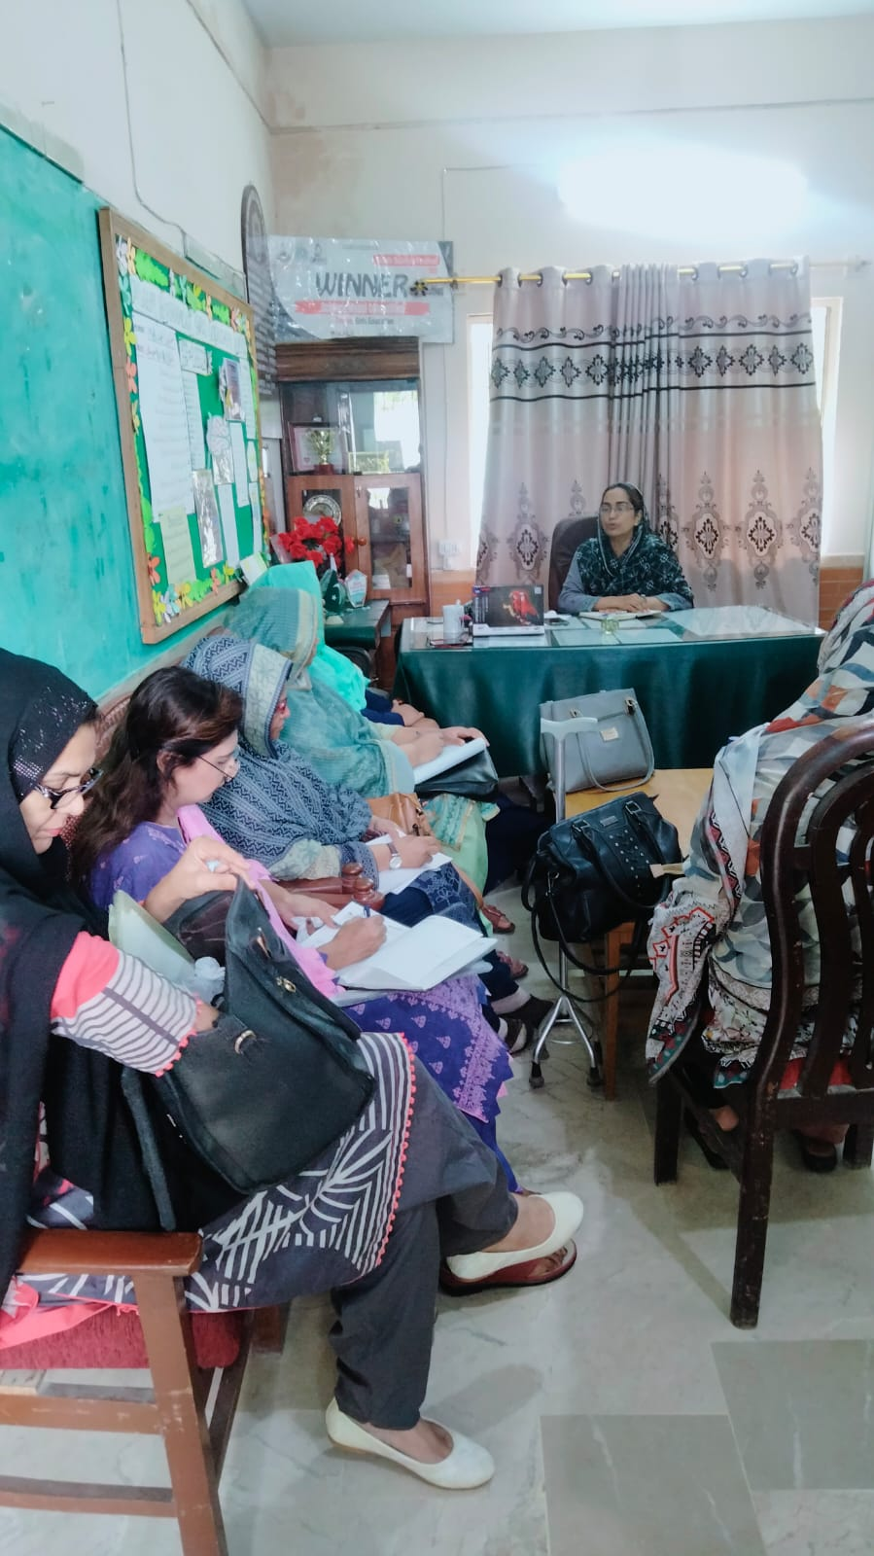
Meetings with Teachers

Slide 5
Implementation of D.D.O Training for Financial Matters
How to maintain a stock register.
How to distribute items from stock to teachers and maintain records.
Numbering for furniture or any government equipment.
FO forms (1, 2 and 3).
BCC forms.
Creating and managing budget demands

Slide 6
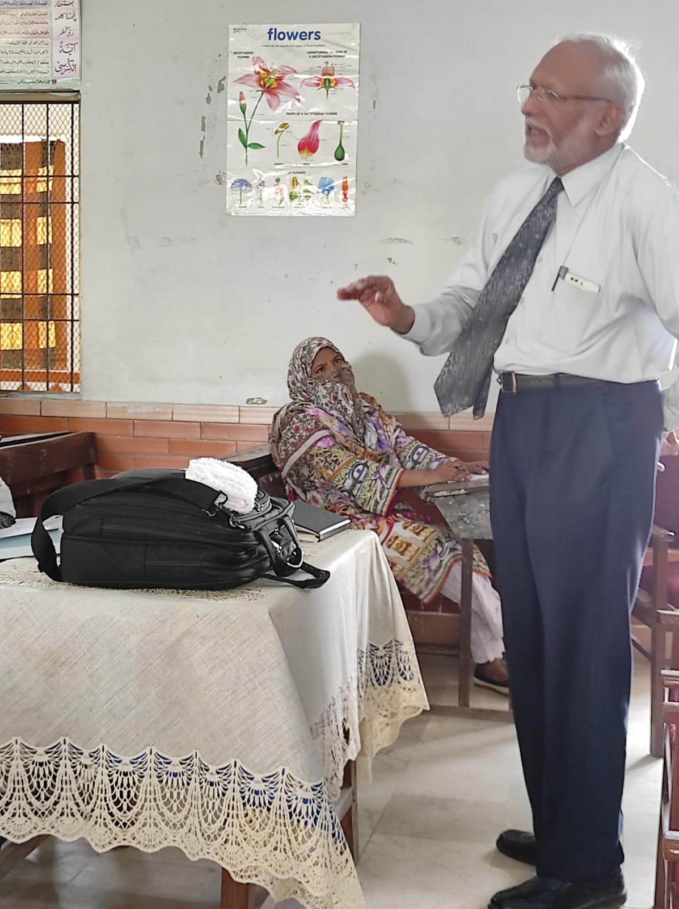
Professional Development of Teachers/HM: Session by Mr Abbas Husain on Preparing Children for 2040 and Beyond

Slide 7
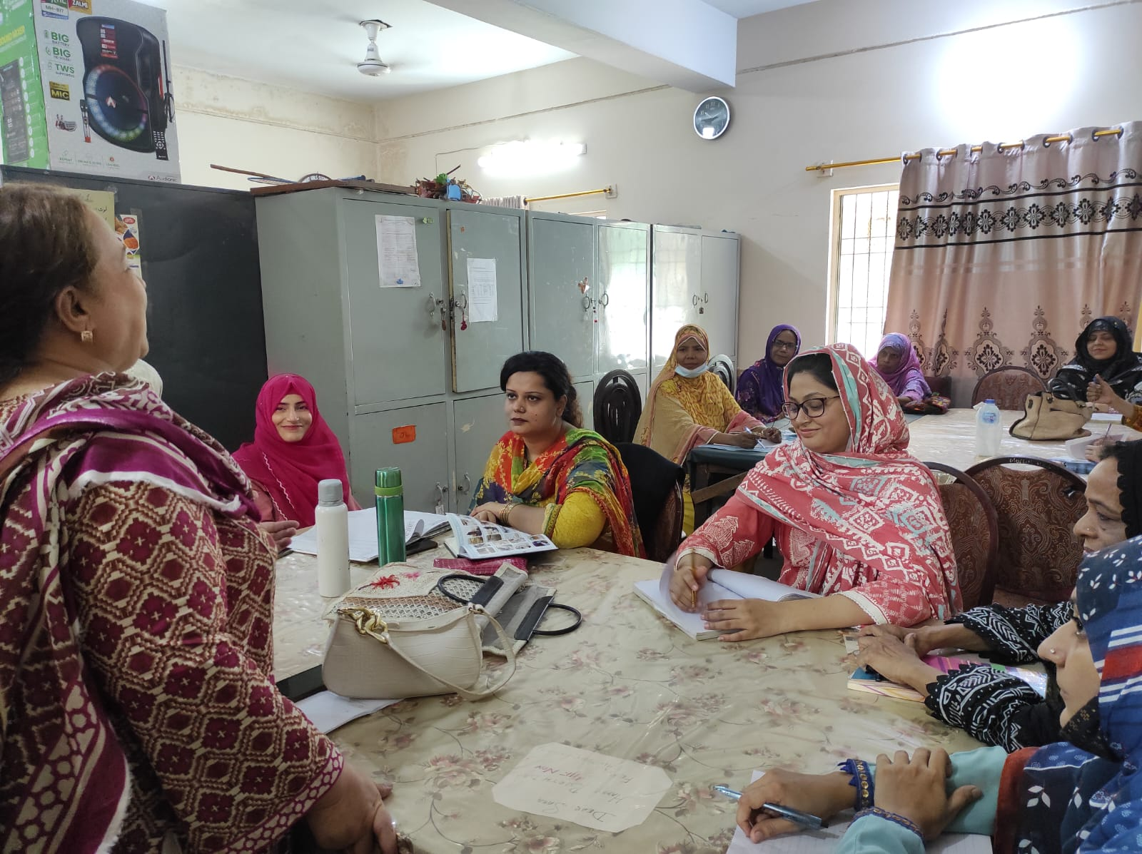
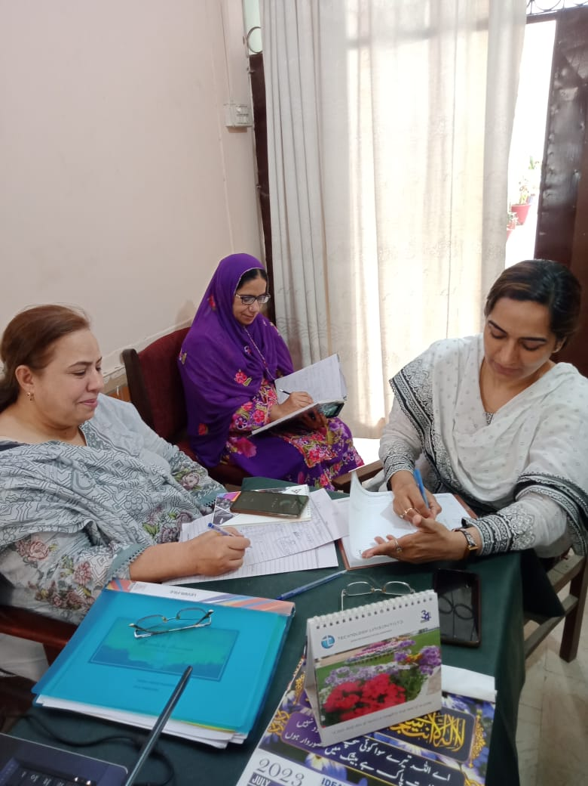
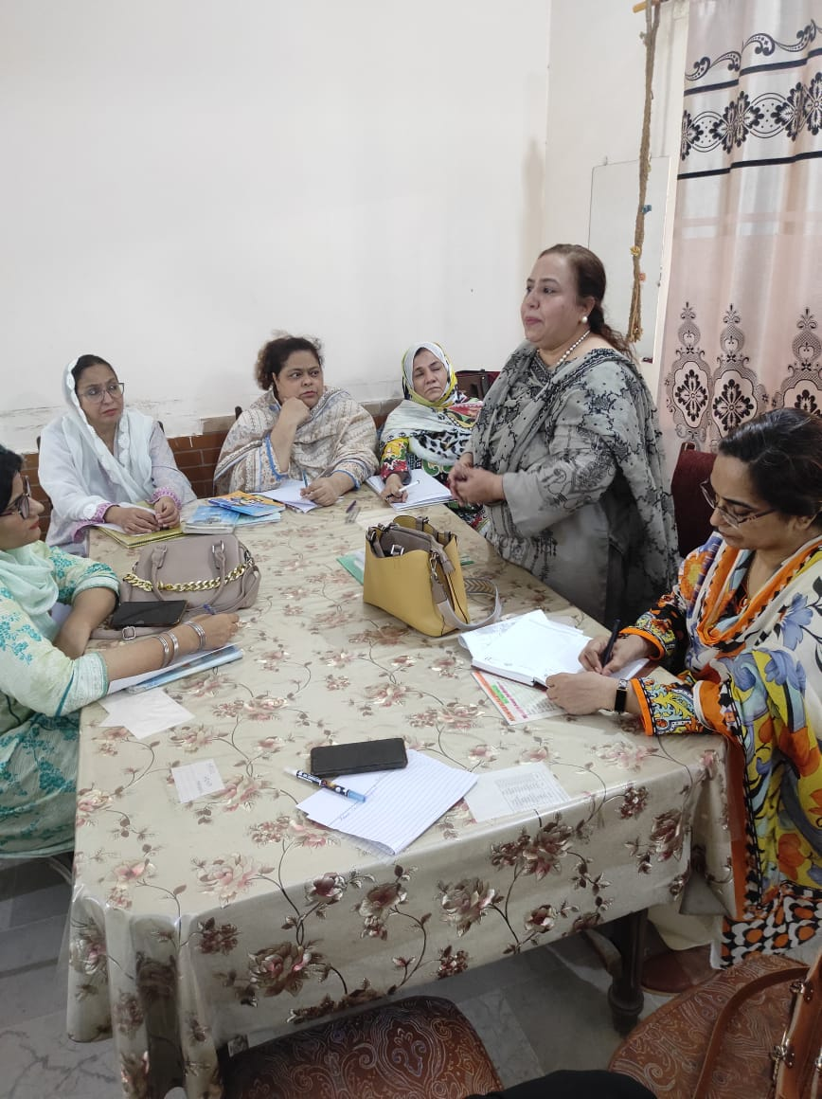
Professional Development of Teachers/HM: Session by Syeda Umme Humaira on Lesson Planning Techniques and Academic Planner

Slide 8
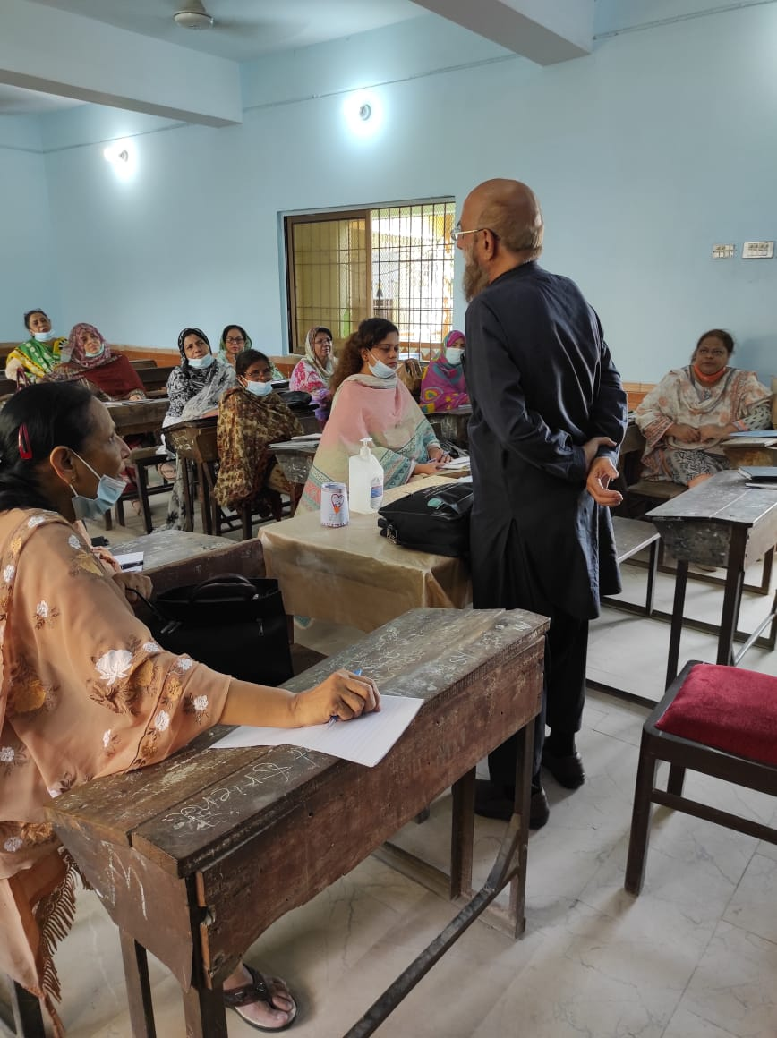
Professional Development of Teachers/HM: Session by Mr Tahir Javed from Patabata: Muslim School’s Teachers also Received Scholarships

Slide 9
Professional Development of Teachers/HM:
Session by Mr Ibrahim on educational games
Online sessions by Erum kamran from Turning Point
Fearless Leadership Course from tdc and Noor-ul-Huda
Leadership course from Mr Abbas Husain (tdc)
Leadership course from Sadika Kebbi (Kun) etc.

Slide 10
Academic Development
Maintaining an academic planner.
Implemenmation of lesson planning techniques.
Portfolio of teachers.
Zero periods for communication skills and ethics.
Parent teacher meetings

Slide 11
1. Maintaining an Academic Planner
Clearly outline the duration of academic year.
Specify the number of working days.
Break down the essential activities to be conducted each month Include specific events, workshops, or seminars planned for each month.
Clearly define the examination schedule, including dates for mid-terms and finals.
Ensure a balanced distribution of exams across the academic term.

Slide 12
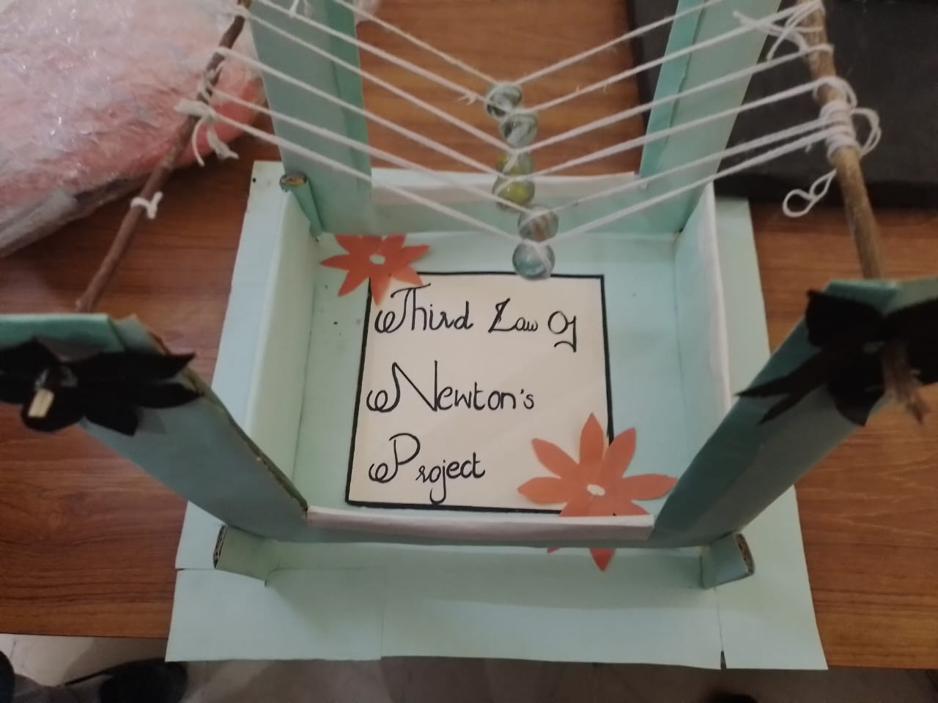
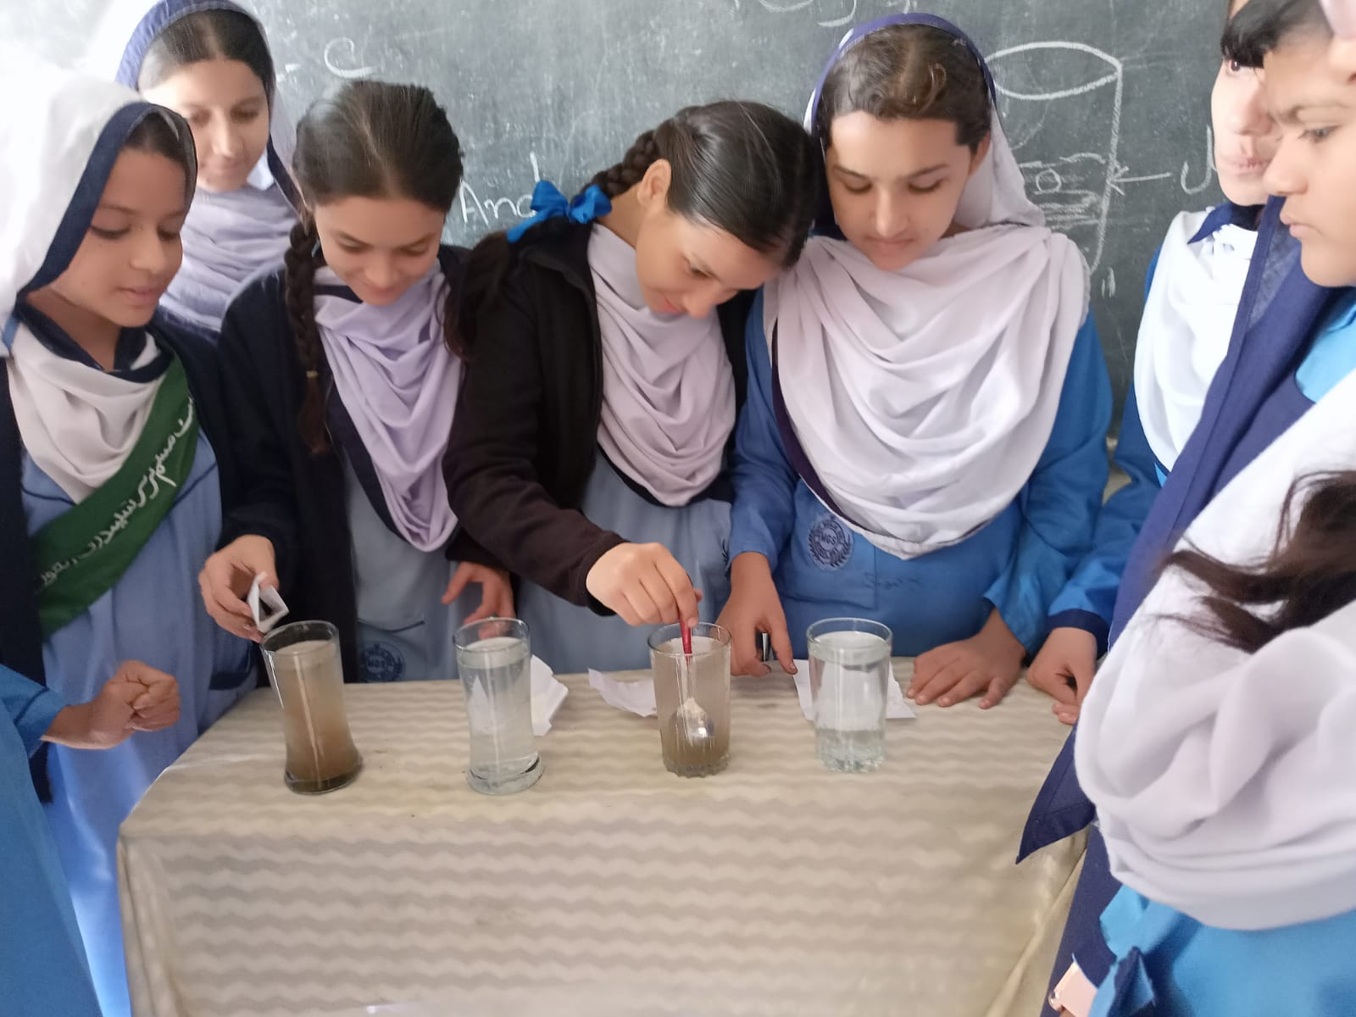
2. Implementation of Lesson Planning Techniques

Slide 13
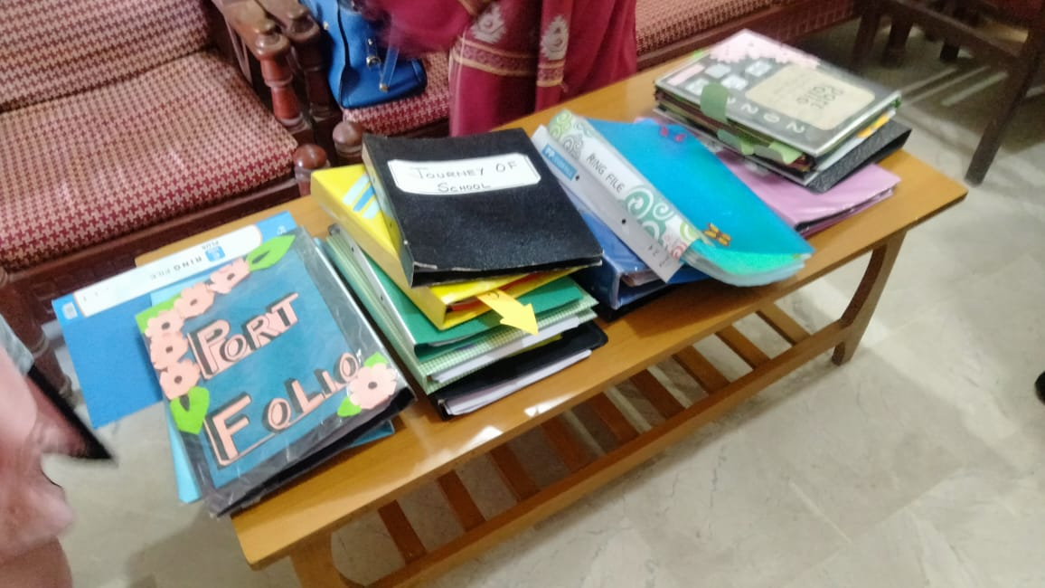
3. Portfolio of Teachers

Slide 14
4. Zero Periods for communication Skills and Ethics

Slide 15
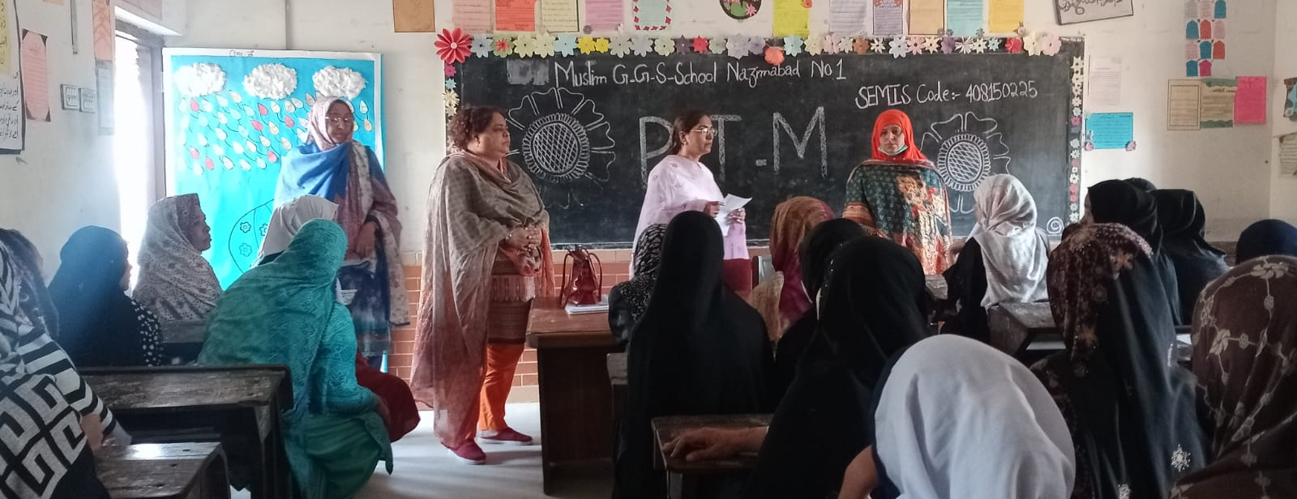
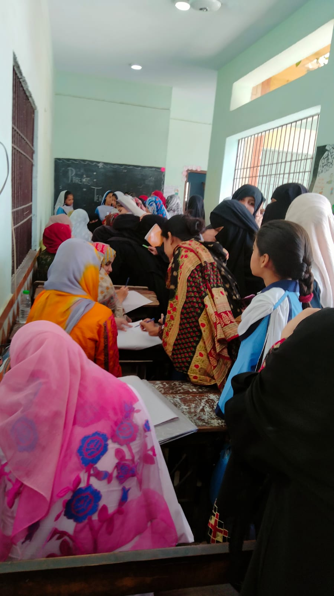
5. Parent Teacher Meeting

Slide 16
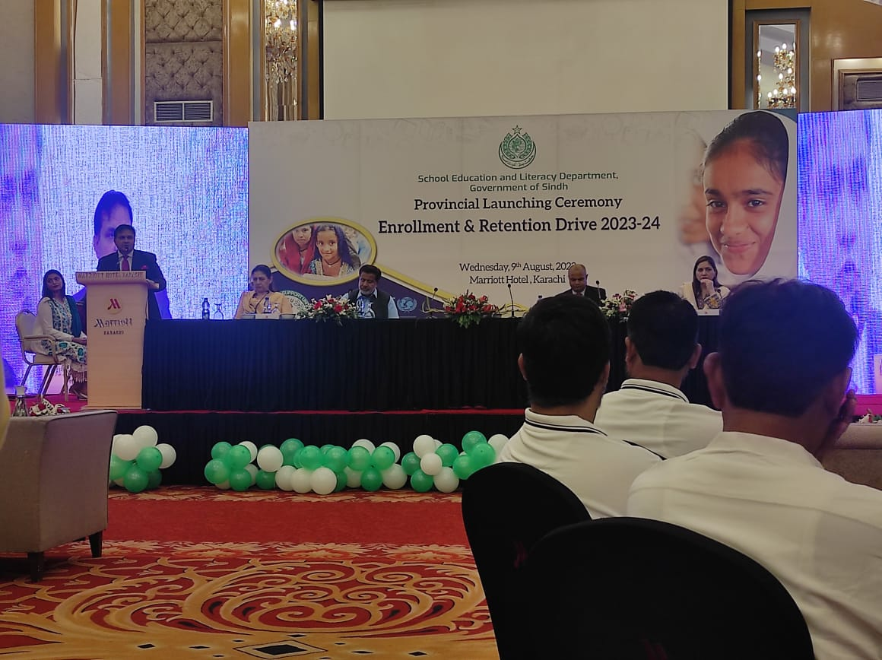
Acheivements of Muslim G.G.S.S No 1/ Town Level : Increased Enrollment

Slide 17
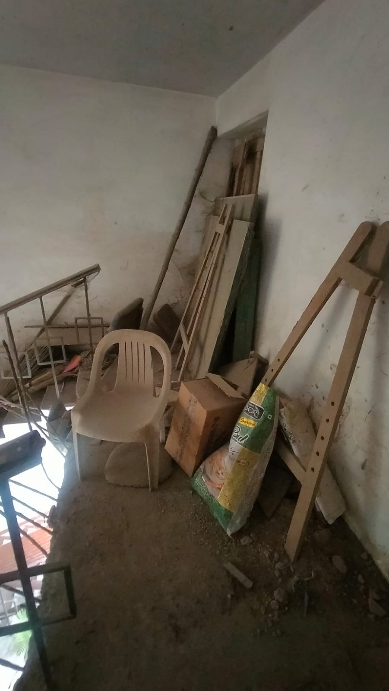
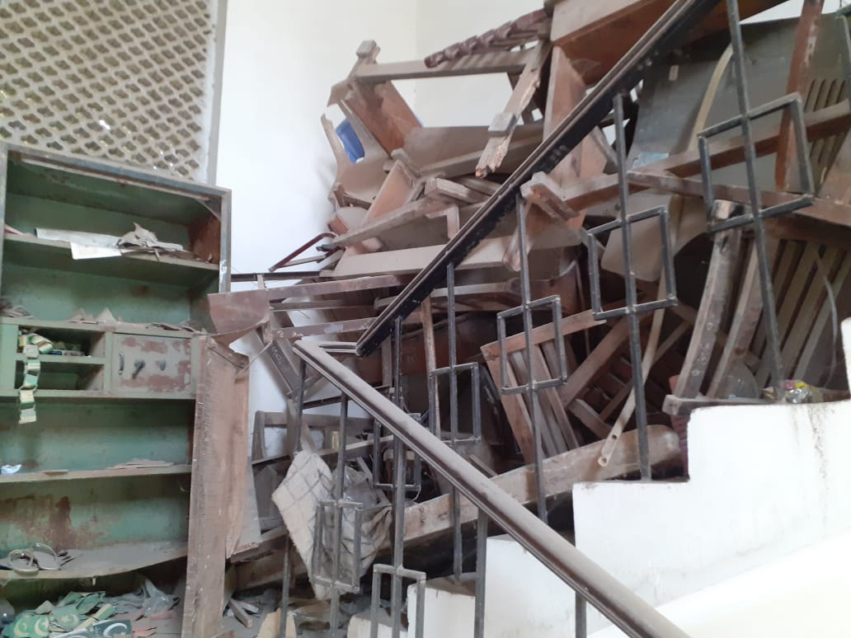
Stairs Library (Before)

Slide 18
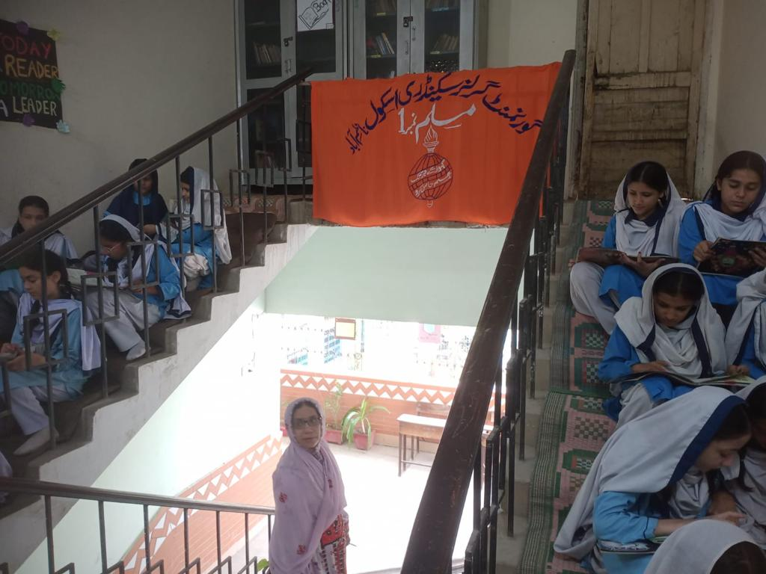
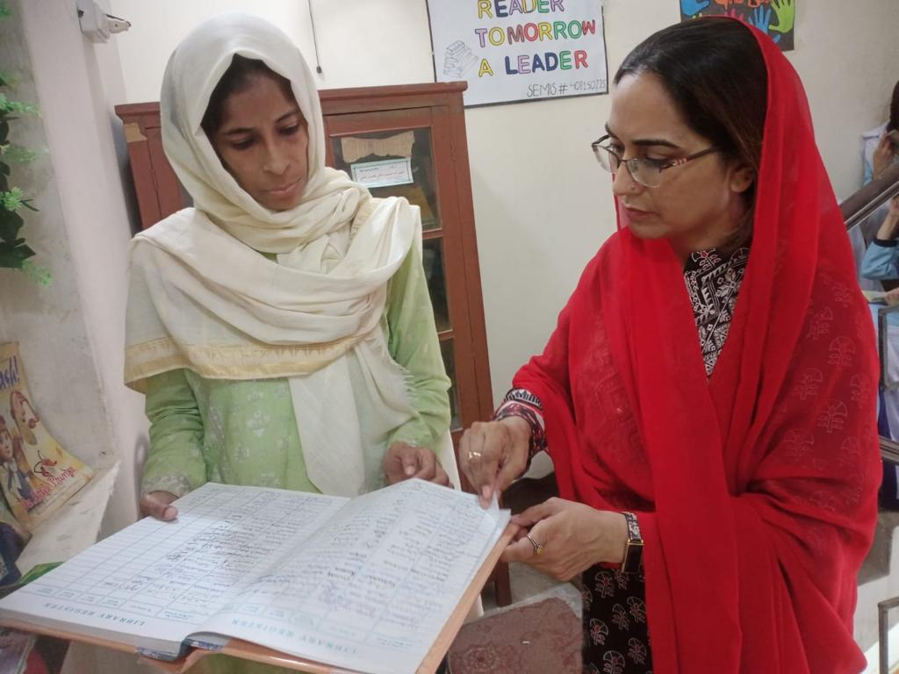
Acheivements of Muslim G.G.S.S No 1: Stairs Library (After)

Slide 19
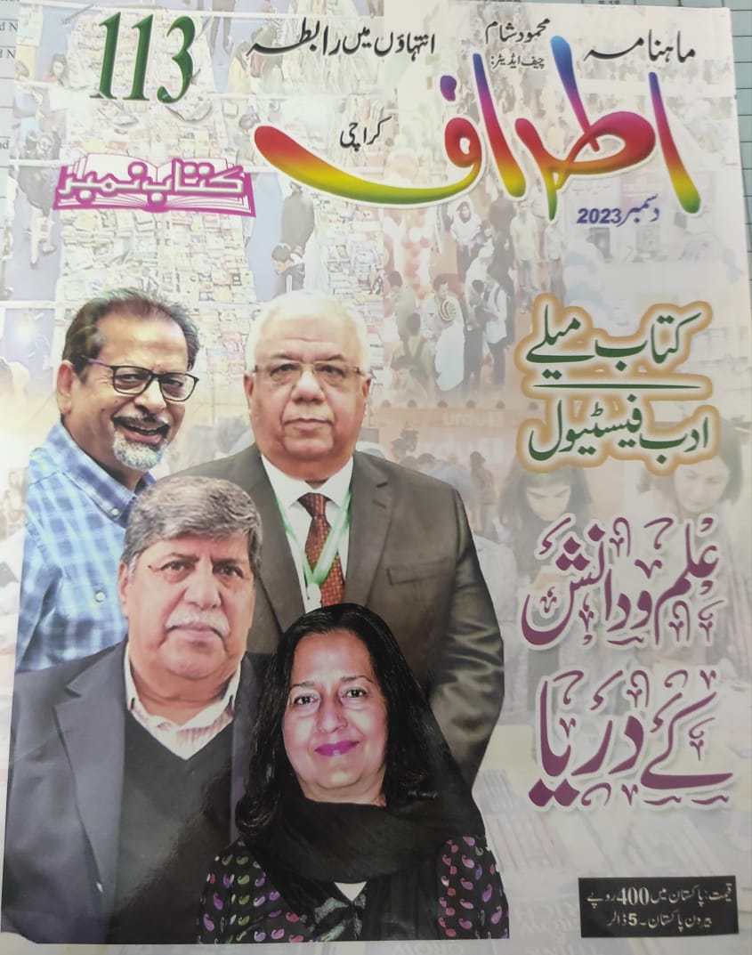
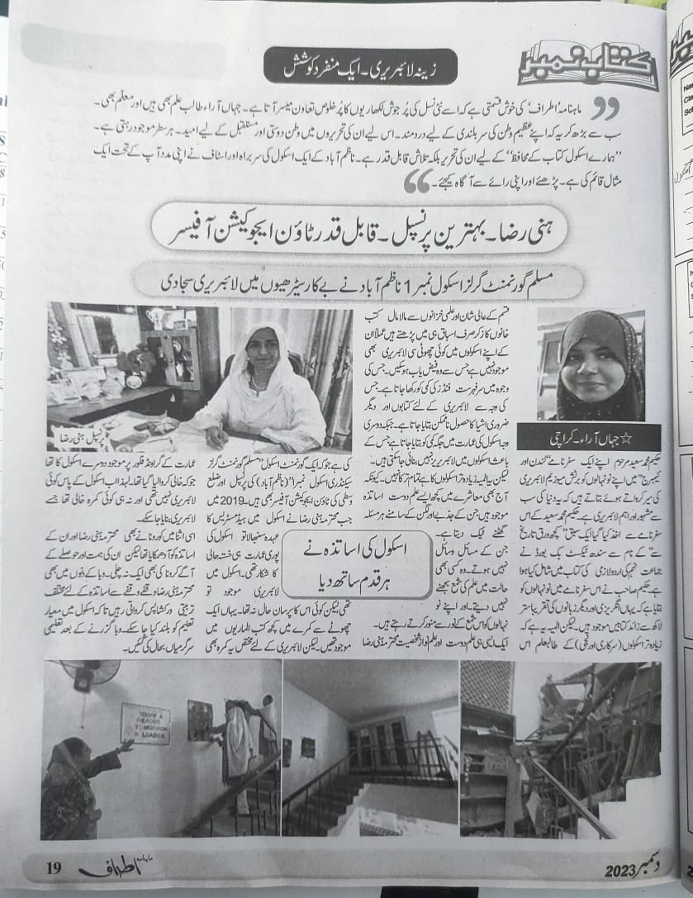
Recognition of Stairs Library as ( Zeena Library) (Mahnama Atraf by Mahmood Sham)

Slide 20
Book Reviews by Students

Slide 21
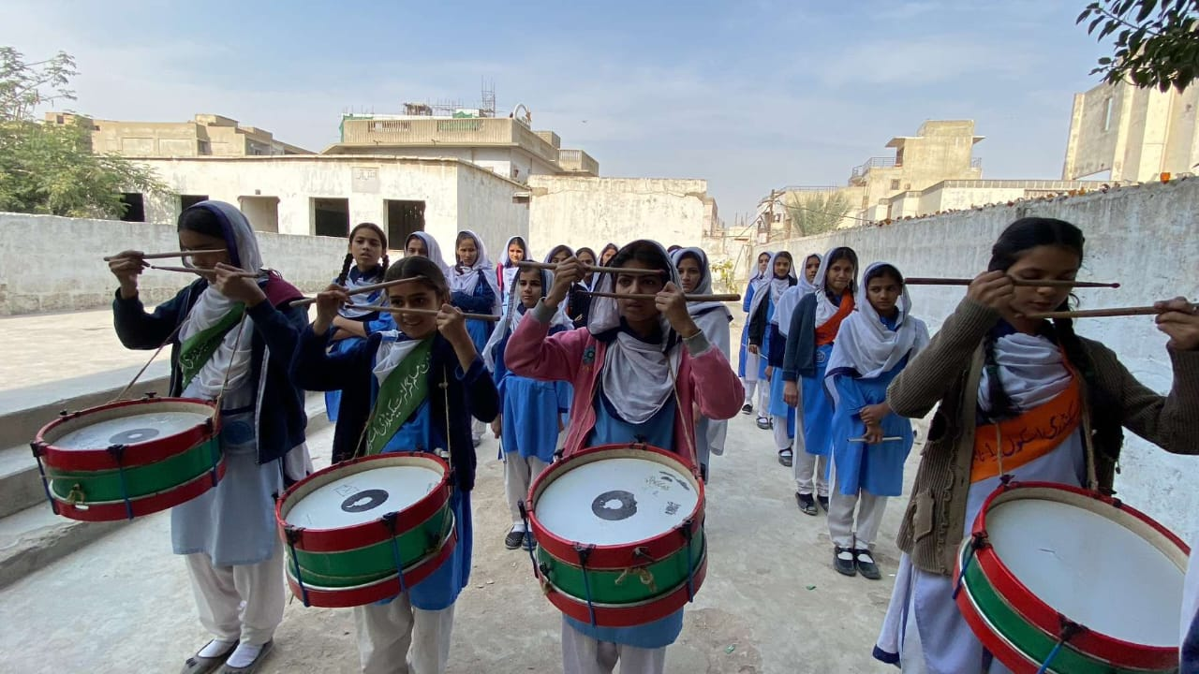
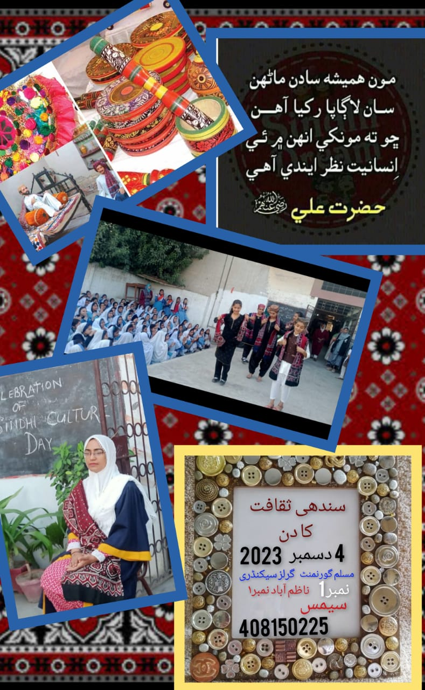
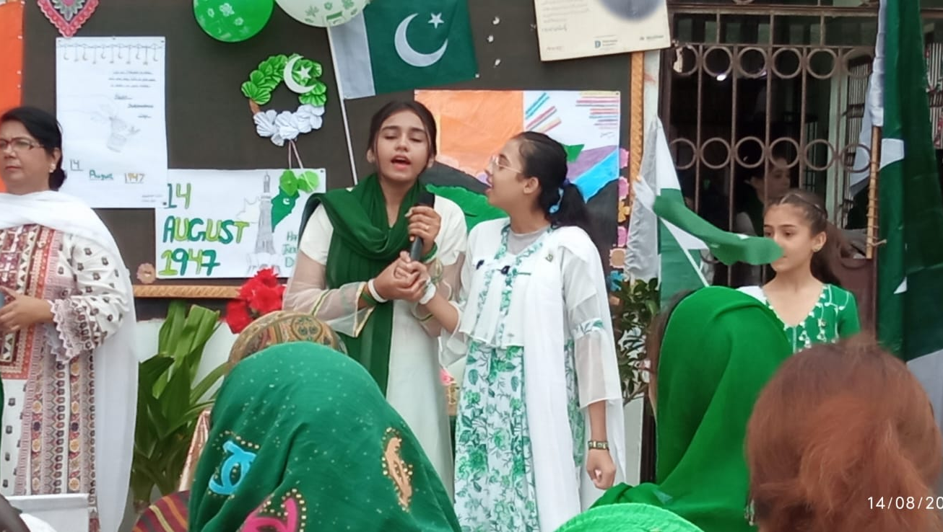
Co-curricular Activities

Slide 22
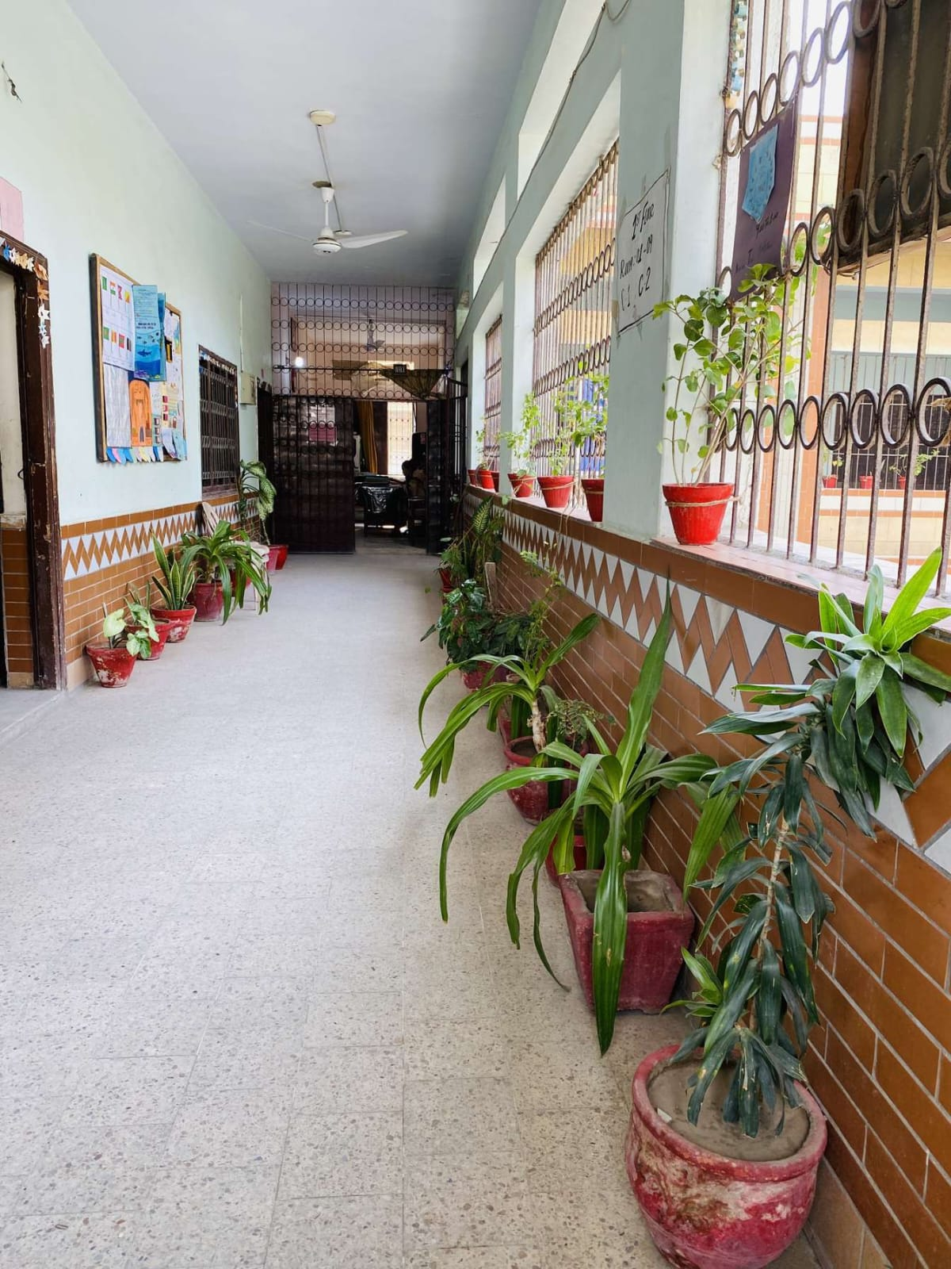
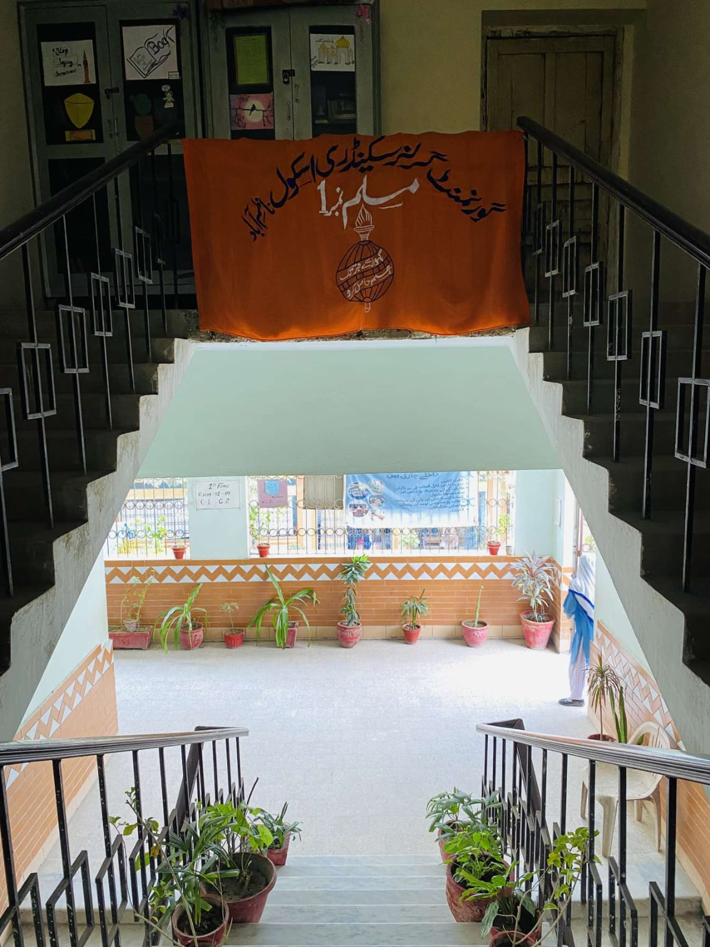
Healthy and Conducive Environment

Slide 23
THANK YOU

