Slide 1
CPD Model 2022 and its success stories
Enhancing Teacher skills and Improving Student Learning in Sindh

Slide 2
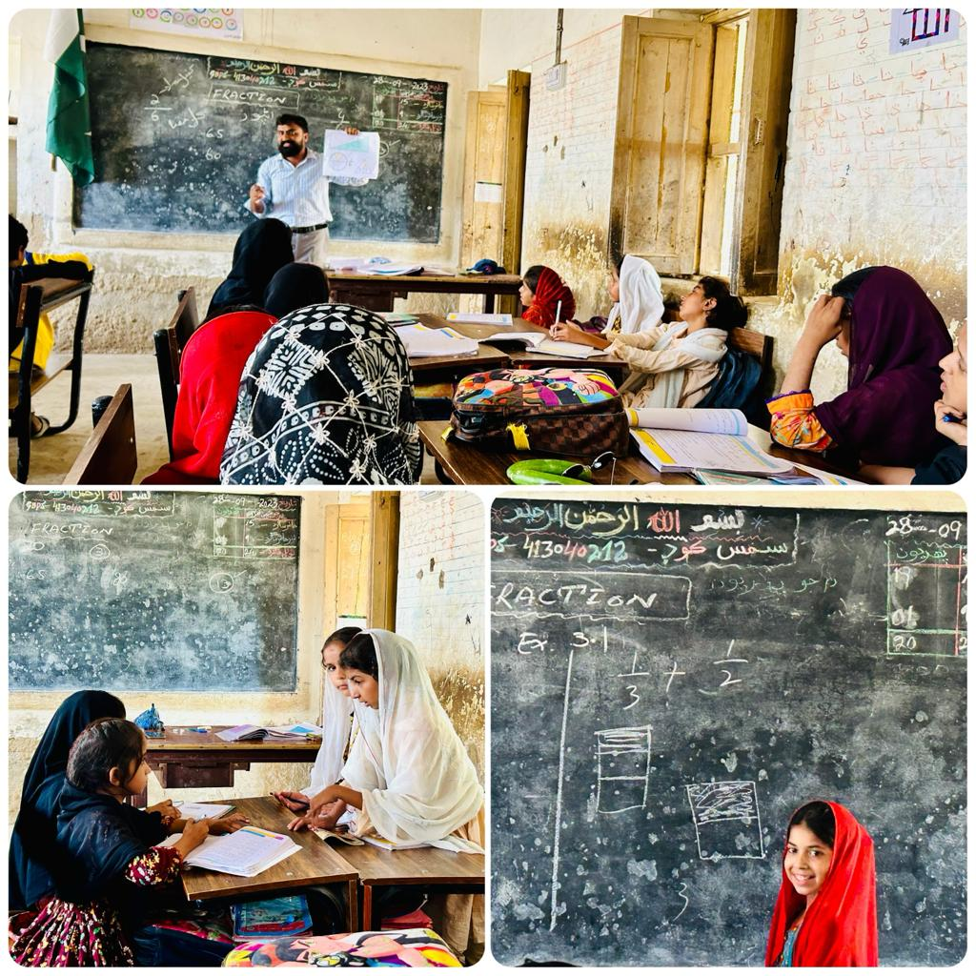
Introduction
Introduction to CPD Model 2022
Goals: Enhancing student learning, improving teacher practices
Emphasis on teacher’s development and learning culture

Slide 3
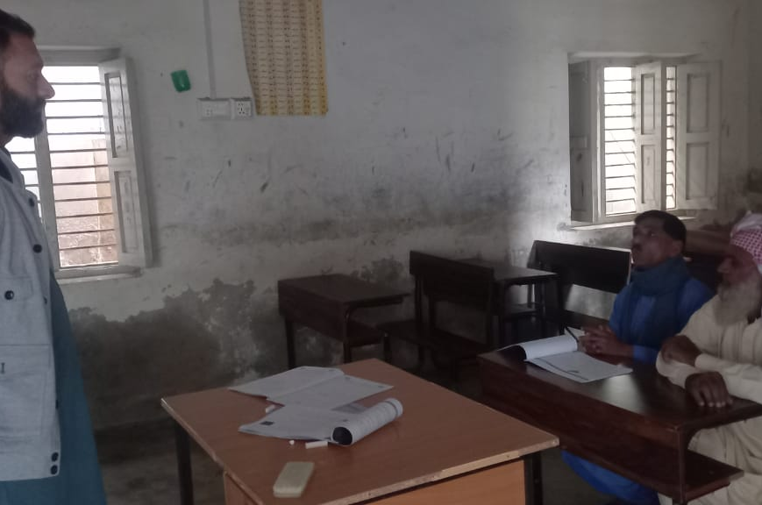
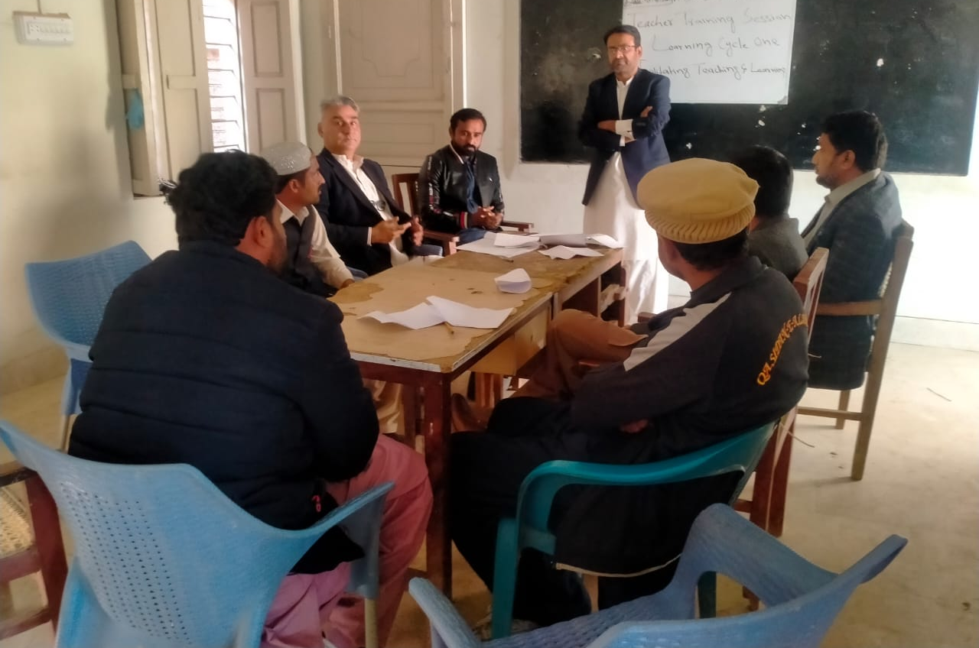
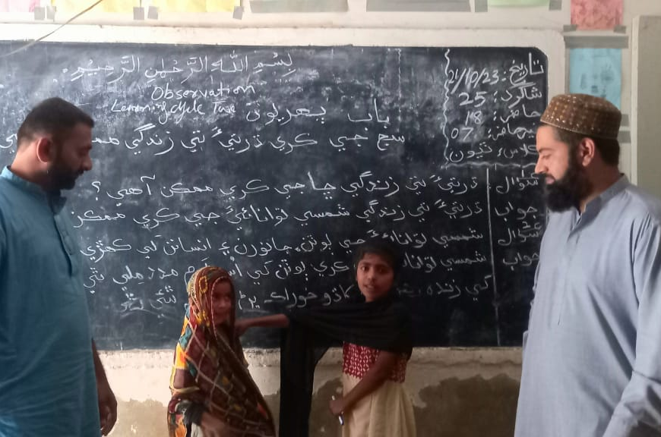
Key Characteristics of CPD Model
Face-to-face interaction with Mentees
Role of Guide Teachers and Subject Coordinators
Monthly training sessions at Cluster/Hub School

Slide 4
Processes & Activities with Six Steps of CPD
Identify Student
Learning Needs
(1)
CPD Evaluation
(6)
Identify Teachers
Needs
(2)
Improved
Achievement
On-going Support
(5)
Identify CPD
Targets
(3)
Design and
Implement CPD
(4)

Slide 5
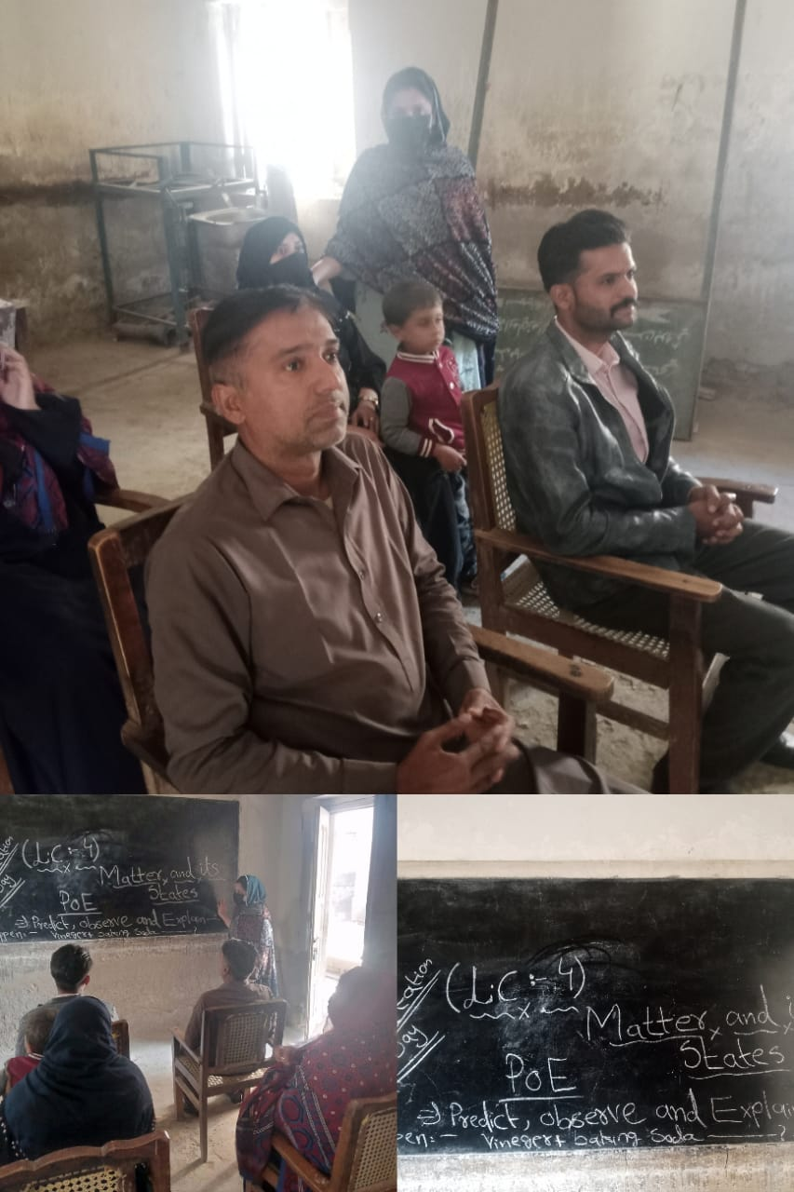
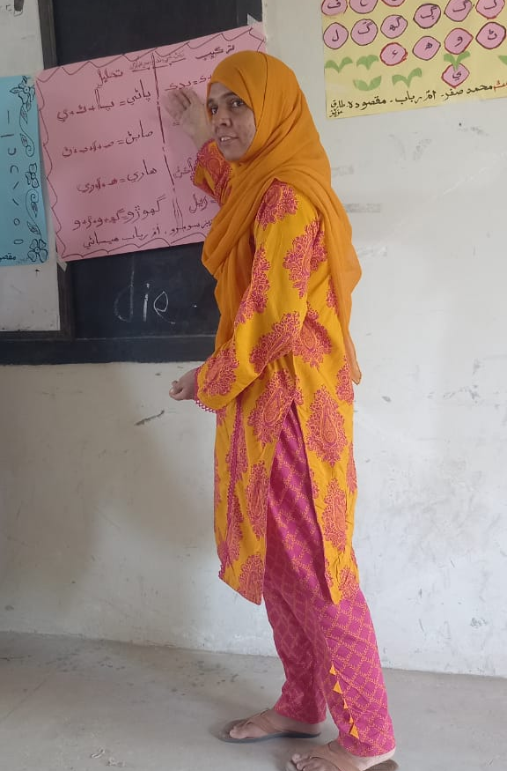
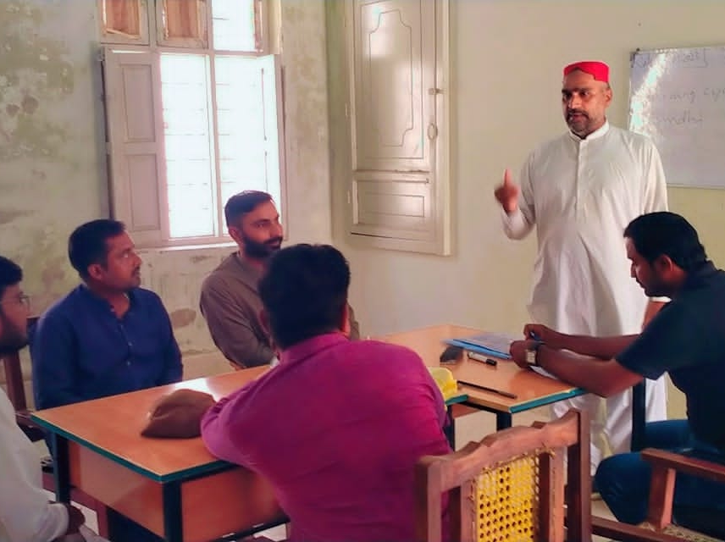
Peer Coaching and Collaboration
Subject Coordinators as peer coaches
Role in mentoring, facilitating training, and leading reflective sessions
Monthly training sessions for Guide Teachers and Subject Coordinators
Collaboration between Guide Teachers and Subject Coordinators
Importance of collaborative learning among teachers

Slide 6
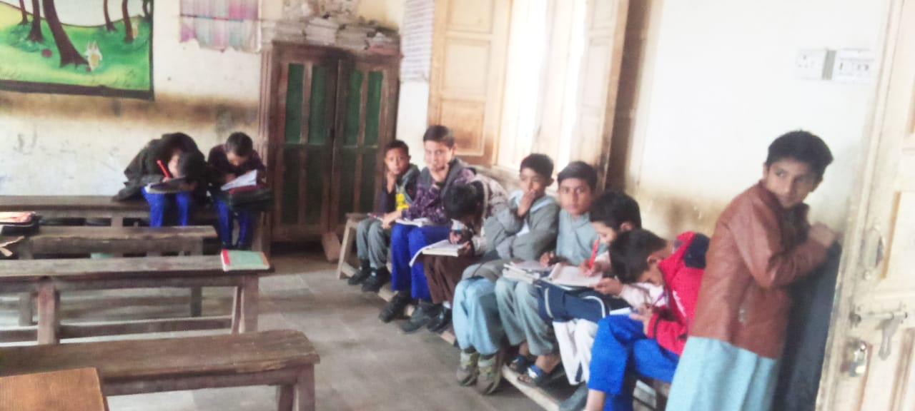
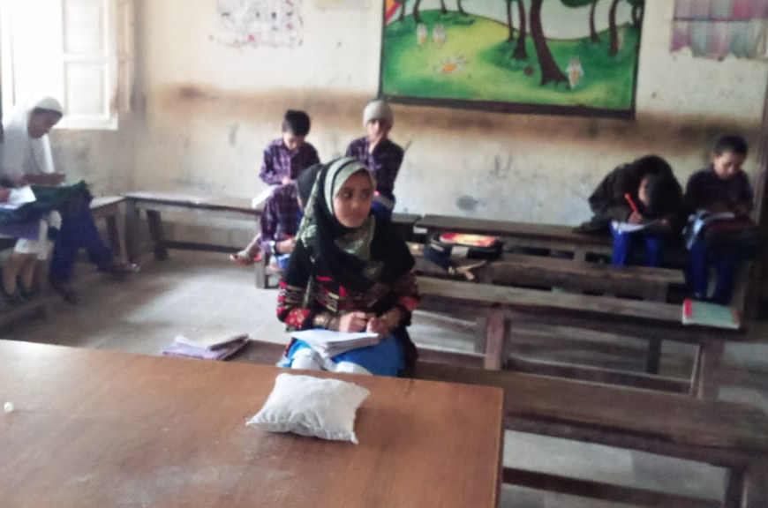
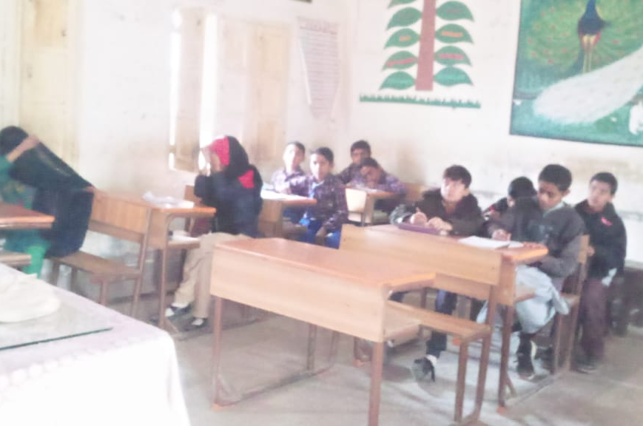
Before CPD Model
Challenges faced by teachers and students pre-CPD
No visual presented to children
Lack of systematic improvement in teaching practices
Impact on student learning outcomes

Slide 7
After CPD: Teacher Practices
After
Visual comparison of traditional vs. modern teaching methods
Examples of traditional teaching practices
Implementation of new pedagogical skills
Integration of technology and interactive learning methods
Positive changes in teacher-student interactions
Improved engagement and participation

Slide 8
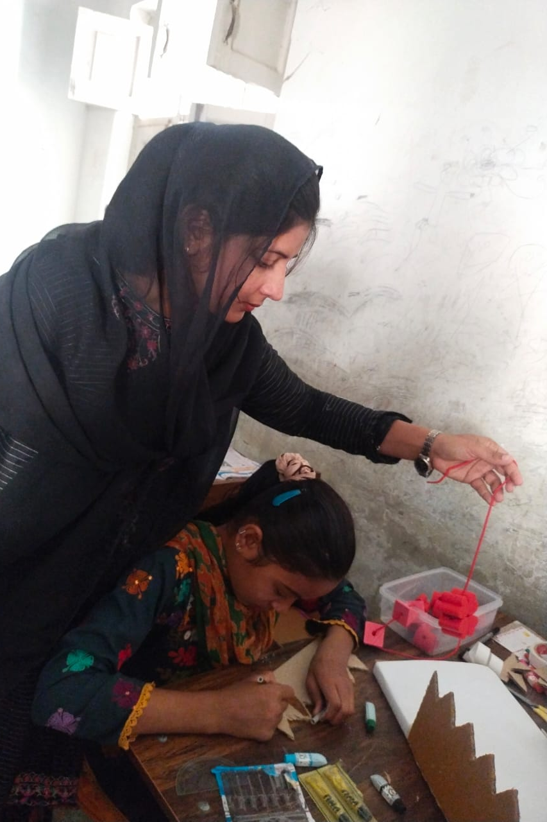
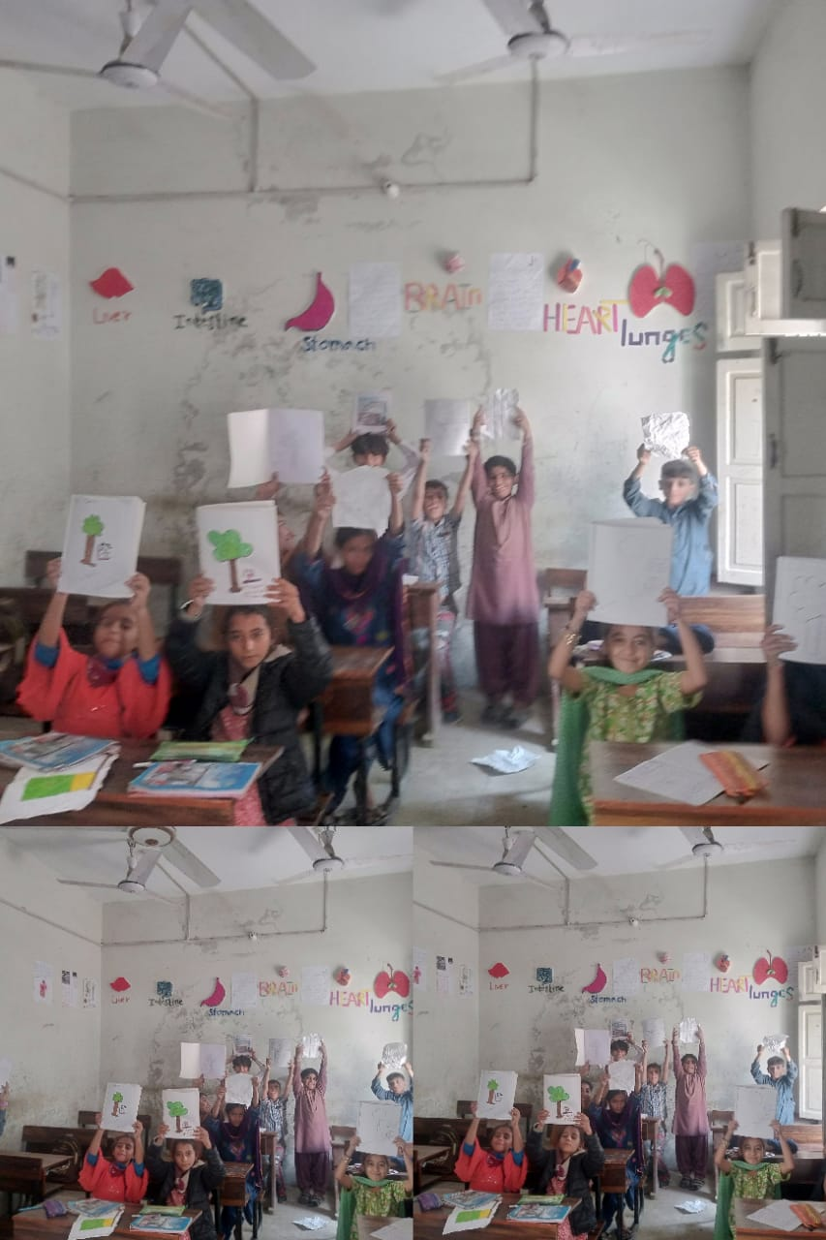
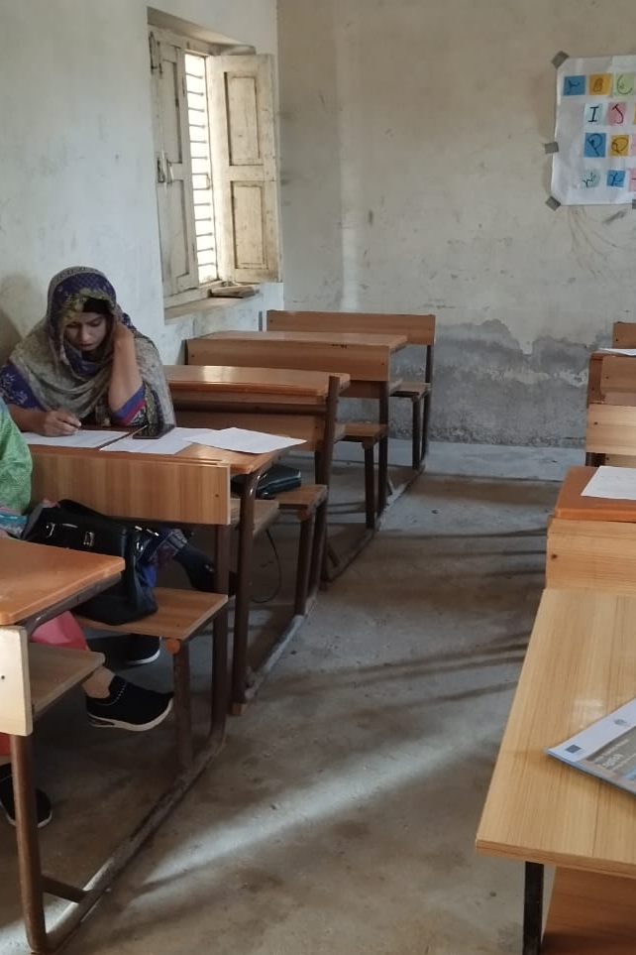
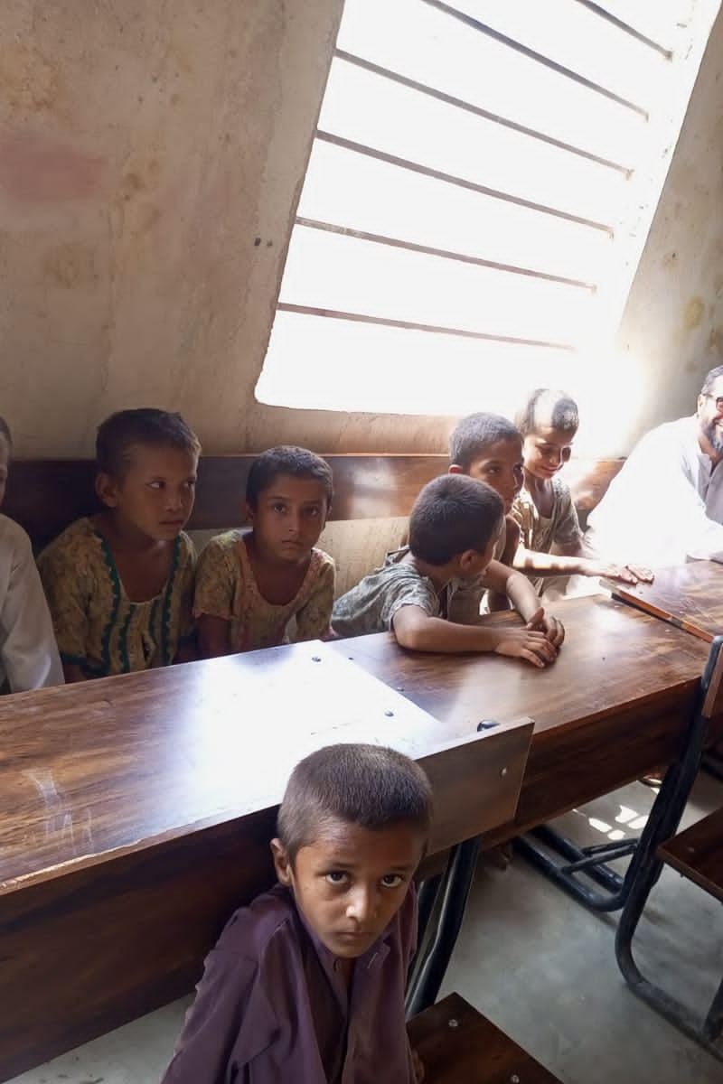
Measuring Impact
Impact on the school learning culture and environment
Importance of teacher self-reflection reports
Classroom observation by Guide Teachers and Subject Coordinators

Slide 9
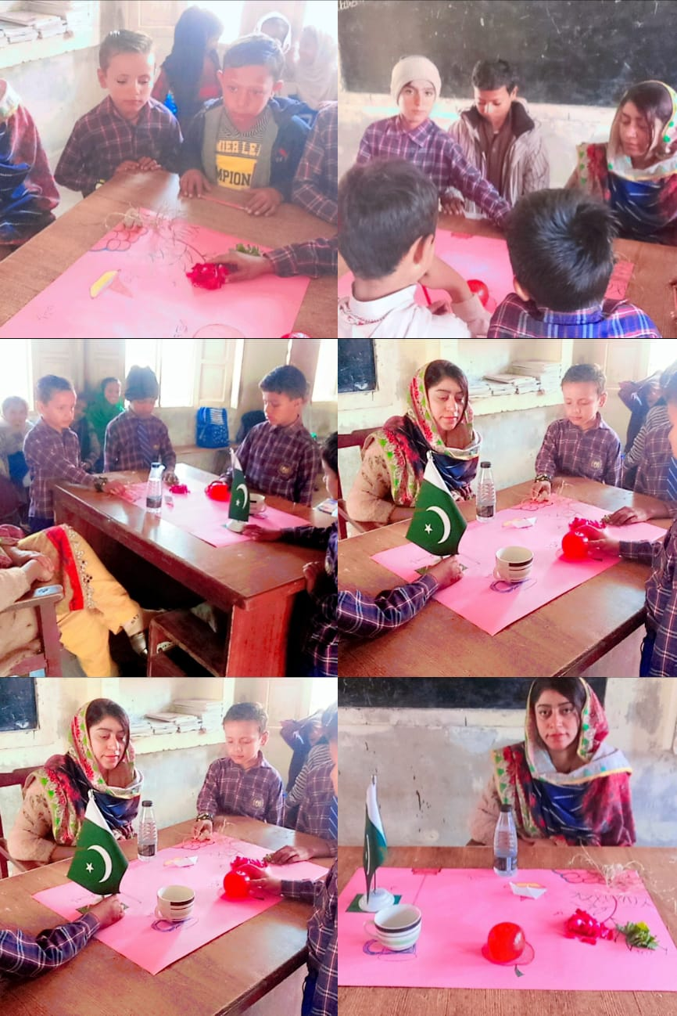
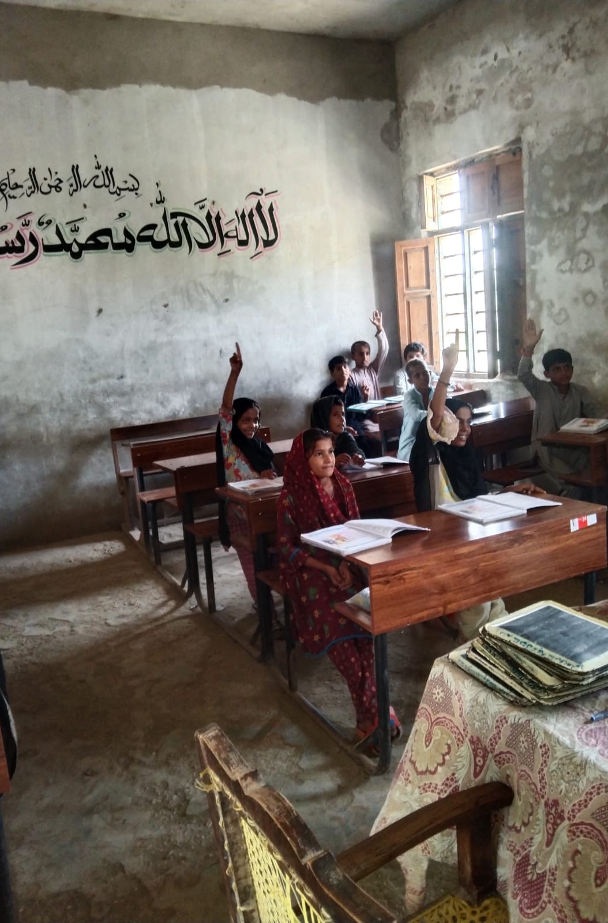
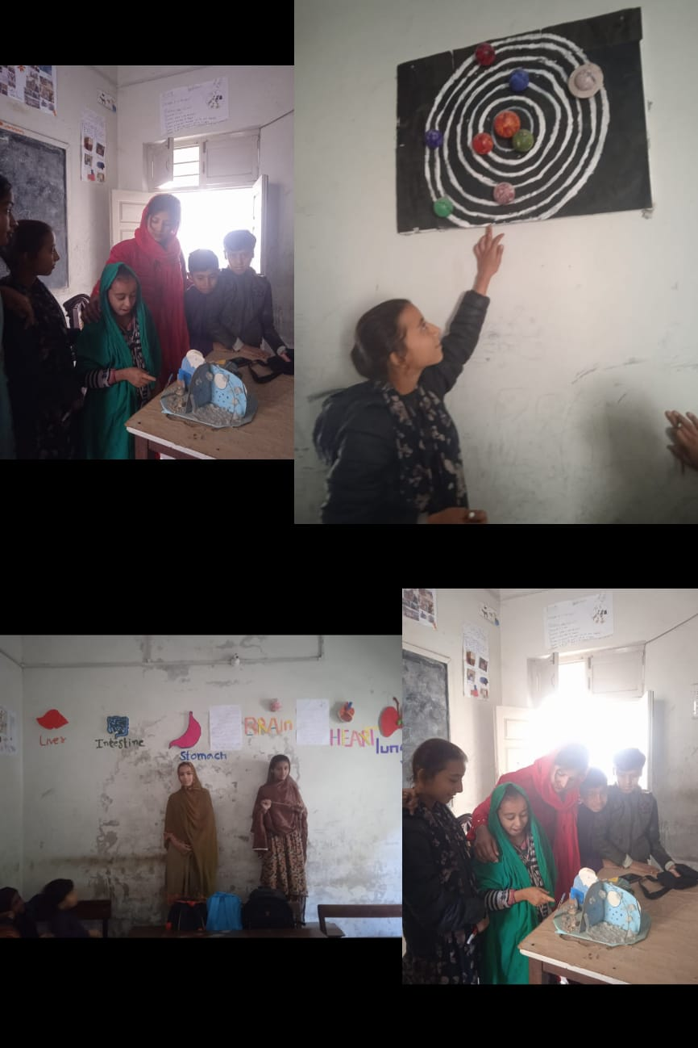
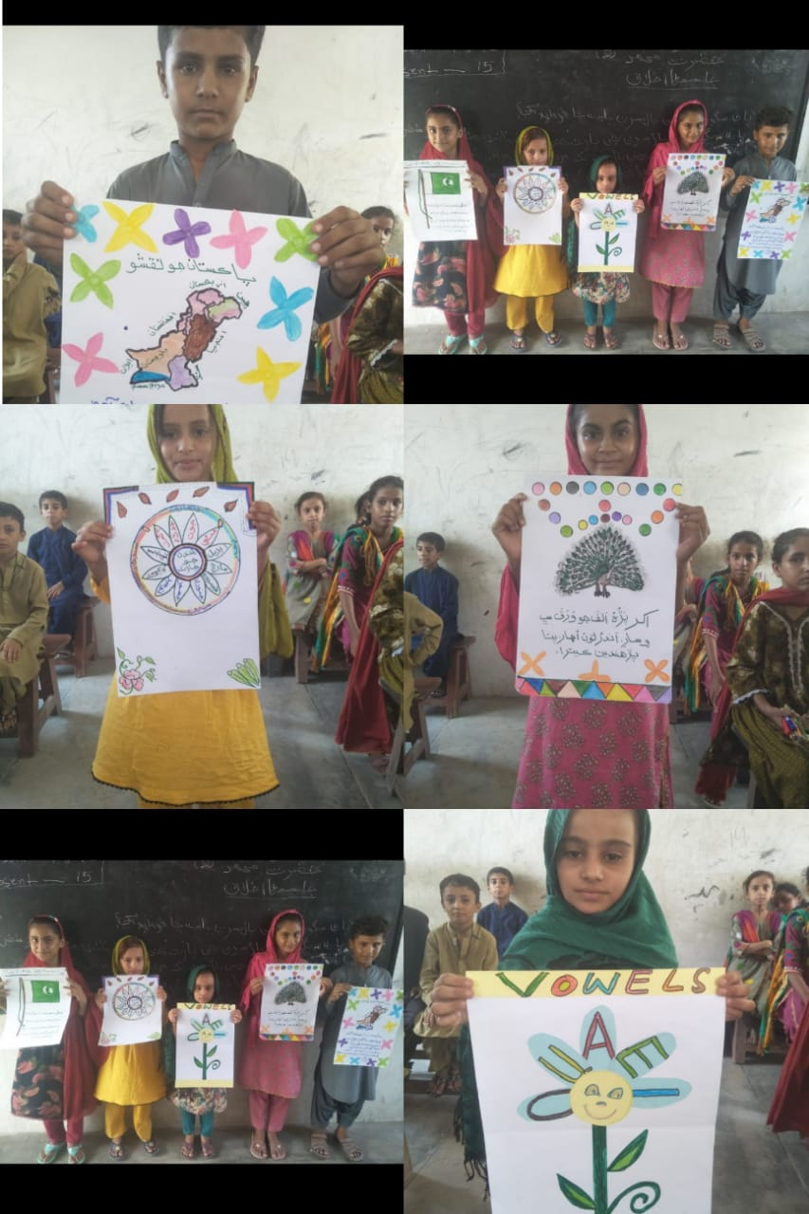
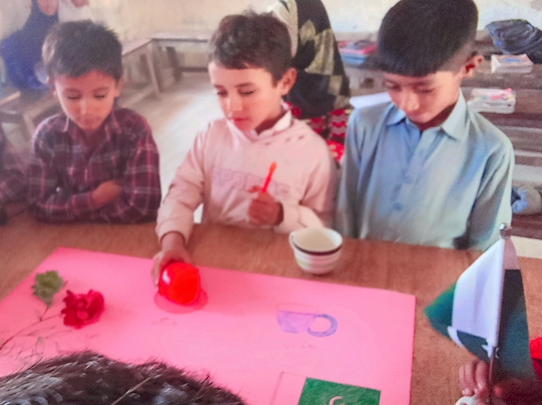
Progress
Measuring tool with five key areas
Student, Teacher, Headteacher, Child-friendly environment, and Guide Teachers/Subject Coordinators
Focus on active and critical learning, and creative learning environment
Importance of collaborative learning among teachers and studnets
Improvement of school culture
Quarterly reviews and discussions at Cluster Hub Schools

Slide 10
Before and After CPD : Classroom Environment
Before
Visual transformation of learning through charts, pictures and different model etc.
Traditional classroom setup vs. modern learning environment
Student participation was negligible
Teacher’s focus on lecture method
Positive impact on student motivation and focus
Supportive and student-friendly atmosphere
After

Slide 11
Success Stories
Specific examples of teacher success stories
Improvement in student outcomes
Mentee
Interview
Impact on teacher confidence and motivation
Recognition of positive changes in teaching practices
Showcase of student achievements and projects

