Slide 1
(UNICEF)
PARTNER
SUKKUR IBA
STA-DEEP PROJECT

Slide 2
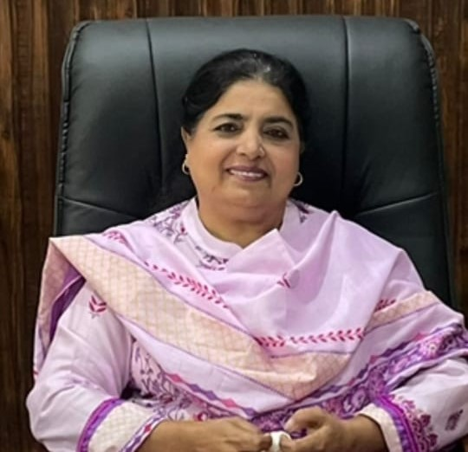
DIRECTOR PITE
MADAM NUSRAT FATIMA KALHORO

Slide 3
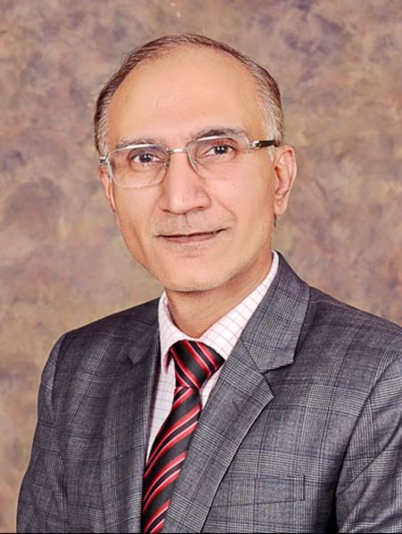
VICE CHANCELLOR
SUKKUR IBA UNIVERSITY
PROF. DR. ASIF AHMED SHAIKH

Slide 4
DISTRICT EDUCATION
OFFICERS
MR. KHALIL AHMED MAHAR
DEO PRIMARY SUKKUR
MR. SYED SAFDAR ALI SHAH
DEO ES&HS SUKKUR

Slide 5
TALUKA EDUCATION
OFFICERS

Slide 6
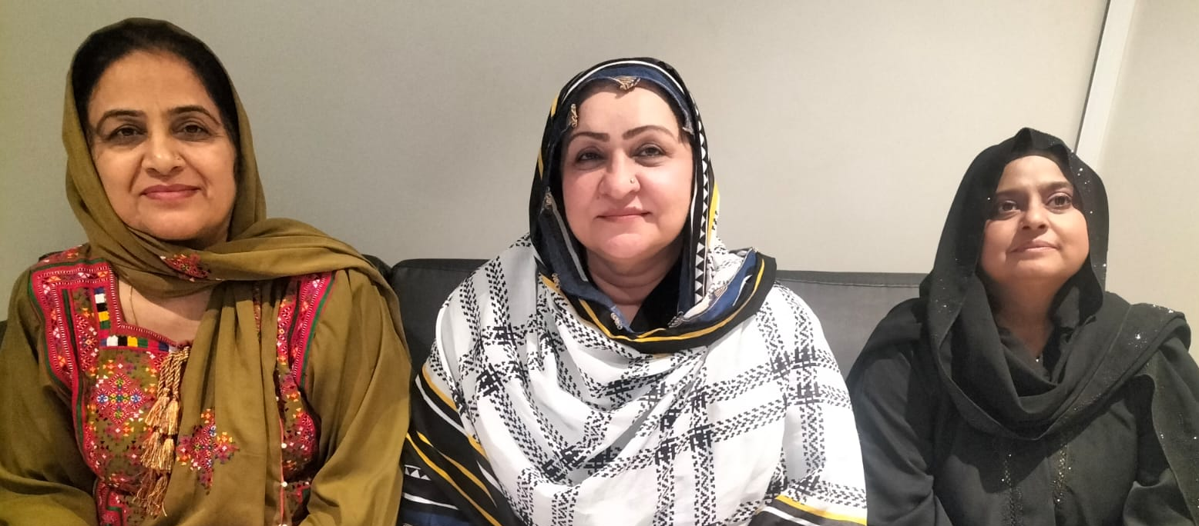
TALUKA EDUCATION
OFFICERS

Slide 7
HEAD CLUSTER
MRS MUNAWAR SULTANA

Slide 8
PROGRAM COORDINATOR
MRS RABIA BATOOL

Slide 9
FOCAL PERSON
MR ZULFIQAR ALI MIRANI

Slide 10
HUB CLUSTER
GOVT (GIRLS) HIGHER
SECONDARY SCHOOL ROHRI

Slide 11
PEDAGOGIES

Slide 12
CYCLE NO 1
(FACILITATING TEACHING AND LEARNING)

Slide 13
CYCLE NO 2
MOTIVATING AND ENGAGING

Slide 14
CYCLE NO 3
LEARNING AND ACQUISITION

Slide 15
CYCLE NO 4
ACTIVE LEARNING STRATEGIES

Slide 16
CYCLE NO 5
ASSESSMENT

Slide 17
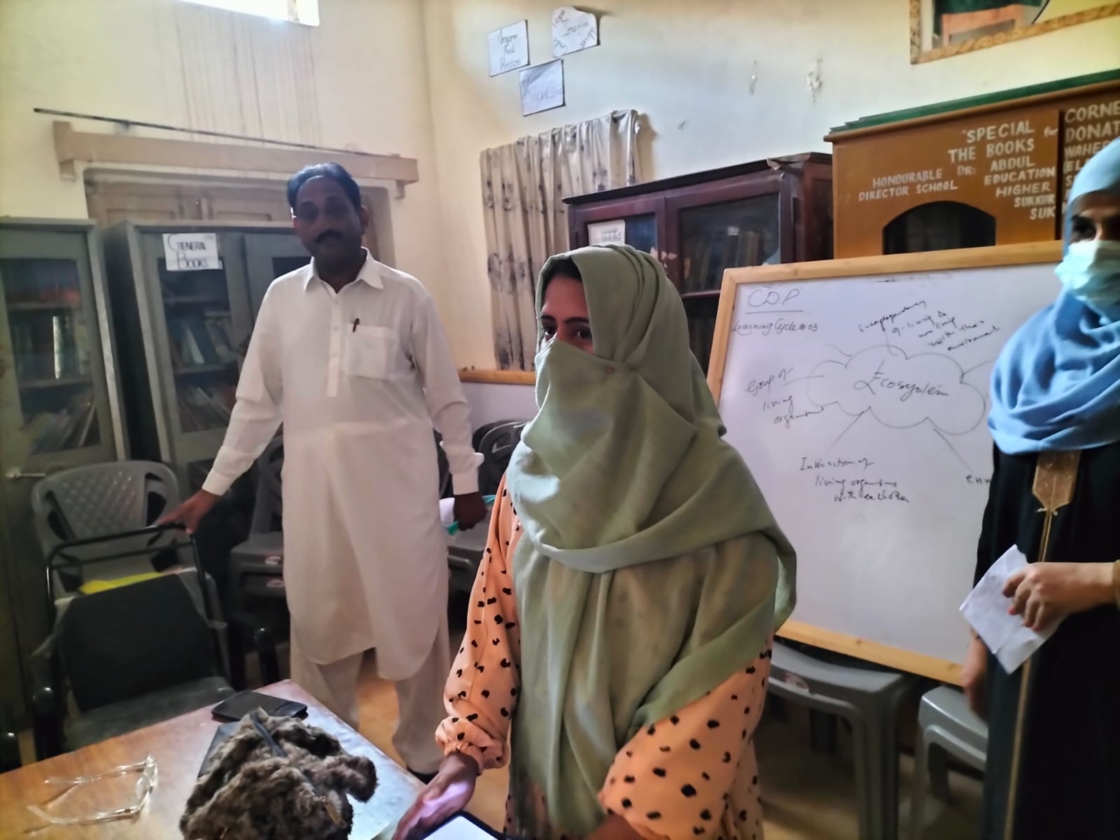

Slide 18
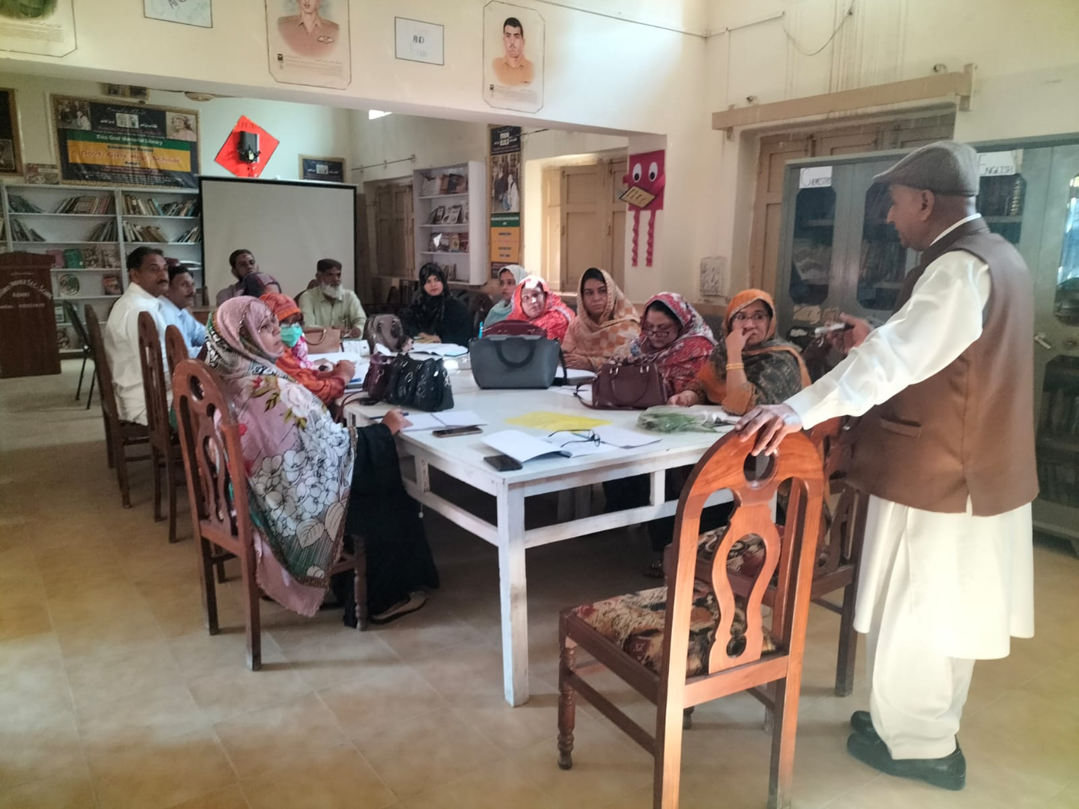

Slide 19
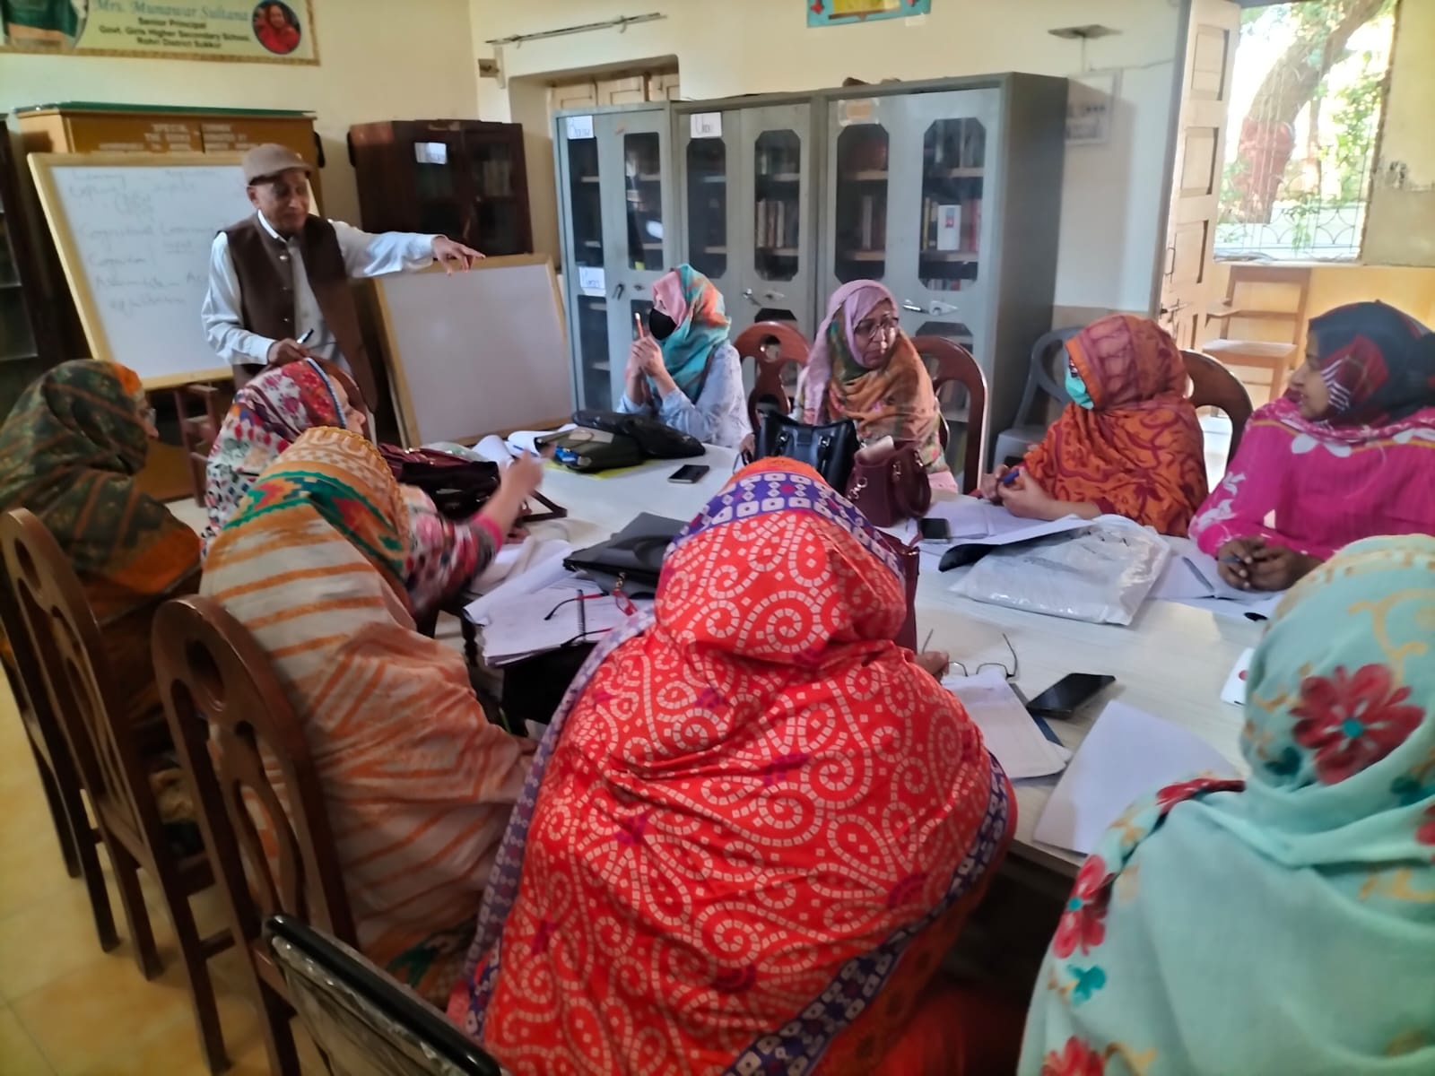

Slide 20
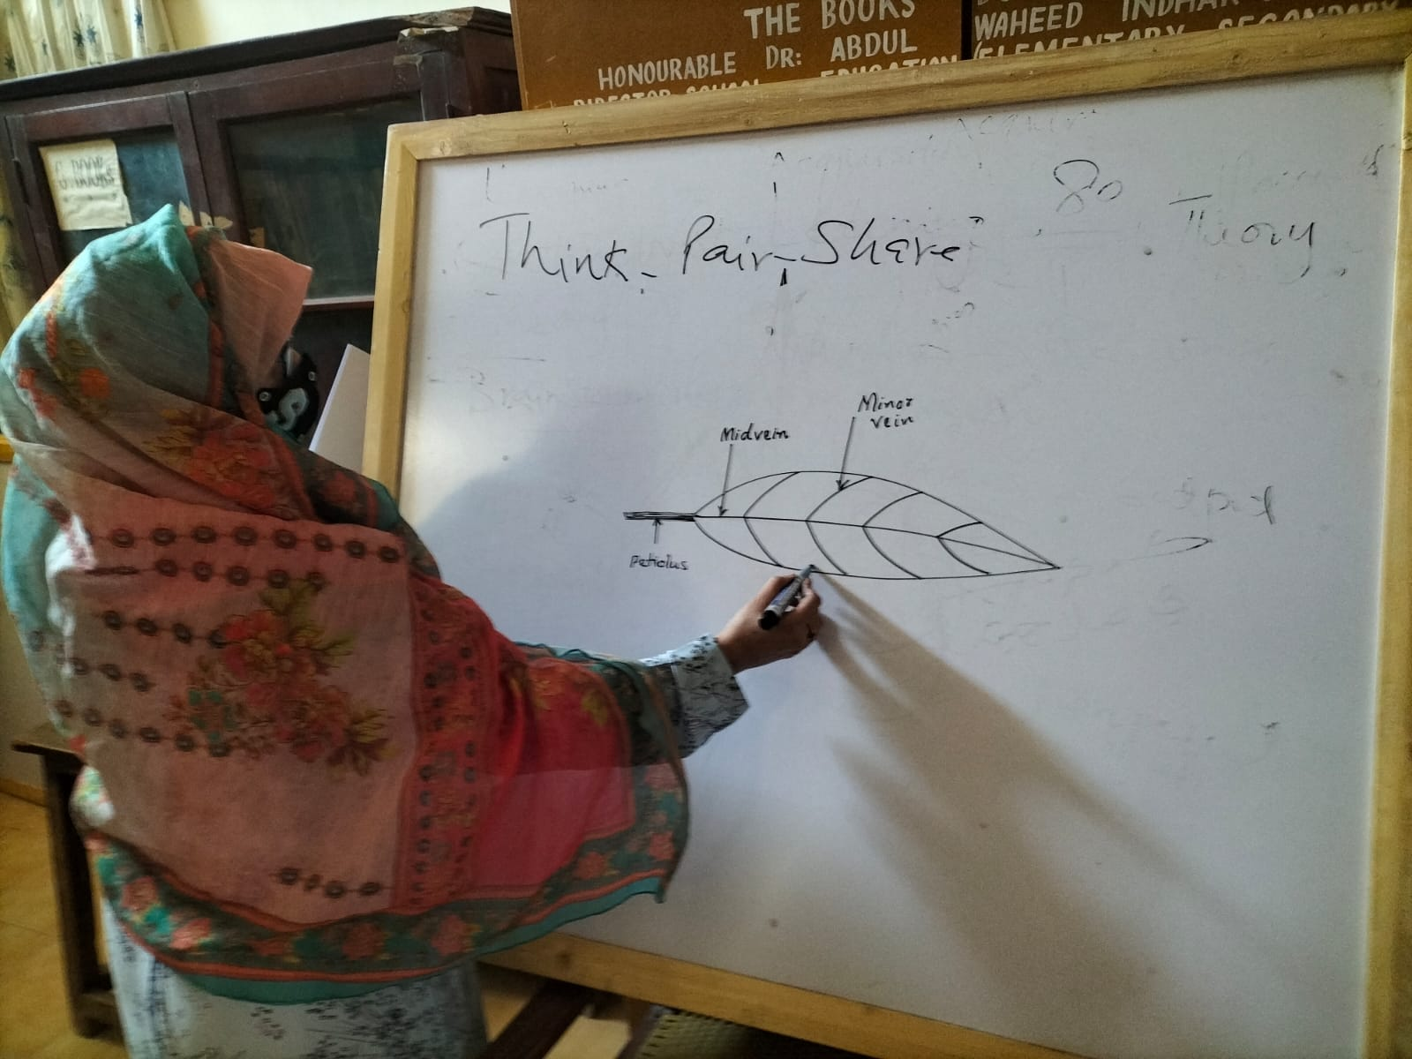

Slide 21
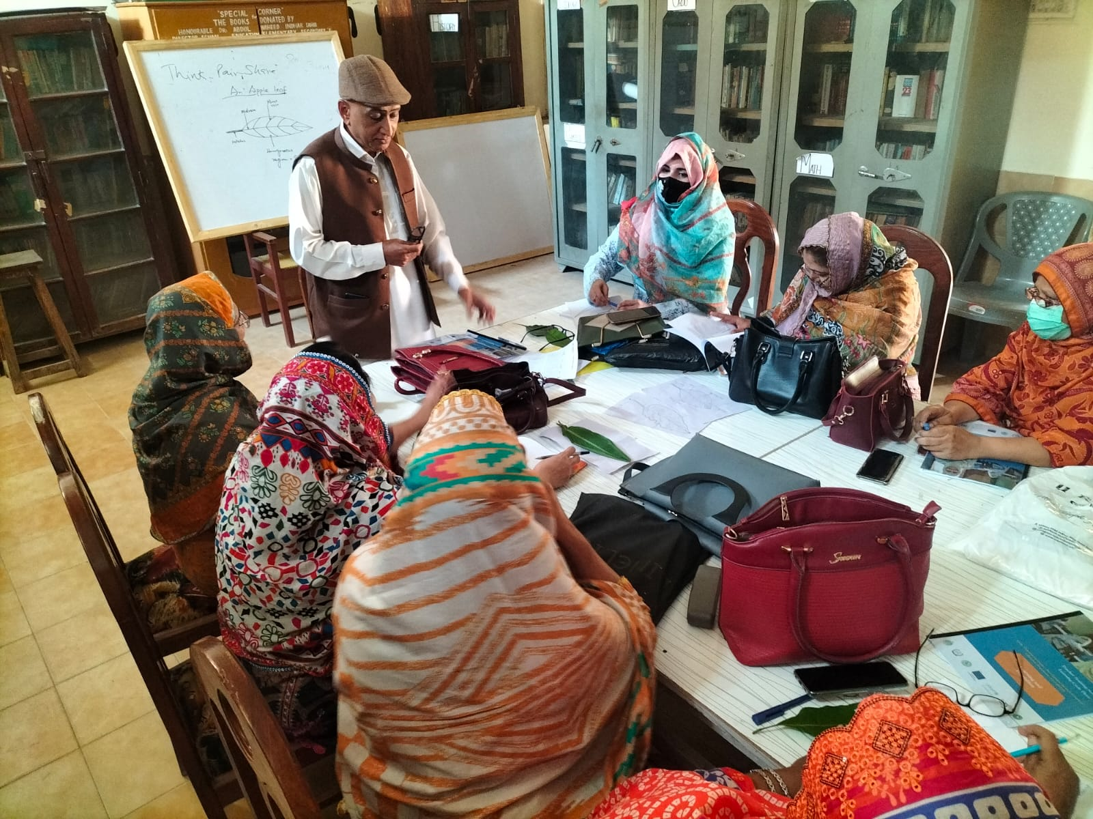

Slide 22
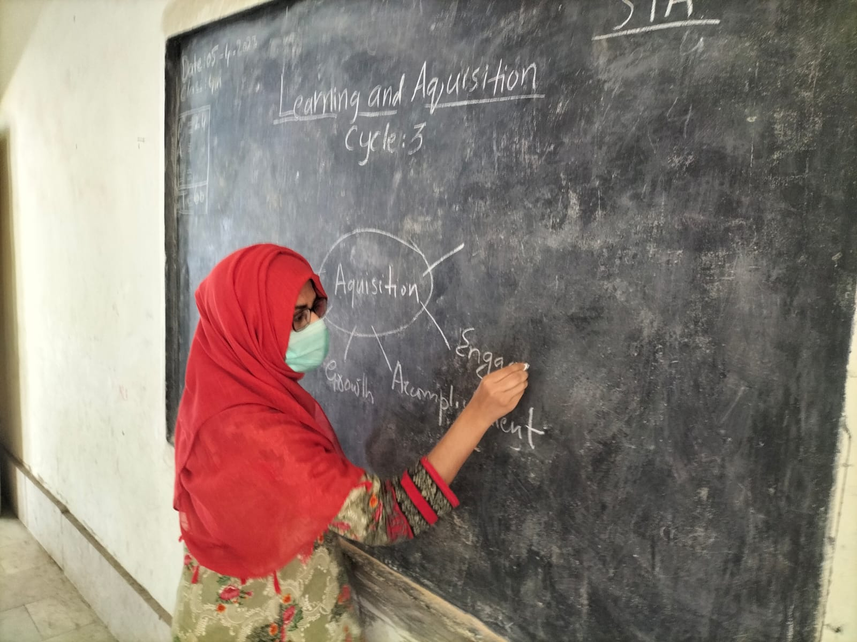

Slide 23
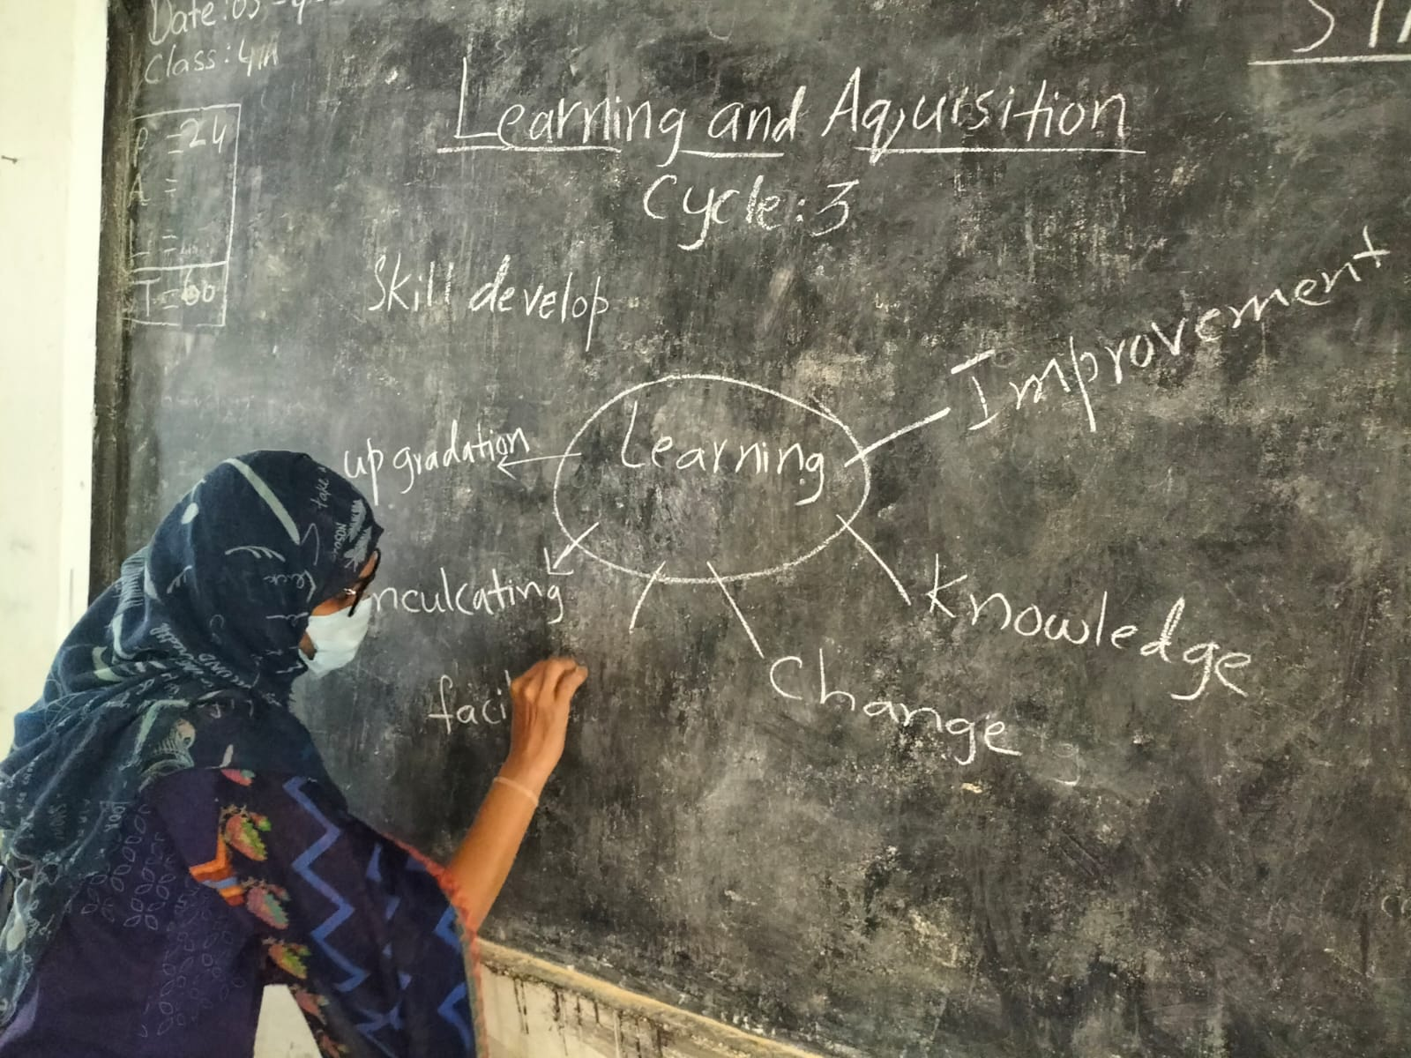

Slide 24
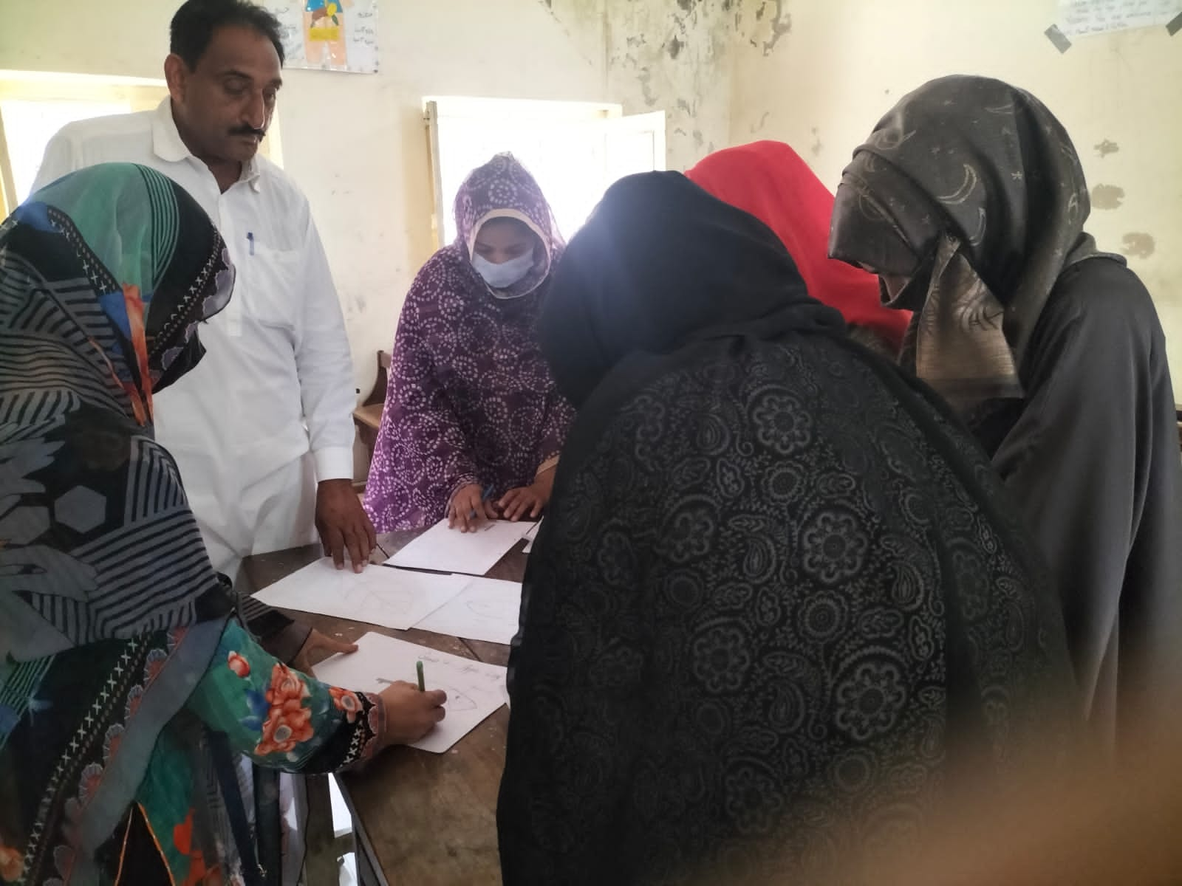

Slide 25
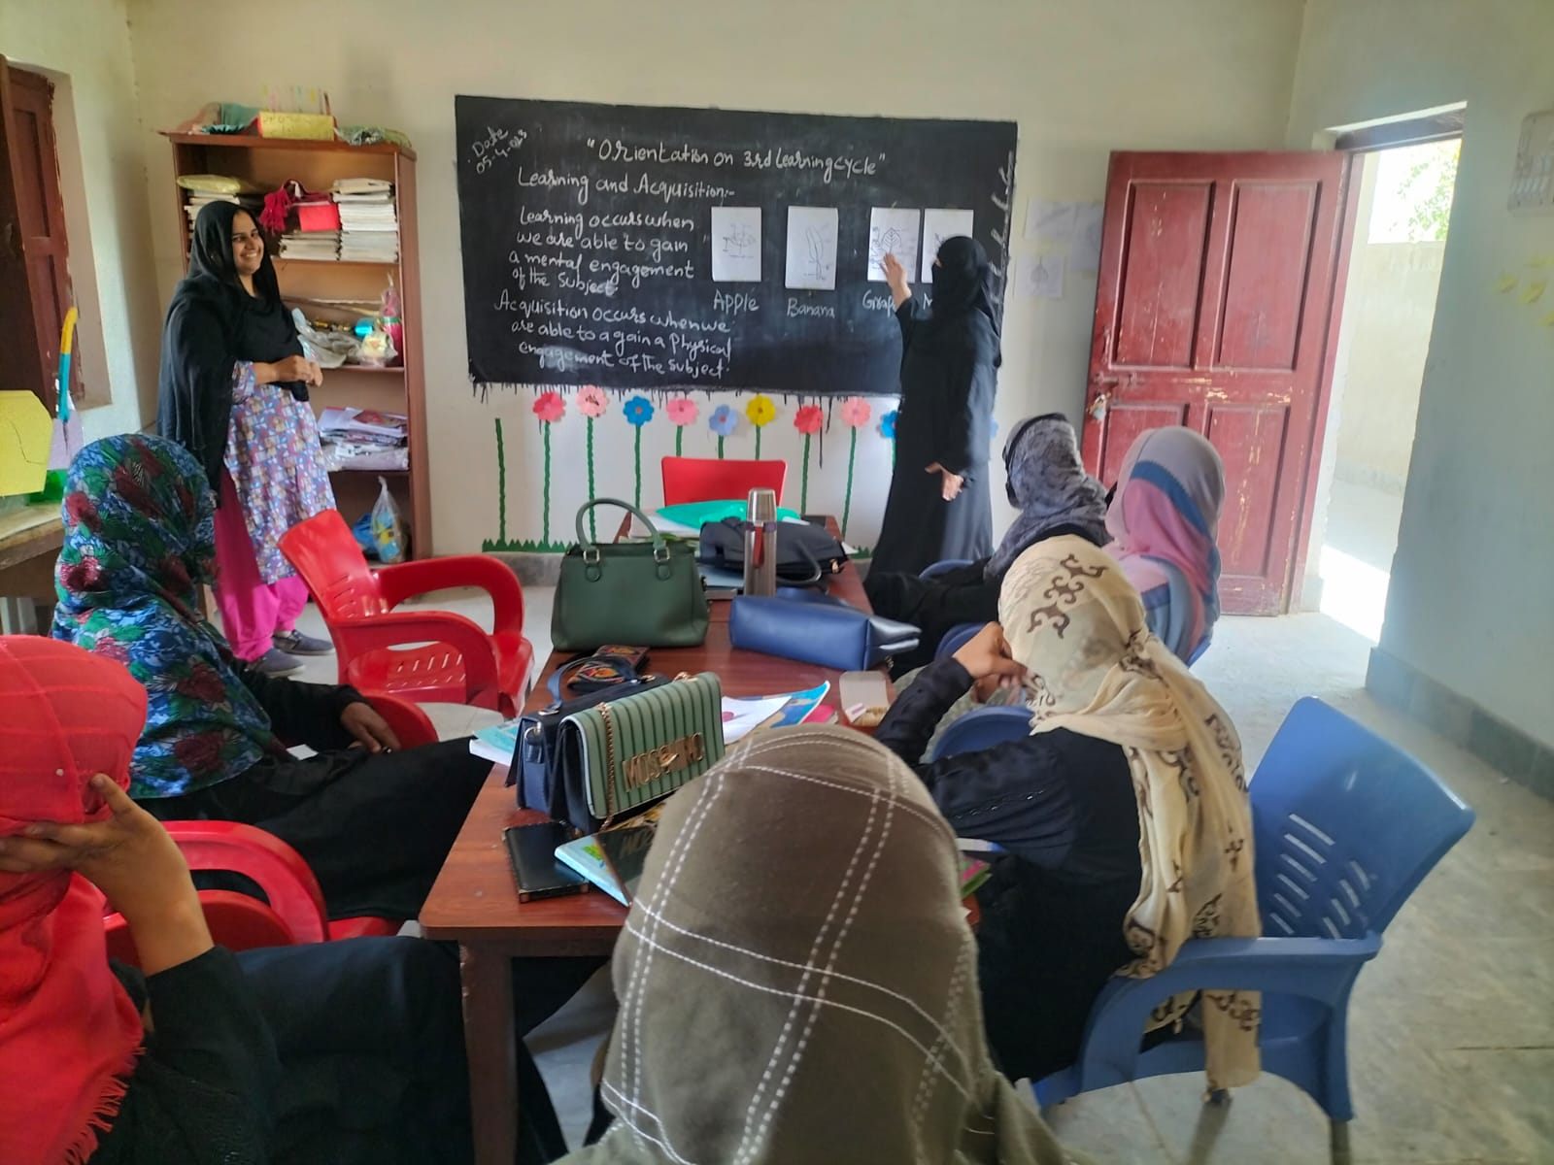

Slide 26
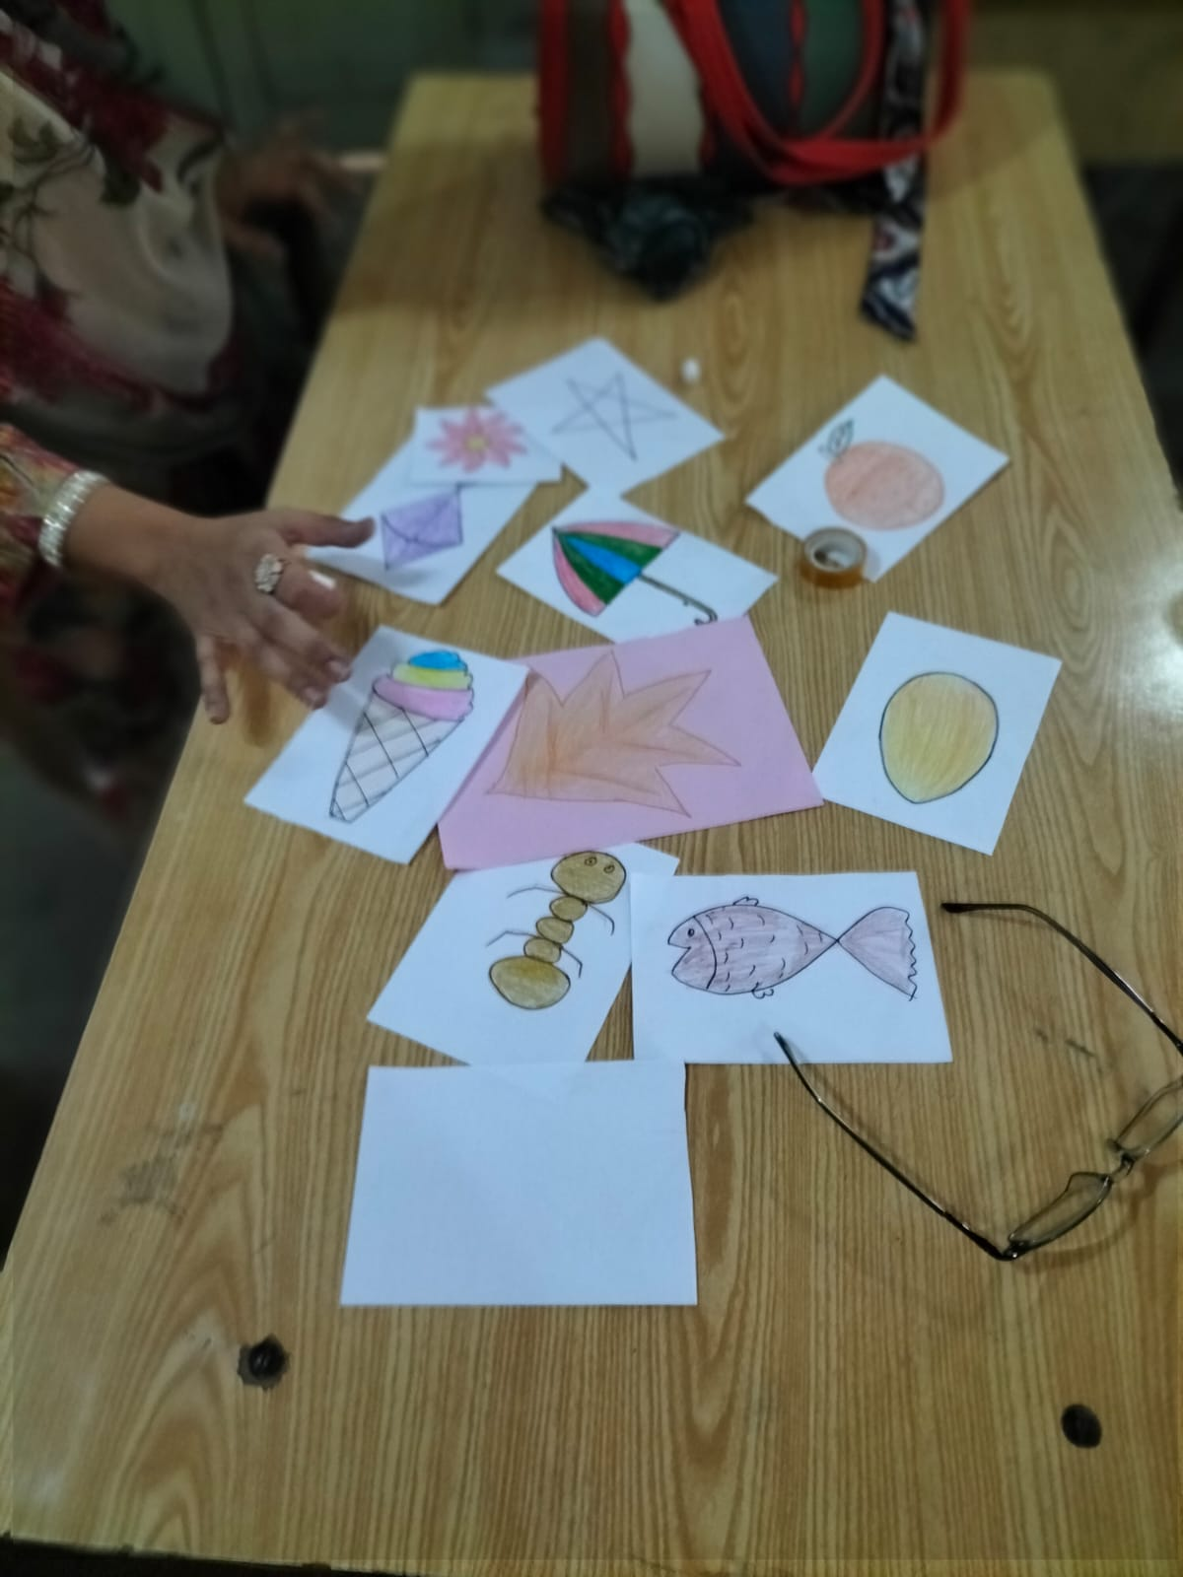
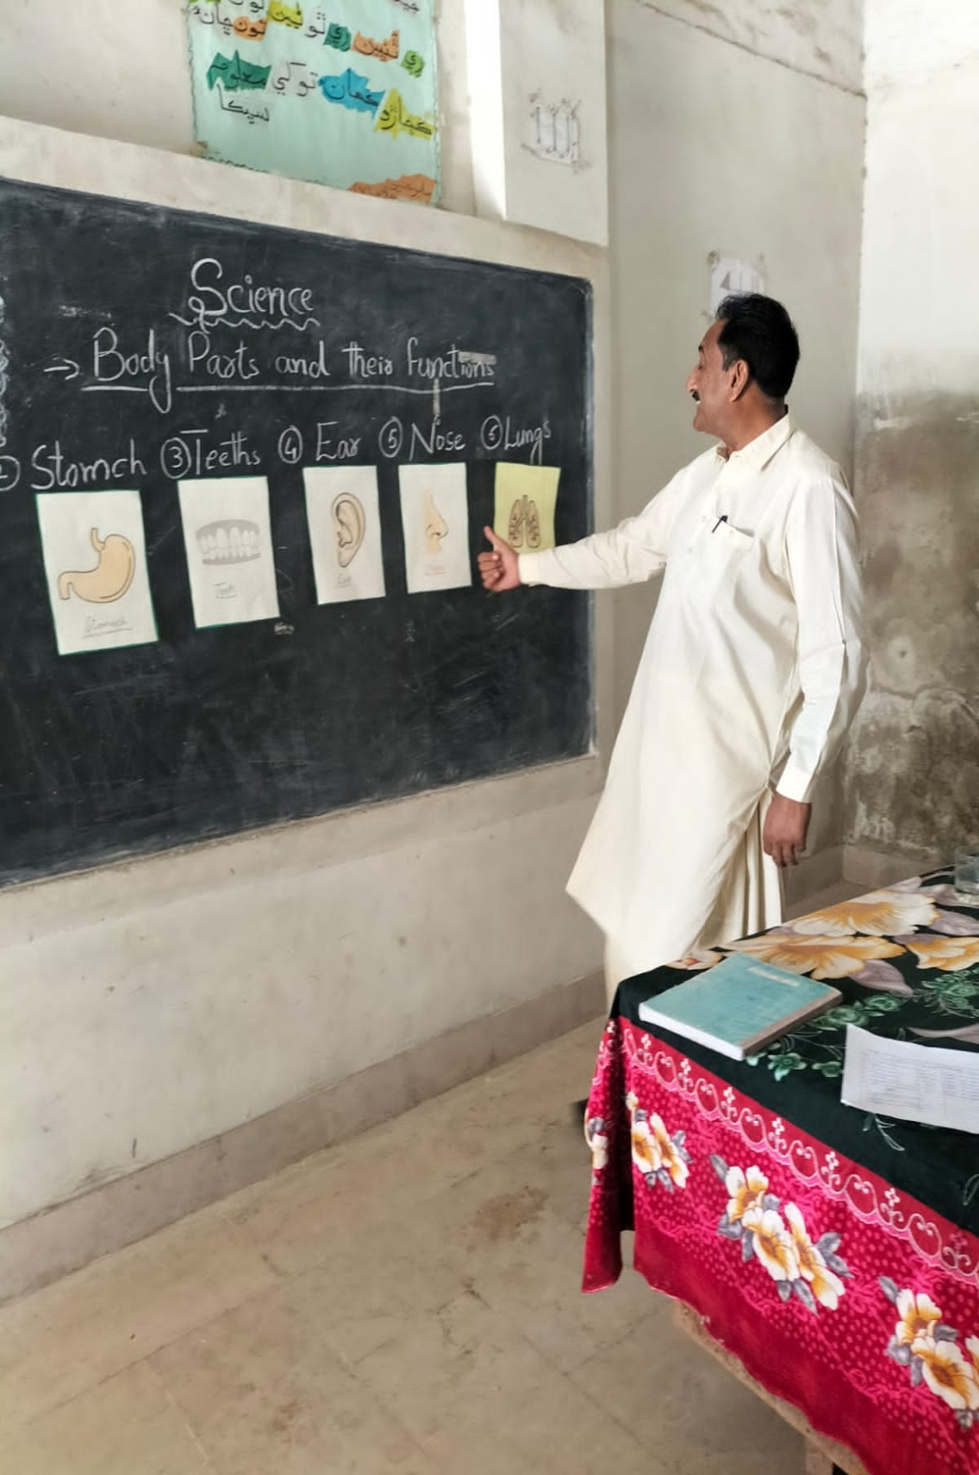

Slide 27
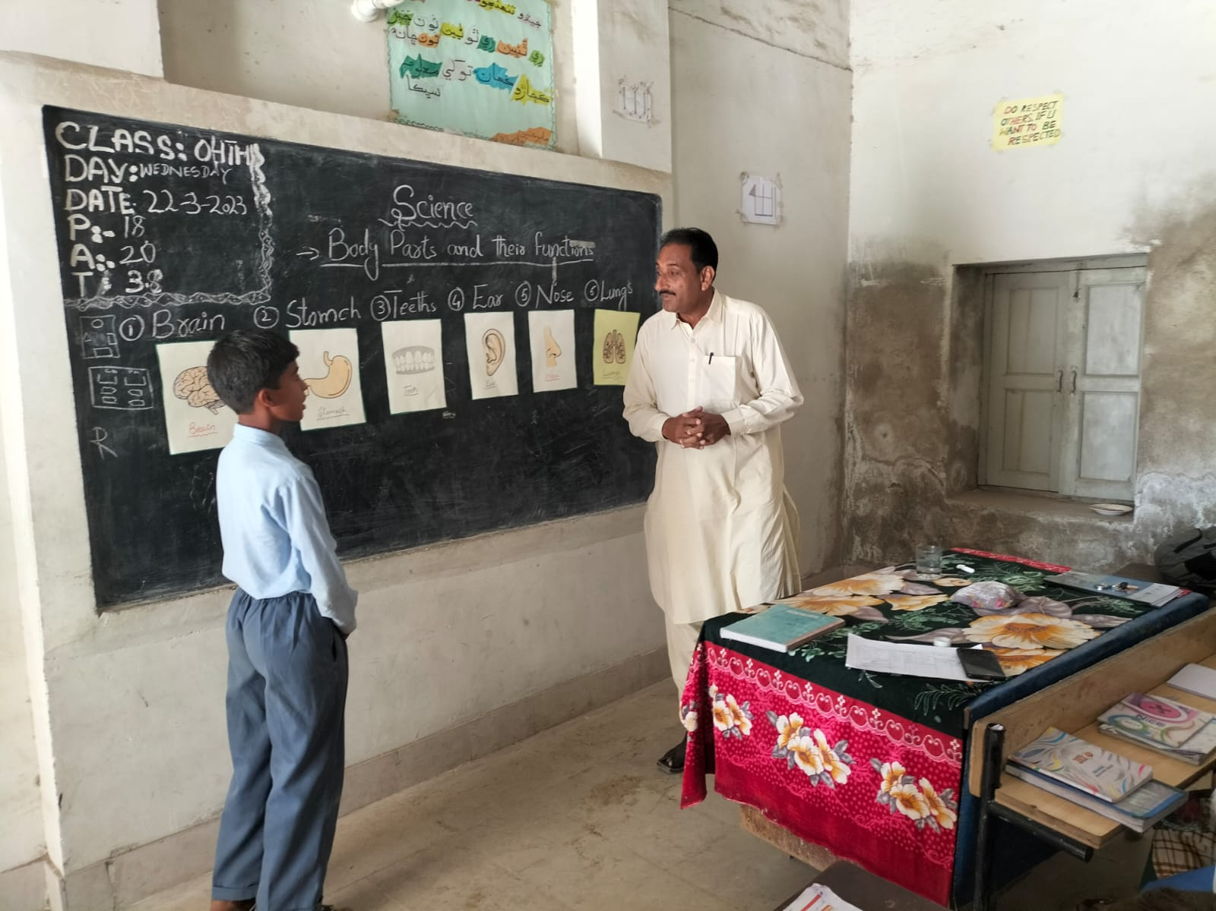

Slide 28
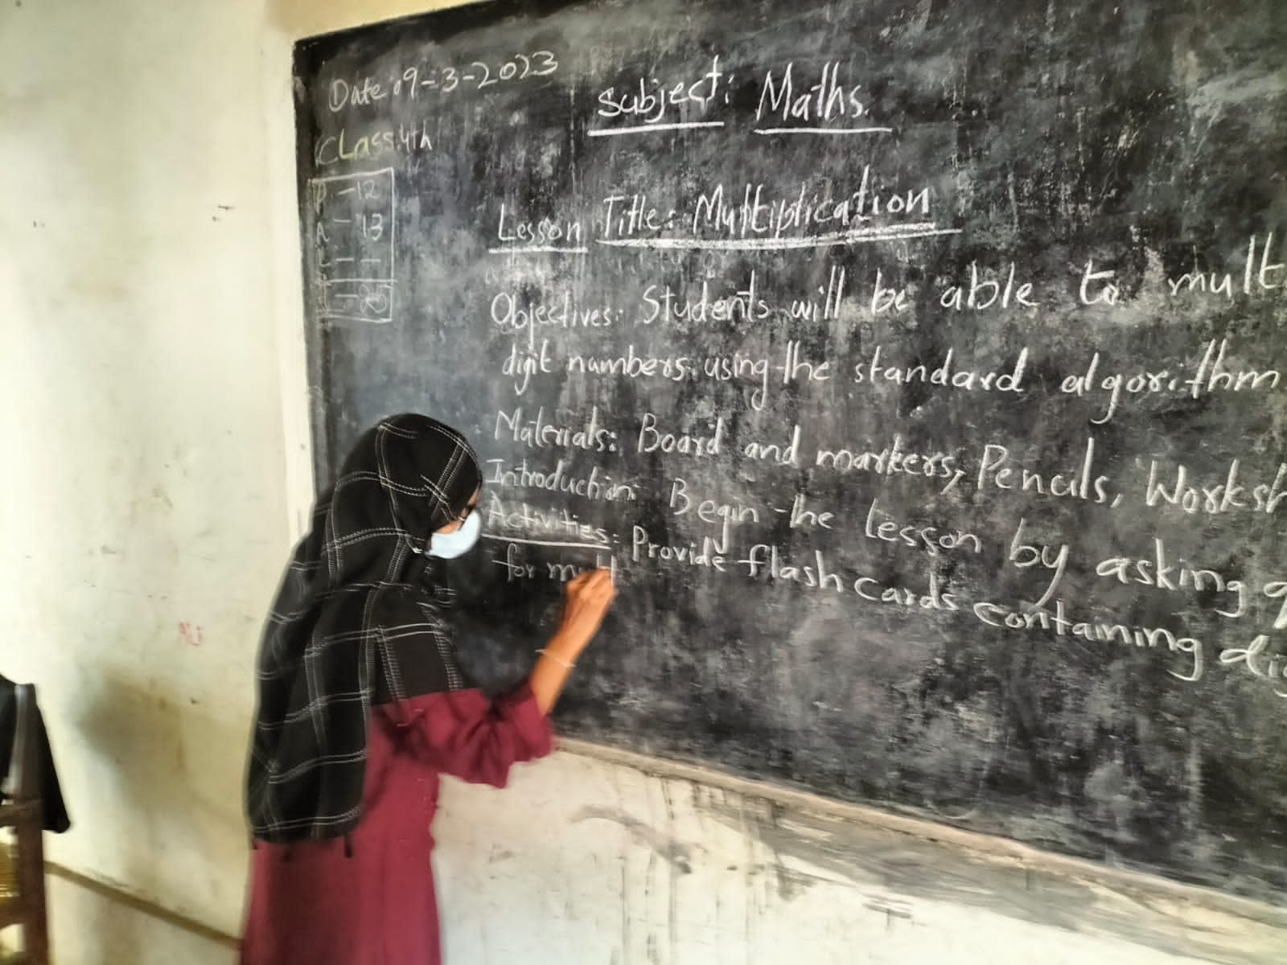

Slide 29
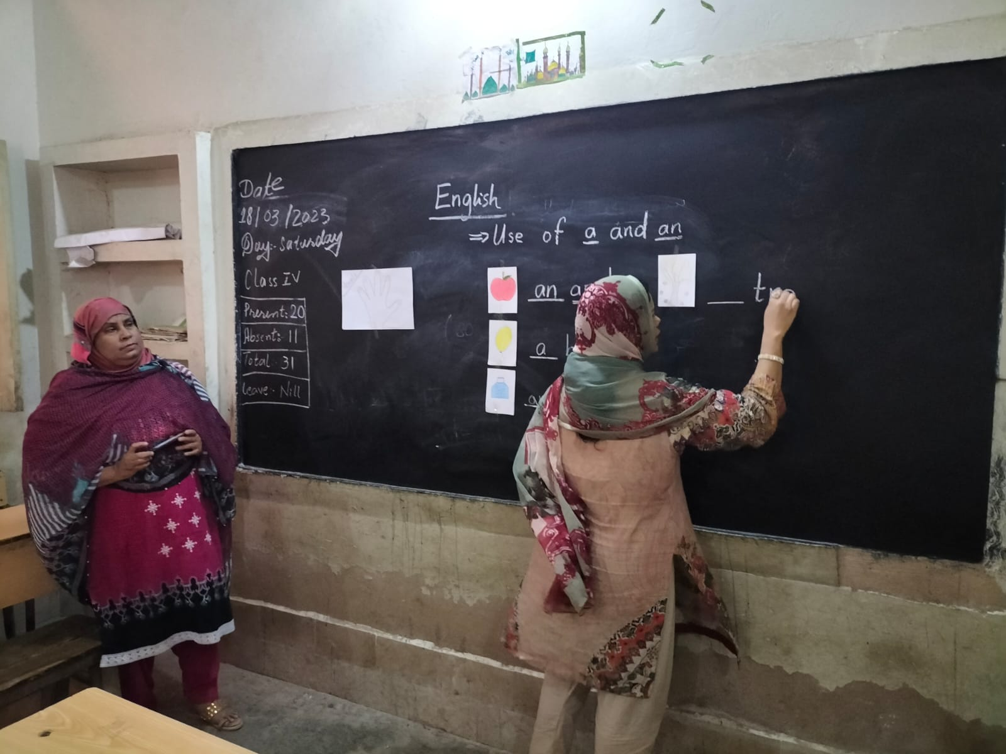

Slide 30
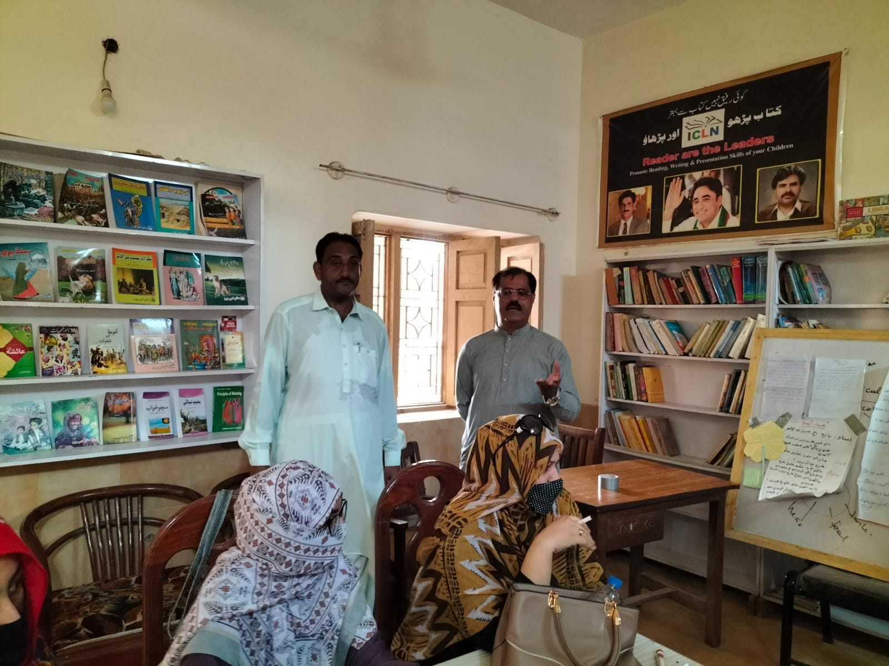

Slide 31
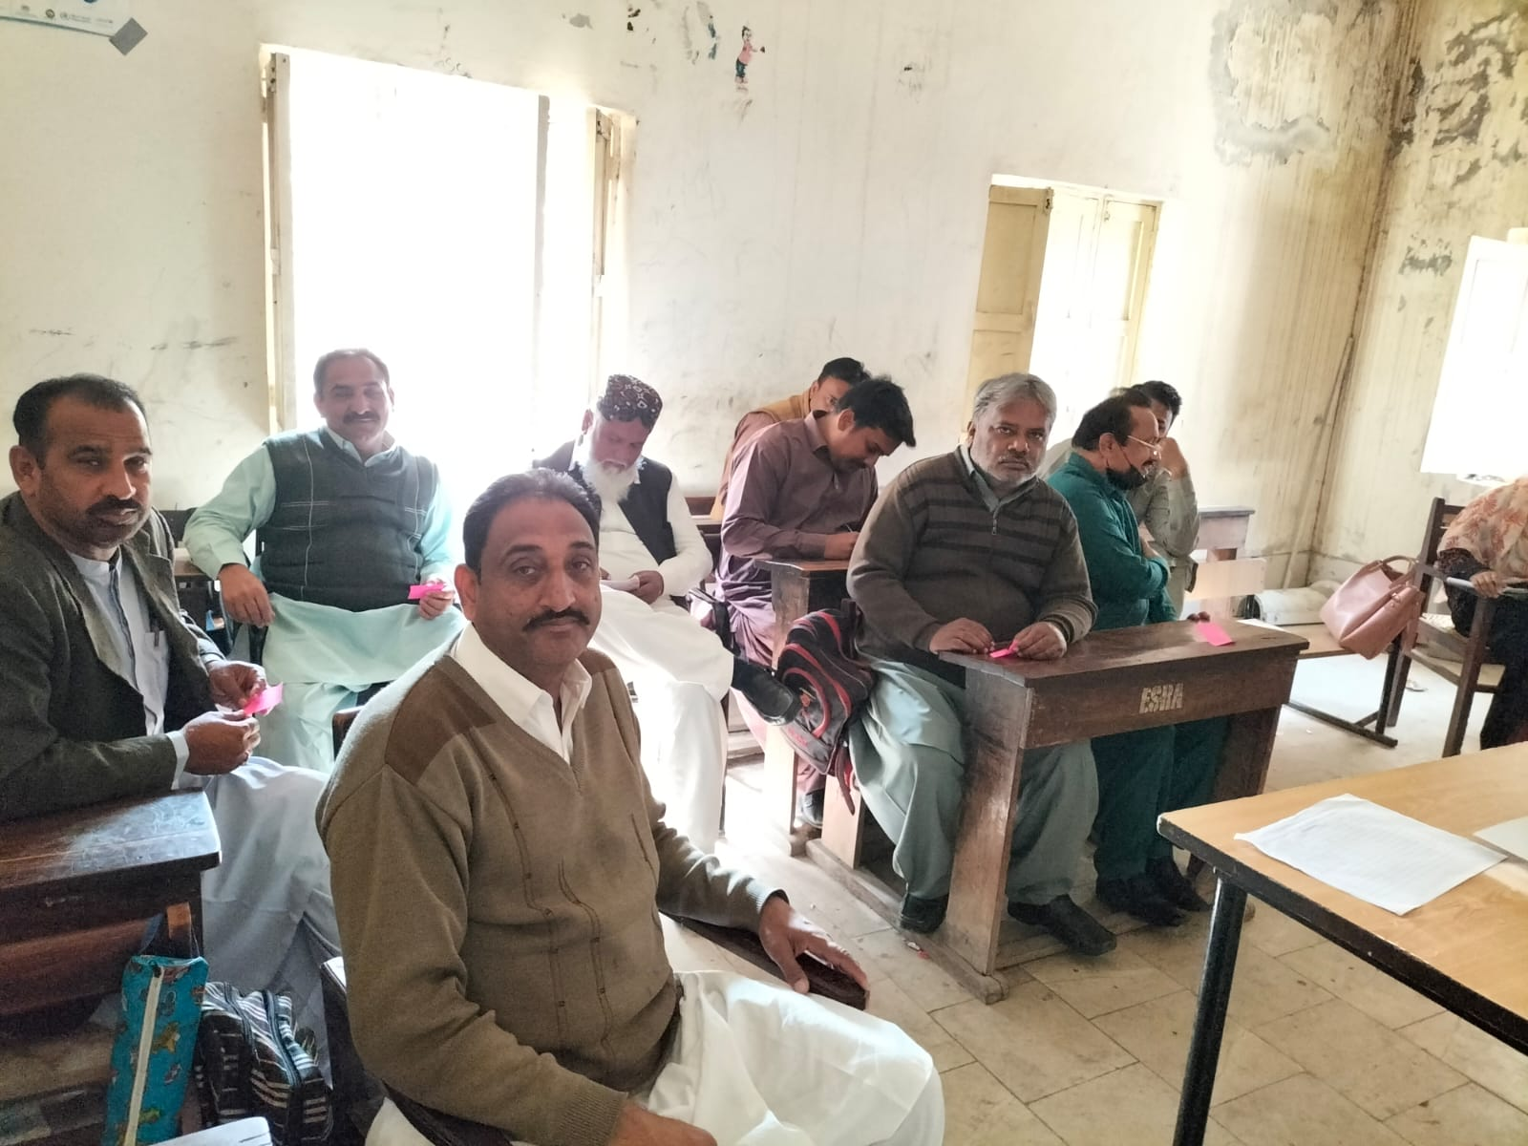

Slide 32
THANKS

