Slide 1
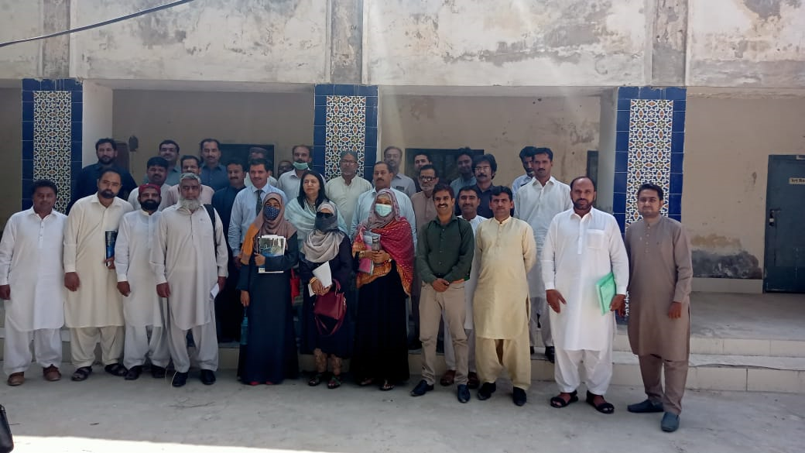
Cpd model
Presenters : Mathematics group From Naz Cluster Hub School Khairpur Mirs’

Slide 2
Content
Introduction (CPD)
CPD Goal
Role of CPD In Educational Development
Core personals of CPD
Content Based Knowledge (Learning Cycles-Phase II)
Challenges
Strengths
Successful Efforts
End Note/ Conclusion
Glimps at a Galance

Slide 3
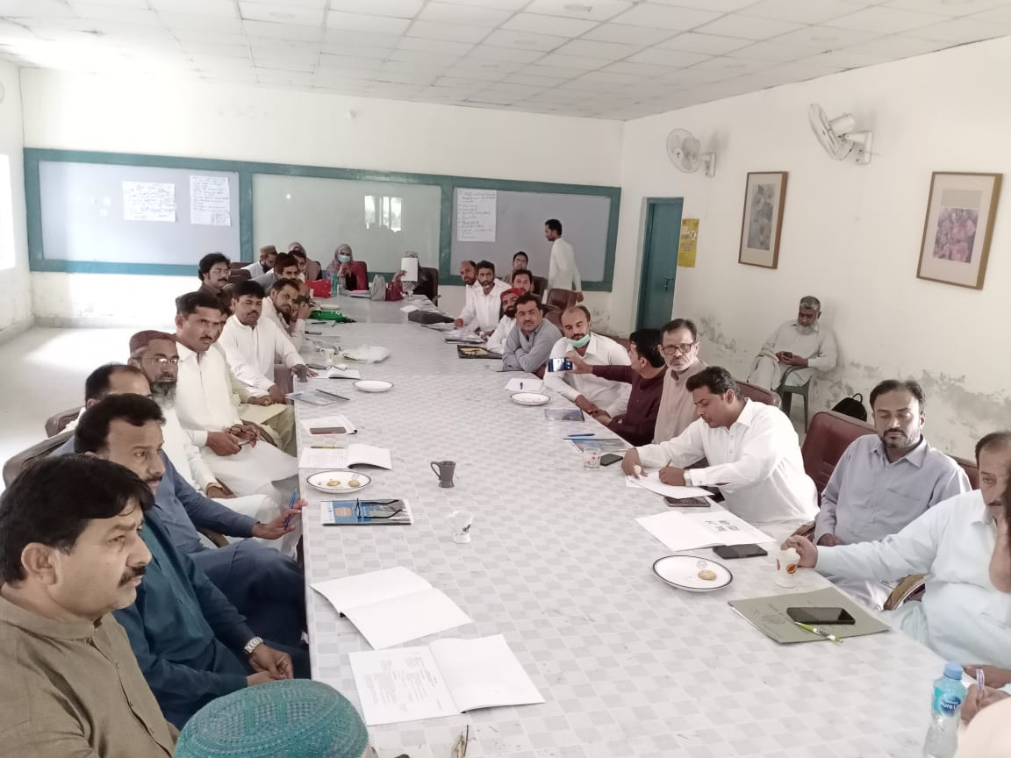
1.INTRODUCTION (CPD)
The CPD Model is based on a cluster-cum-school approach. The CPD model was developed to complement the school Clustering policy to Improve students’ learning achievements in Sindh through the systematic improvement of teacher pedagogical practices and subject matter knowledge.

Slide 4
2.CPD Goal
The goals of CPD model are to improve students’ learning outcomes by involving improvements in teachers’ professional development skills.

Slide 5
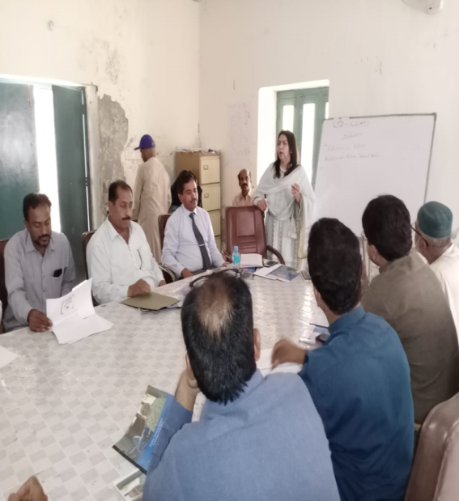
3. ROLE OF CPD IN EDUCATIONAL DEVELOPMENT
CPD increases teacher motivation, confidence, and commitment to teaching.
Learning new skills and applying them in the classroom
Leading to a more effective teaching environment.

Slide 6
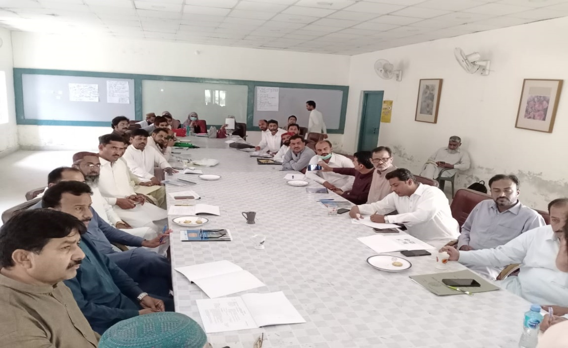
Continu…
Allows teachers (and other teaching staff) to stay up to date with their specialism and develop professionally.
To enhance the work performance of educators in the classroom and increase learners' academic achievement.

Slide 7
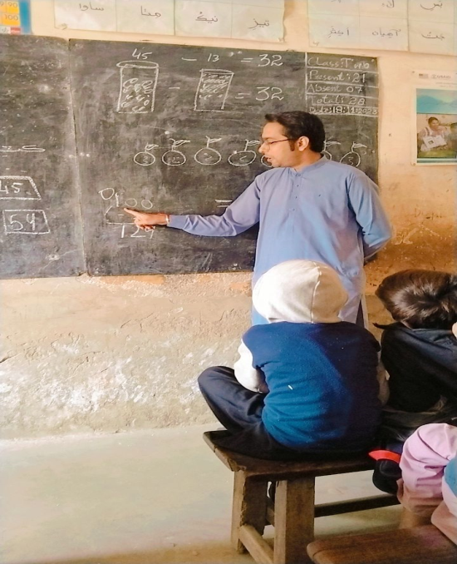
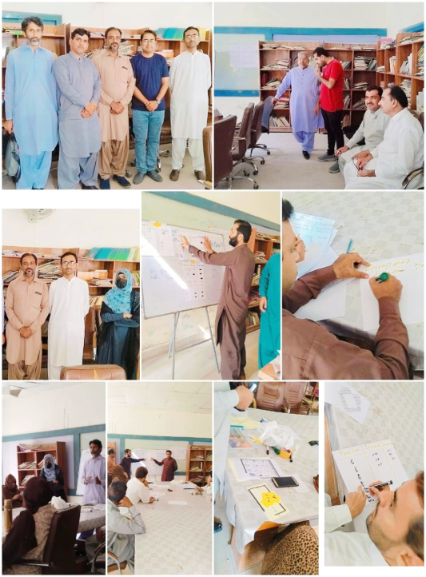
4.Core personals OF cpd model
GUIDE TEACHER
Conduct trainings of SCs at cluster level.
Visit schools for CPD supervision and facilitation.
Conduct a meeting of SCs on the last day of each month to discuss main problems and their solutions.
Visit at least 2-3 schools to have direct observation of teaching learning activities.

Slide 8
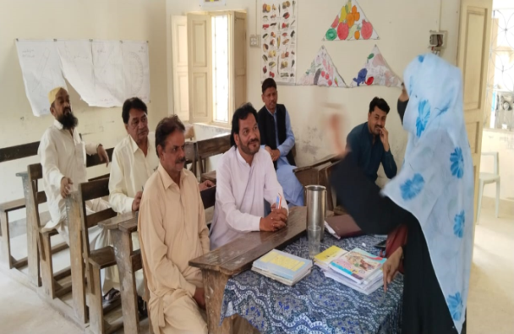
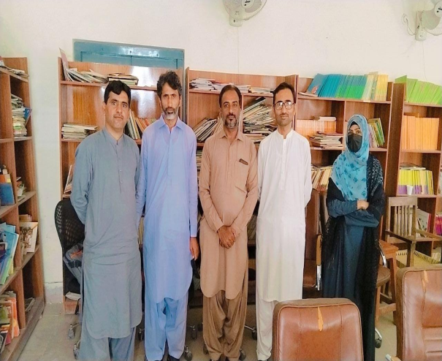
Subject coordinator
Provide mentoring support by conducting fortnightly sessions of teachers at feeder level.
Monthly schools 3-4 visits for the purpose of class observations about learning cycles in teaching methodology.
Discuss the problems with their proposed solutions.
Meeting with head teachers to discuss content matters and teaching activities.

Slide 9
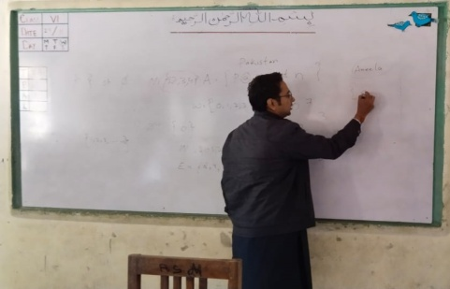
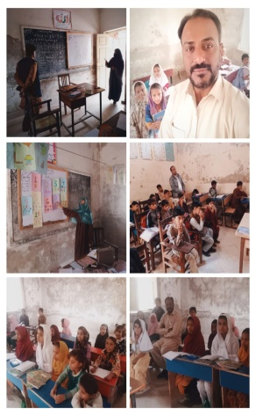
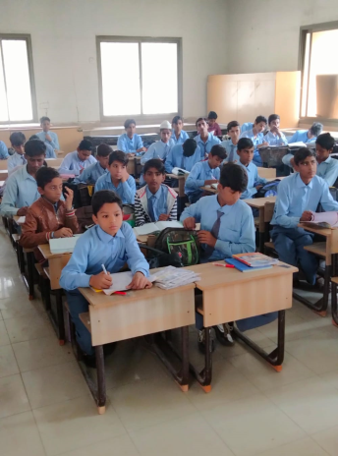
CONTENT BASED KNOWLEDGE (LEARNING CYCLES PHASE II)
Content based knowledge refers to the body of knowledge –facts, theories, principles, ideas, vocabulary– which teachers must master to be effective.
Teachers should have a deep understanding of the subject they teach and corresponding curriculum (subject content knowledge).

Slide 10
Challenges
The SCs and GTs are involved in CPD model, have disturbance in their own teachings activities which is directly effect on syllabus content.
Lack of clearance of CBLC Observational activities and tools.(either it would be on session content based or class running content based)
SCs & GTs Performing all duties and responsibilities Without any mobility allowances since a year.
Lack of facilitating materials for sessions .

Slide 11
Challenges
some teachers are nearer to retirement, they are hired as a nominator of CPD Model, who are not willing to attend the sessions.
Some teachers are forcedly included related to other subjects in CPD model, while they were not willing.
visual aids aware almost removed or not in used, but CPD regenerated them.
Faced some barries at field in classes, schools and teaching methodologies.
No TA/DA but its essential to be on time schedule.

Slide 12
Strengths
CPD trainings introduced the concept of check and balanced of teachers during their teachings.
Teachers becomes more conscious in their teaching methodologies by applying Content Based Learning Cycles (CBLC).
CPD allows staff to think more deeply about issues that might come up in the classroom and how they can be resolved.
CPD builds teachers-students learning interests.

Slide 13
Strengths
CPD brought the syllabus content in more effective and easier manners .
CPD brought active Participations of teachers and students by removing passive methods.
Group discussions, content activities and counseling increased either in classrooms and teachers as well as at high levels.
Communications and coordination amongst personals increased.

Slide 14
Successful Efforts
Challenges. At the very first field regarding CPD trainings we met HMS and teachers regarding Selection of mentees, which big challenges we had faced that were in form of some queries i.e.
Q. Is Training ka kiya faida hoga?
Q. Kiya hamhen bonus mily ga koi?
Q. Koi TA/DA mily ga?
Q.Apko kiya faida hoga?
Q. New Knowledge kiya hai?
Q. Is Training sy hamara syllabus disturb hojaye ga?
Q. Hmari service 50 saal ki hy,,, ap kal k bachy hamhen parahain gy?
Q. Changes lany k liey hamhen facilities provide kren.

Slide 15
Challenge faced clip

Slide 16
Successful results
Those personals who are asking all these questions now became motivated by removing their queries as under
kindly share schedule for the monthly session.
Observational dates share karen tak hamra lesson paln effective ban saky.
kindly guide us for an activity to the mentioned topics.
We become refreshed and energies for our teachings.

Slide 17
SUCCESSFUL Result clips
MR. ABDUL QUDOOS (TRAINEES) @ GBPS-Sindhi School Khairpur
MR. Abdul Aziz (HM) @ GBPS- Social Welfare urdu Khairpur
Mr. LAL M. Jalbani (HST) @ GHS- Bhurgri Khairpur
MR. UZAIR BHUTTO (TRAINEES) @ GHS- DABAR
MR. WAHEED AHMED GHUMRO (HM) @ GBPS-Sindhi School Khairpur

Slide 18
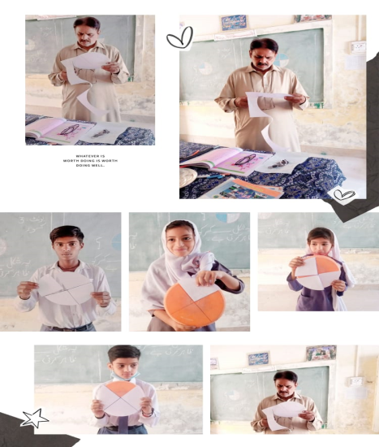
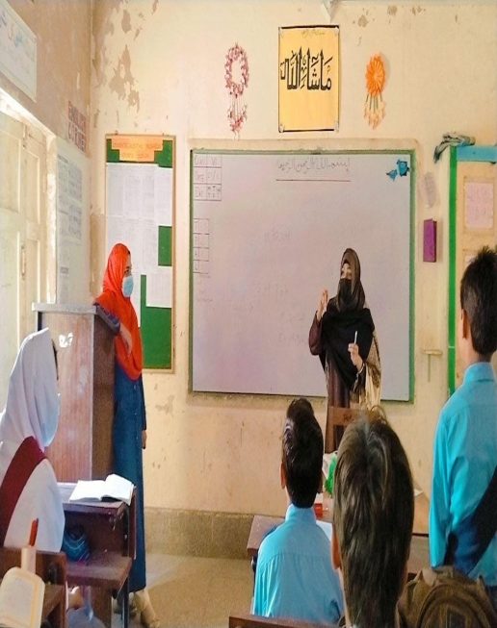
Successful Efforts
2. He is the tarinees, Mr. shahid Hussian zaidi at GBPS- Social Welfare urdu Luman Khairpur, who introduced low cost material activities to the students of class Four, by using cap of cooler.
3. In a Class room observation, Sc Saima Mughal present a very effective Example of Null set, by showing an empty box.

Slide 19
CBLC Glimpse

Slide 20
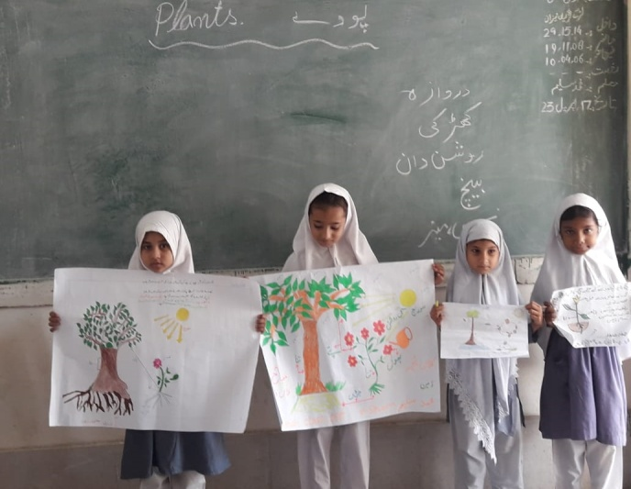
SUM UP
Continuous Professional development (CPD) brought somehow change in educational institutions. This project will be more effective in the development of Sindh Education by continuous running in more enhanced ways.

Slide 21
End sweet note
The Capacity to LEARN is a Gift,
the Ability to LEARN is a skill, and
the willingness to LEARN is a choice.
Brian Herbert
(American Author)

Slide 22
THANK YOU

Slide 23
Any Query ?

